Slide 2
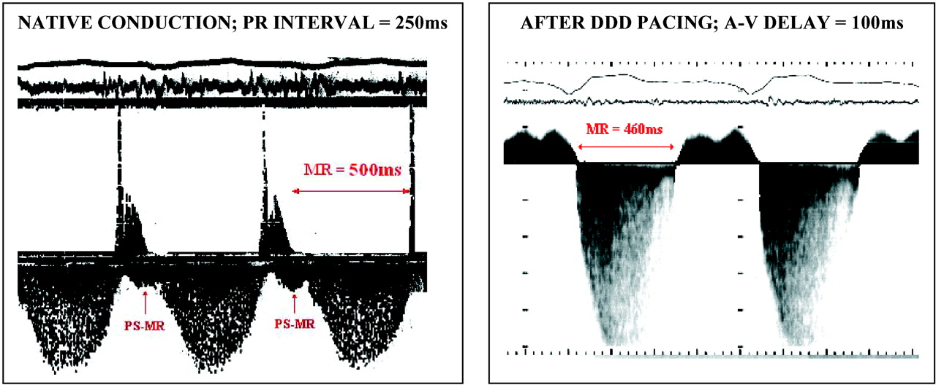
Doppler continuo: rigurgito mitralico. Pz. Con CMD e prolungato intervallo PR., prima e dopo stimolazione DDD con ottimizzazione dell’intervallo AV. L’MR è di lunghissima durata (500ms) nella conduzione nativa in quanto contiene una componente presistolica (PS-MR) che abbrevia il tempo di riempimento del VS. Accorciando l’intervallo AV con la stimolazione DDD viene eliminato il PS-MR, ridotta la durata del totale MR ed incrementato dunque il tempo di riempimento ventricolare.

Slide 3
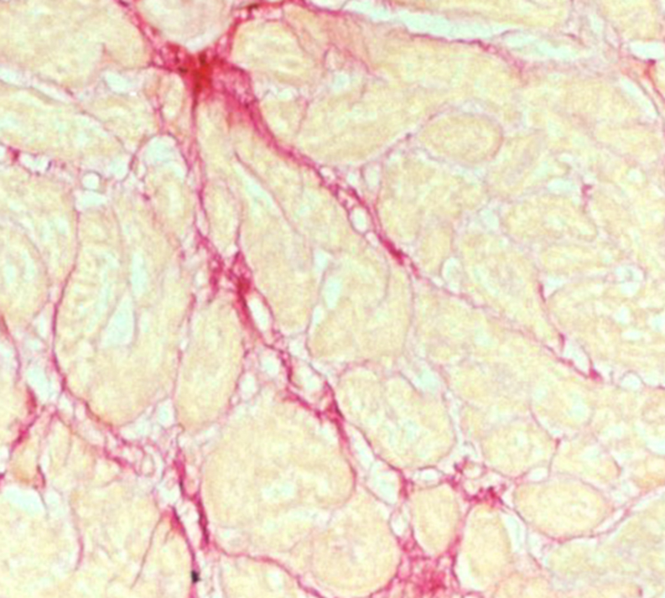
Risultati: Frazione volumetrica del collagene
Immagine istologica di tessuto miocardico prima e 6 mesi post CRT
Le figure mostrano la frazione di volume collagene fissata al rosso picrosirio.

Slide 4
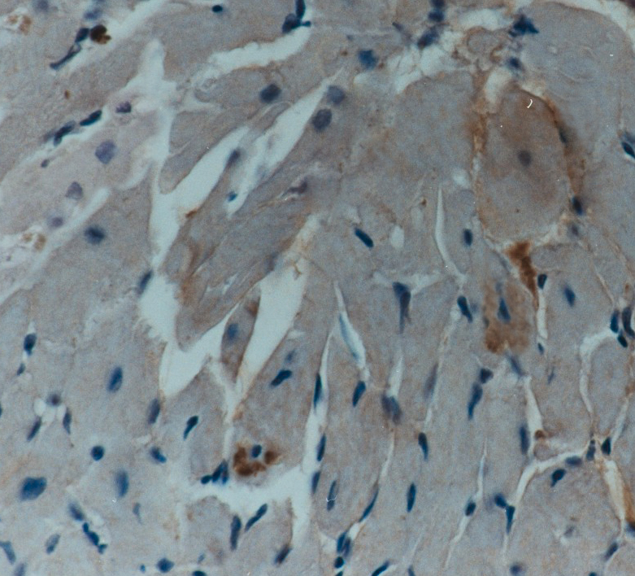
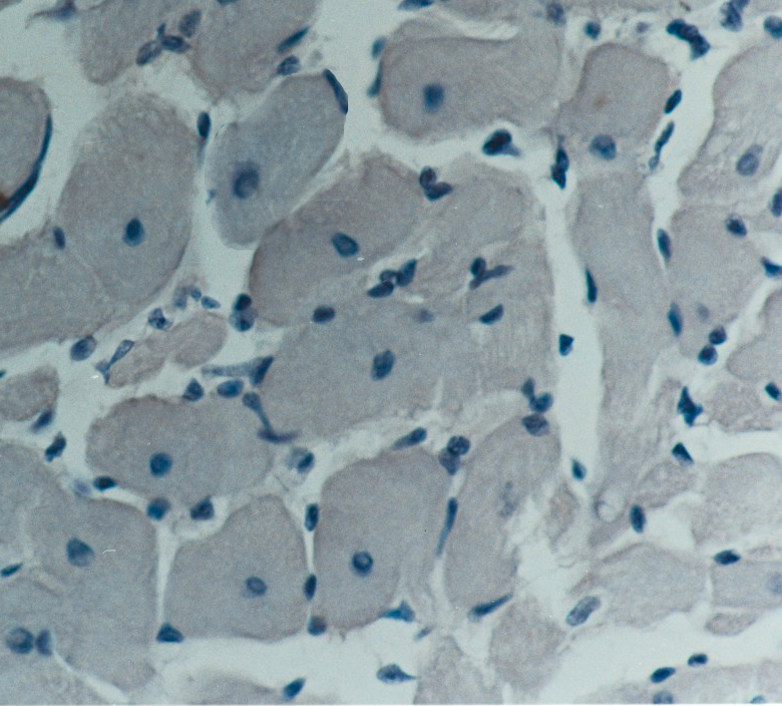
Risultati:TNF-α
Immagine istologica di tessuto miocardico prima e 6 mesi post CRT Immuno reazione al TNF-alfa (freccia nera)

Slide 5
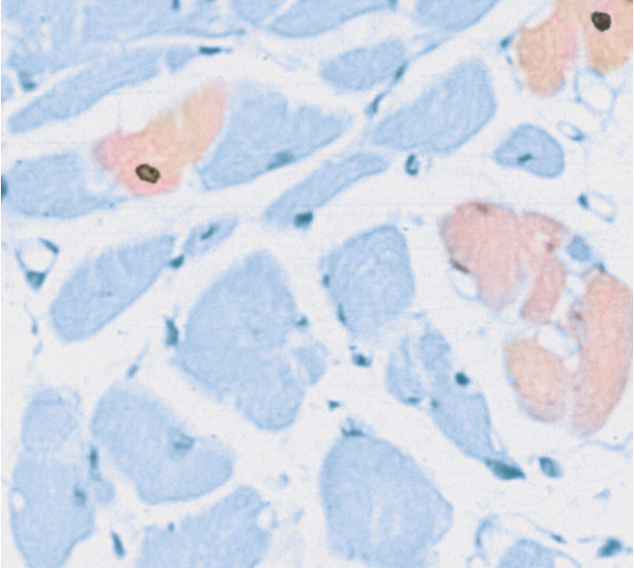
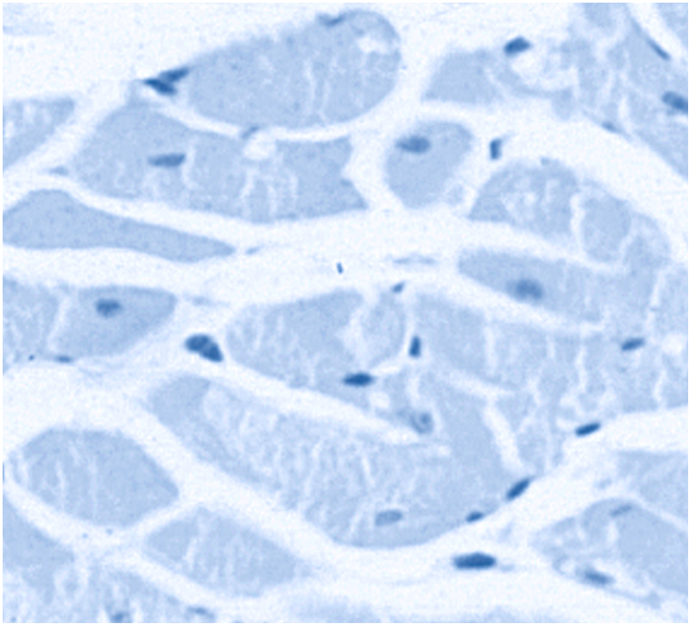
Risultati: Indice Apoptotico
Immagine istologica di tessuto miocardico prima e 6 mesi post CRT
Nuclei apoptotici marcati con sonda DAB (freccia rossa)
Immunoreazione per l’attivazione della CASPASI 3, marcata in luce rossa (freccia nera)
Nella seconda immagine non si evidenzia apoptosi

Slide 6
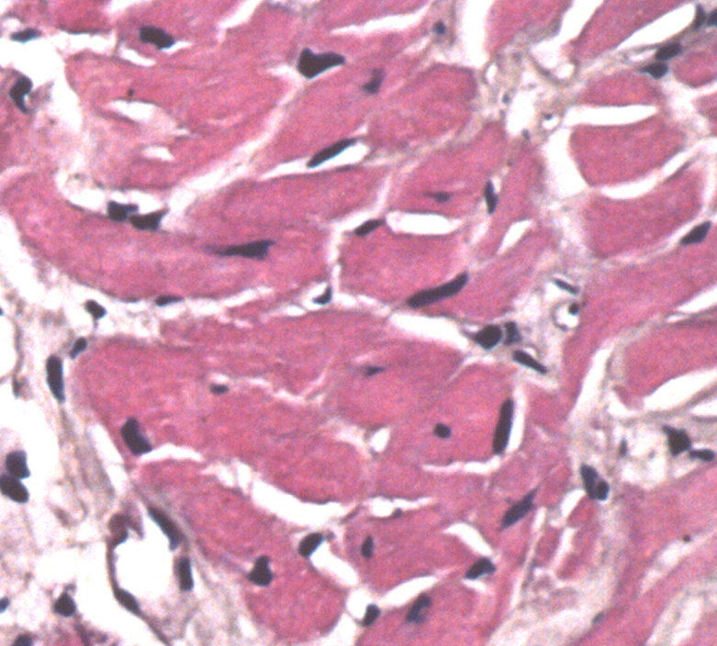
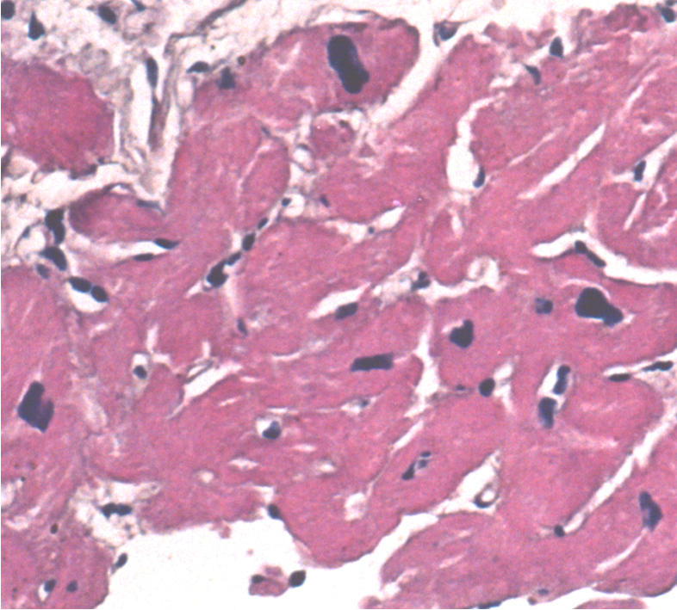
Risultati: Diametro cardiomiocitario
Pre-CRT
6 mesi Post-CRT

Slide 7
CARE-HF Aprile 2005
SCD-HeFT Gennaio 2005
COMPANION
Maggio 2004
MADIT II
Marzo 2002
Il percorso delle nuove linee guida
Precedenti linee guida ACC/AHA Guidelines per gli ICD
Settembre 2002
Linee guida ESC aggiornate
Maggio 2005
Linee guida ACC/AHA aggiornate
Agosto 2005

Slide 8
Evoluzione delle linee guida internazionali
2002
Arresto cardiaco dovuto a VF o VT, non causato da motivi transitori o reversibili.
TV spontanea sostenuta in associazione con malattie cardiache strutturali.
Sincope di origine non spiegata con TV clinicamente rilevante e emodinamicamente sostenuta, o FV indotta durante studi elettrofisiologici quando la terapia farmacologica è inefficace, non tollerata o non preferita.
TV non sostenuta in pazienti con malattie coronariche, pregresso infarto miocardico, disfunzione LV , VF inducibile o VT sostenuta negli studi elettrofisiologici che non viene eliminata con un farmaco antiaritmia di classe I
TV spontenea sostenuta in pazienti senza malattia cardiaca strutturale non sottoponibile ad altri trattamenti
FE ≤ 30% almeno un mese dopo infarto miocardico e 3 mesi dopo una rivascolarizzazione chirurgica delle arterie coronariche
Novità 2005
Classe I:
Prevenzione secondaria per prolungare la sopravvivenza in pazienti con attuali o precedenti sintomi di HF e ridotto LVEF che hanno una storia di arresto cardiaco, fibrillazione ventricolare o tachicardia ventricolare emodinamicamente destabilizzante (Livello di evidenza A)⁽¹⁾
Prevenzione primaria di SCD in pazienti con malattie cardiache ischemiche, ≥ 40 giorni dopo un infarto miocardico, EF ≤ 30%, classe NYHA II o III, OPT (Livello di evidenza A)⁽¹⁾
Prevenzione primaria di SCD in pazienti con cardiomiopatia non ischemica, EF ≤ 30%,,NYHA classe II o III,OPT. (Livello di evidenza:B)
Classe IIa:
Cardiomiopatia ischemica, ≥ 40 giorni post-MI, EF ≤ 30%, classe NYHA I, OPT. (Livello di evidenza B)⁽¹⁾
FE dal 30% al 35% di quelunque origine con sintomi di classe funzionale NYHA II o III, OPT (livello di evidenza: B)

Slide 9
Evoluzione delle linee guida internazionali
2002
Classe IIa:
Stimolazione ventricolare in pazienti sintomatici in classe NYHA III o IV con cardiopatia dilatativa idiopatica o ischemica, intervallo QRS prolungato (≥ 130 ms), diametro diastolico del VS ≥ 55 mm, EF ≤ 35%.
Novità 2005
Classe I:
FE ≤ 35%, ritmo sinusale, classe NYHA III o classe ambulatoriale IV, dissincronia cardiaca definita come QRS > 120 ms, sintomatica nonostante la stabile e ottimale terapia farmacologica per l’insufficienza cardiaca. (livello di evidenza A)(1)

Slide 10
Evoluzione delle linee guida internazionali
ESC (May 2005)
Classe I:
Prevenzione secondaria per migliorare la sopravvivenza nei pazienti sopravvissuti ad un arresto cardiaco o che hanno TV sostenuta, mal tollerata o associato a una ridotta funzione sistolica ventricolare sinistra (livello di evidenza: A)
Prevenzione primaria di SCD in pazienti con FE ≤ 30-35%, non entro 40 giorni da pregresso infarto miocardico, OPT. (Livello di evidenza: A)
ACC/AHA (Aug 2005)
Classe I:
Prevenzione secondaria per prolungare la sopravvivenza in pazienti con attuali o precedenti sintomi di HF e ridotta FEVS, che hanno una storia di arresto cardiaco, fibrillazione ventricolare o tachicardia ventricolare emodinamicamente destabilizzante (Livello di evidenza: A)⁽¹⁾
Prevenzione primaria di SCD in pazienti con malattia cardiaca ischemica, ≥ 40 giorni dopo un infarto miocardico, FE ≤ 30%, classe NYHA I o III, OPT (Livello di evidenza: A)⁽¹⁾
Prevenzione primaria di SCD in pazienti con cardiomiopatia non ischemica, FE ≤ 30%, classe NYHA II o III, OPT (Livello di evidenza: B)⁽¹⁾
Classe IIa:
Cardiomiopatia ischemica, ≥ 40 giorni post-MI, FE ≤ 30%, NYHA classe I, OPT (Livello di evidenza: B)⁽¹⁾
FE dal 30% al 35% di qualunque origine con sintomi di classe funzionale NYHA II o III, OPT (Livello di evidenza: B)⁽¹⁾

Slide 11
ESC updated guidelines for HF treatment
Class I | Evid level | Class IIa | Evid level | Class IIb | Evid level | Class III | Evid Level
ACE Inhibitors | A | CRT-D (LVEF ≤ 35%, QRS ≥120 msec, NYHA III-IV, OPT | B | Revascularization | C | Vasodialtors | A
Beta-blocking agents (NYHA II-IV) | A | Ventricular Assist devices/artificial heart | C | Mitral Valve Surgery | C | Vasodialtors | B
Diuretic | A | Classes of Recommendation Class I: Evidence and/or general agreement that a given diagnostic procedure/treatment is beneficial, useful, and effective. Class II: Conflicting evidence and/or a divergence of opinion about the usefulness/efficacy of the treatment. Class IIa: Weight of evidence/opinion is in favour of usefulness/efficacy Class IIb: Usefulness/efficacy is less well established by evidence/opinion. Class III: Evidence or general agreement that the treatment is not useful/effective and in some cases may be harmful. Level of evidence Level of evidence A: data derived from multiple randomized clinical trials or meta-analyses Level of evidence B: data derived from single randomized clinical trials or large non-randomized studies Level of evidence C: Consensus of opinion of the experts and/or small studies, reprospective studies, registries |  |  |  | Calcium antagonists | C
ICD (LVEF < 30-35%, MI >40 days, OPT); | A |  |  |  |  | Positive inotropic agents | A
CRT (QRS ≥120 ms, FE<35%, NYHA III-IV, OPT) | A |  |  |  |  | Class I anti-arrhythmics | B
HF multidisciplinary Approach | A |  |  |  |  | Class III anti-arrhythmics | B
Angiotensin II receptor Blocker (alternative to ACEI) | B |  |  |  |  | Cardiomyoplasty | C
Aldosterone antagonists (NYHA III-IV) | B |  |  |  |  | Batista | C
Cardiac Glycosides (atrial fibrillation) | B |  |  |  |  | External ventricular Restoration | C
Heart transplantation/LV Aneurysmectomy | C |  |  |  |  | Pacemaker | C

Slide 12
LA TERAPIA DI RESINCRONIZZAZIONE
NELLO SCOMPENSO CARDIACO
Quando utilizzare il PM biventricolare
con Defibrillatore
C. D’Ascia
Dir.Settore Funzionale Aritmologia
UNIVERSITÀ DEGLI STUDI DI NAPOLI
FEDERICO II
Paestum settembre 20 04

Slide 13
Heart Failure Definition (HF)
Many definitions of chronic heart failure exist but highlight only selective features of this complex syndrome. None is entirely satisfactory and one commonly used definition is: heart failure is a pathophysiological state in which an abnormality of cardiac function is responsible for the failure of the heart to pump blood at a rate commensurate with the requirements of the metabolizing tissues.
A simple objective definition of chronic heart failure is currently impossible as there is no cut-off valve or cardiac or ventricular dysfunction or change in flow, pressure, dimension or volume that can be used reliably to identify patients with heart failure. The diagnosis of heart failure relies on clinical judgement based on a history, physical examination and appropriate investigations.
The European Society of Cardiology Task Force considers the essential components of heart failure to be a syndrome where the patients should have the following features; symptoms of heart failure, typically breathlessness or fatigue, either at rest or during exertion, or ankle swelling and objective evidence of cardiac dysfunction at rest.
“Guidelines for the diagnosis and treatment of chronic heart failure”; European Heart Journal (2001) 22, 1527–1560
Notes:
Heart Failure is a syndrome or collection of symptoms and signs, that result from a wide variety of problems.
Heart failure used to be defined as a poor cardiac output, but that definition fails to take into account the effects of such unrelated phenomena as bradycardias, hypovolemia, etc..
This definition alludes to those phenomena as exclusions in the basic definition and description of heart failure.

Slide 14
Epidemiology of CHF in the US
Large treatment trials provide another valuable source of information about the causes of heart failure. Data are from a compilation of heart failure trials published between July 1989 and June 1990; categories are based on the presence or absence of significant ischemic heart disease ¹.
[1] Am J Cardiol:1991:121:1852-1853; Teerlink JR, Goldhaber SZ, Pfeffer MA: An overview of contemporary etiologies of congestive heart failure.
Notes:
Figure 3-2. The epidemiology of congestive heart failure in the United States.
The Framingham Heart Study, which followed a cohort of 9405 Americans over a 40-
year period, has provided valuable information regarding the etiologic basis of
congestive heart failure in the United States [5]. A, Of 331 men and 321 women
who developed heart failure, the majority had coronary artery disease (CAD) with
or without hypertension (HTN), and approximately one third had HTN alone. At
present, idiopathic dilated cardiomyopathy has replaced HTN as the second most
important etiologic factor in the development of heart failure. CAD continues to
be the most common risk factor for the development of heart failure in the
United States.B, Large treatment trials provide another valuable source of
information about the causes of heart failure. Data are from a compilation of
heart failure trials published between July 1989 and June 1990; categories are
based on the presence or absence of significant ischemic heart disease [6]. In
this analysis, 50% of cases were attributable to coronary disease; 18.2% of all
patients and approximately 50% of those with nonischemic disease had idiopathic
dilated cardiomyopathy. Less commonly, valvular heart disease, HTN, and excess
alcohol consumption were identified as significant etiologic factors. (Part A
adapted from Ho and coworkers [5]; part B adapted from Teerlink and coworkers
[6].)

Slide 15
Epidemiology of CHF in the US
Large treatment trials provide another valuable source of information about the causes of heart failure. Data are from a compilation of heart failure trials published between July 1989 and June 1990; categories are based on the presence or absence of significant ischemic heart disease ¹.
[1] Am J Cardiol:1991:121:1852-1853; Teerlink JR, Goldhaber SZ, Pfeffer MA: An overview of contemporary etiologies of congestive heart failure.
Notes:
Figure 3-2. The epidemiology of congestive heart failure in the United States.
The Framingham Heart Study, which followed a cohort of 9405 Americans over a 40-
year period, has provided valuable information regarding the etiologic basis of
congestive heart failure in the United States [5]. A, Of 331 men and 321 women
who developed heart failure, the majority had coronary artery disease (CAD) with
or without hypertension (HTN), and approximately one third had HTN alone. At
present, idiopathic dilated cardiomyopathy has replaced HTN as the second most
important etiologic factor in the development of heart failure. CAD continues to
be the most common risk factor for the development of heart failure in the
United States.B, Large treatment trials provide another valuable source of
information about the causes of heart failure. Data are from a compilation of
heart failure trials published between July 1989 and June 1990; categories are
based on the presence or absence of significant ischemic heart disease [6]. In
this analysis, 50% of cases were attributable to coronary disease; 18.2% of all
patients and approximately 50% of those with nonischemic disease had idiopathic
dilated cardiomyopathy. Less commonly, valvular heart disease, HTN, and excess
alcohol consumption were identified as significant etiologic factors. (Part A
adapted from Ho and coworkers [5]; part B adapted from Teerlink and coworkers
[6].)

Slide 16
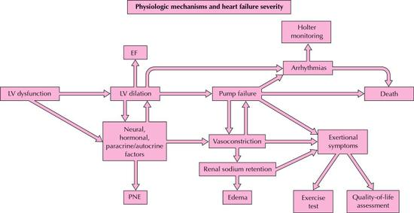
Physiologic mechanisms leading to markers for severity
Left ventricular (LV) dysfunction progresses through ventricular remodeling to chamber enlargement that can be detected by echocardiographic, radionuclide, or angiographic measurement of reduced LV ejection fraction (EF) or an increased chamber volume. LV dysfunction and chamber dilation result in activation of neural, hormonal, and local tissue paracrine and autocrine processes, which contribute to vasoconstriction, renal sodium retention, and aggravation of LV dysfunction.
Notes:
Figure 8-15. Physiologic mechanisms leading to markers for the severity of heart
failure. Left ventricular (LV) dysfunction progresses through ventricular
remodeling to chamber enlargement that can be detected by echocardiographic,
radionuclide, or angiographic measurement of reduced LV ejection fraction (EF)
or an increased chamber volume. LV dysfunction and chamber dilation result in
activation of neural, hormonal, and local tissue paracrine and autocrine
processes, which contribute to vasoconstriction, renal sodium retention, and
aggravation of LV dysfunction. The neurohormonal abnormality can be detected by
elevated circulating levels of norepinephrine, renin activity, atrial
natriuretic peptide, or other hormonal markers of the process. The sodium
retention is manifested by edema or pulmonary congestion. The LV pump failure
combined with the neurohormonal and vasoconstrictor mechanisms contribute to
symptoms that can be quantitated by a formal exercise test, often supplemented
by measurement of gas exchange.Quality of life instruments provide a more global
assessment of the functional impairment produced by the disease and its
treatment. Pump failure may progress to death, but ventricular arrhythmias that
are frequent accompaniments of LV dilation and pump failure may contribute
independently to sudden death and may be detected and quantitated by Holter
monitoring. In the treatment of heart failure, an improvement in any of these
clinical markers may be used as a guide to a therapeutic response, but the
relationship of any of these markers to clinical benefit, including life
prolongation, has not yet been validated empirically. PNE&#150;plasma
norepinephrine concentration.

Slide 17
SCOMPENSO CARDIACO:
STRATEGIE DI TRATTAMENTO
EPIDEMIOLOGIA
Interessa una popolazione sempre
più estesa
aumento dell'età media
•maggiore successo nel trattamento dell’ IMA
Notevole peso economico
Alta frequenza di mortalità
•
•
C D’Ascia, G Riccio
Università degli Studi di Napoli Federico II

Slide 18
Goals for Treating Heart Failure
Decrease Symptoms
Reduce Need for Hospitalizations
Quality of Life
Prolong Life

Slide 19
Summary
The most common treatment for HF is diuretics, ACE inhibitors and beta blockers.
IV inotropes such as dobutamine can be useful in overcoming HF decompensation and for “pulsed therapy” (which remains controversial).
“Sliding Scale” diuretics coupled with frequent clinic follow-ups are becoming more common.
Digoxin has become a third line therapy.
Despite advances, patient outlook remains dismal.

Slide 20
Epidemiology of CHF in the US
Large treatment trials provide another valuable source of information about the causes of heart failure. Data are from a compilation of heart failure trials published between July 1989 and June 1990; categories are based on the presence or absence of significant ischemic heart disease ¹.
[1] Am J Cardiol:1991:121:1852-1853; Teerlink JR, Goldhaber SZ, Pfeffer MA: An overview of contemporary etiologies of congestive heart failure.
Notes:
Figure 3-2. The epidemiology of congestive heart failure in the United States.
The Framingham Heart Study, which followed a cohort of 9405 Americans over a 40-
year period, has provided valuable information regarding the etiologic basis of
congestive heart failure in the United States [5]. A, Of 331 men and 321 women
who developed heart failure, the majority had coronary artery disease (CAD) with
or without hypertension (HTN), and approximately one third had HTN alone. At
present, idiopathic dilated cardiomyopathy has replaced HTN as the second most
important etiologic factor in the development of heart failure. CAD continues to
be the most common risk factor for the development of heart failure in the
United States.B, Large treatment trials provide another valuable source of
information about the causes of heart failure. Data are from a compilation of
heart failure trials published between July 1989 and June 1990; categories are
based on the presence or absence of significant ischemic heart disease [6]. In
this analysis, 50% of cases were attributable to coronary disease; 18.2% of all
patients and approximately 50% of those with nonischemic disease had idiopathic
dilated cardiomyopathy. Less commonly, valvular heart disease, HTN, and excess
alcohol consumption were identified as significant etiologic factors. (Part A
adapted from Ho and coworkers [5]; part B adapted from Teerlink and coworkers
[6].)

Slide 21
Heart Failure Therapy Timeline

Slide 22
History of studies for cardiac resynchronization
Notes:
Key Points: CR Therapy originated with the innovative use of standard pacemaker products by physicians largely on their own initiatives. Manufacturers adapted existing products and developed new ones in collaboration with innovating physicians. Medtronic, in its leadership role, was the first to introduce an entire system (the InSync system), using a transvenous stylet controlled approach to the LV, the first to have a chronic lead implanted using a guide catheter approach, and the first with a device combining CR and ICD therapy with separate control of the RV and the LV.

Slide 23
Cardiac Resynchronization Studies Timeline
InSync Study
(EU, Canada)
Cazeau Reports 1st Use of Standard Pacemaker With Adapter And Transvenous Leads
MUSTIC
CARE-HF
Miracle
1994
1995
1996
1997
1998
1999
2000
2001
2002
2003
Bakker Reports
BiV Pacing in HF
With Epicardial
Lead for LV with
Adapter
Path-CHF
PAC-MAN
Companion
InSync Italian Registry
Believe

Slide 24
Goals for Treating Heart Failure
Decrease Symptoms
Reduce Need for Hospitalizations
Quality of Life
Prolong Life

Slide 25
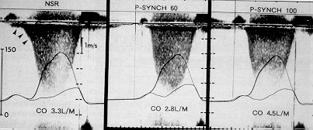
Mechanism of hemodinamic improvement by DDD pacing for severe LV dysfunction. An acute doppler and catheterization hemodynamic study. Nishimura et al. JACC 1995
Normal Sinus Rhythm with a long intrinsic PR interval
P synchronous pacing with a short AV interval (60 ms)
P synchronous pacing at the optimal AV interval (100 ms)
Continuous wave Doppler image of the mitral regurgitation signal and simultaneous left atrial and left ventricular pressure curves
Mitral regurgitation abolition and Cardiac Output improvement with DDD pacing and optimazed AV delay in patients affected by DCM and long P-Q

Slide 26
Heart Failure Statistics
50% of HF patients have 3 or more co-morbidities¹
HF patients take an average of six medications¹
78% of HF patients have had at least two hospital admissions per year¹
Cost of HF in the U.S. is estimated to be between $10 billion and $38 billion annually²
5-year survival rate for all NYHA classes estimated at 50%³
¹ English M and Mastream M. Crit Care Nurse 1995;18:1-6.
² Havranek EP, Abraham WT, The Healthcare Economics of Heart Failure 1998; 14:10-18.
³ American Heart Association, 2001 Heart and Stroke Statistical Update.
Notes:
Heart failure has become an increasingly important health problem and accounts for 5-10% of all hospital admissions. As heart failure progresses, the well-being and exercise tolerance of the patient dramatically deteriorates and the rate of hospitalization increases.

Slide 27
Heart Failure: Prevalence
Worldwide
22.5 millions
Europe 6.5M 1.3%
USA 4.7M 1.8%
By country #pts %pop
Belgium 158K 1.5%
France 618K 1.1%
Germany 1.313K 1.6%
Italy 747K 1.3%
Spain 481K 1.2%
GB 828K 1.4%
Age
2-3%: 25-75 year-old
4-6%: > 65 year-old

Slide 28
Heart Failure: Incidence
Worldwide
2 MLN new pts / year
Europe: 470 K/year
USA: 480 K/year
By country #pts %pop
Belgium 14K 0.14%
France 55K 0.09%
Germany 116K 0.14%
Italy 66K 0.11%
Spain 43K 0.11%
GB 73K 0.12%

Slide 29
Epidemiology: practical questions
1. How to manage > 65 years pts with severe HF symptoms despite modern drug treatment ?
2. Is there a clinical interest to consider a combining treatment giving the possibility to optimize classical drug therapy ?
3. Clinical benefit to delay Cardiac Transplantation in patients who are « typical » candidates ? ….

Slide 30
Epidemiology
Increase in HF patients
awareness, management of CAD, longer life expect.
Increase in age of HF population
most patients (80%) > 65 years
Increase in Drug-Refractory HF patients
Cardiac Transplantation ?, LVAD ? …
Needs to develop non-pharmacological therapies

Slide 31
Ventricular Dysynchrony
Ventricular Dysynchrony¹
Electrical: Intraventricular conduction delays usually manifested as left bundle branch block
Structural: disruption of myocardial collagen matrix impairing electrical conduction and mechanical efficiency
Mechanical: Regional wall motion abnormalities with increased workload and stress—compromising ventricular mechanics
Cardiac Resynchronization
Therapeutic intent of atrial synchronized biventricular pacing
Through the modification of interventricular, intraventricular, and atrial-ventricular activation sequences
In patients with ventricular dysynchrony
¹ Tavazzi L. Eur Heart J 2000;21:1211-1214.
Notes:
Ventricular dysynchrony is defined as the effect caused by intra- or interventricular conduction defects. Dr. Tavazzi’s article contains a summary of the three potential causes of ventricular dysynchrony.

Slide 32
Prevalence of BBB in the General HF Population
N = 32,270
Factors associated with prolonged QRS²:
Older age
Male gender
Caucasian race
Lower EF
Higher LVESD
1. Havranek E, et al. Am Heart J 2002;143:412-7
2. Shenkman et al. Circulation 2000;102(18 Suppl II): abstract 2293
Notes:
Havranek and colleagues studied the charts of 800 Medicare patients per (US) state, or 40,000, who were hospitalized with a principle diagnosis of heart failure. 34,587 were left after exclusing those < 65 years old and other reasons, and of those 32,270 had EKG data available. 15.3% of those were identified as having LBBB.
Shenkman analyzed patients from an integrated health care system in Detroit. Of the 29,686 patients identified with HF from 1989 to 1999, 3,474 had echo and ECG data available (interesting given the fact that these two tests are guideline mandated). This is really the first study to look at the epidemiology of QRS prolongation. They used 130 ms as the cut-off because the center is involved in the MIRACLE study. With a cut-off of 120 ms, the proportion is 19%, per discussion with the author. The fact that this is less than that of the other studies could be attributable to the fact that this was a more racially diverse cohort. This study and others (Aaronson) suggest that ventricular dyssynchrony may be more prevalent among whites than African-Americans.

Slide 33
Prevalence of BBB in the General HF Population
N = 32,270
Factors associated with prolonged QRS²:
Older age
Male gender
Caucasian race
Lower EF
Higher LVESD
1. Havranek E, et al. Am Heart J 2002;143:412-7
2. Shenkman et al. Circulation 2000;102(18 Suppl II): abstract 2293
Notes:
Havranek and colleagues studied the charts of 800 Medicare patients per (US) state, or 40,000, who were hospitalized with a principle diagnosis of heart failure. 34,587 were left after exclusing those < 65 years old and other reasons, and of those 32,270 had EKG data available. 15.3% of those were identified as having LBBB.
Shenkman analyzed patients from an integrated health care system in Detroit. Of the 29,686 patients identified with HF from 1989 to 1999, 3,474 had echo and ECG data available (interesting given the fact that these two tests are guideline mandated). This is really the first study to look at the epidemiology of QRS prolongation. They used 130 ms as the cut-off because the center is involved in the MIRACLE study. With a cut-off of 120 ms, the proportion is 19%, per discussion with the author. The fact that this is less than that of the other studies could be attributable to the fact that this was a more racially diverse cohort. This study and others (Aaronson) suggest that ventricular dyssynchrony may be more prevalent among whites than African-Americans.

Slide 34
QRS Duration: Proportional Mortality Increase
QRS Duration (msec)
VEST study analysis
NYHA Class II-IV patients
3,654 ECGs digitally scanned
Age, creatinine, LVEF, heart rate, and QRS duration found to be independent predictors of mortality
Relative risk of widest QRS group 5x greater than narrowest
<90
90-120
120-170
170-220
>220
Adapted from Gottipaty et al. JACC 1999; 33(2):145A (abstract 847-4)
Notes:
Key message: QRS duration was an independent predictor of mortality in this analysis of the VEST results. Note that the 103 patients in the InSync trial conducted in Europe and Canada had a mean QRS duration of 178 ± 28 msec.
ACC 1999; Abstract: 847-4
The Resting Electrocardiogram Provides a Sensitive and Inexpensive Marker of Prognosis in Patients with Chronic Congestive Heart Failure
Venkateshwar K. Gottipaty, Steven P. Krelis, Fei Lu, Elizabeth P. Spencer, Vladimir Shusterman, Raul Weiss, Susan Brode, Amie White, Kelley P. Anderson, B.G. White, Arthur M. Feldman For the VEST investigators; University of Pittsburgh, Pittsburgh PA, USA
Background: Patients with dilated cardiomyopathies (DCM) routinely undergo 12-lead electrocardiographic (ECG) evaluation. Although ECGs are inexpensive and readily available, their utility in the management of patients with DCM has not been defined. We hypothesized that QRS duration (QRSd), a measure of cardiac depolarization, might provide a marker of risk in patients with DCM and congestive heart failure (CHF). To test this hypothesis we evaluated the resting baseline ECG in patients enrolled in the VEST trial, which assessed the efficacy of Vesnarinone in patients with class II-IV CHF.
Methods: 3654 ECGs were digitally scanned and QRSd in lead II was measured by blinded readers, using electronic calipers. Follow up data were censured at 1 yr and analyzed using multivariate Cox proportional hazards regression, and Kaplan-Meier survival analysis.
Results: The following clinical variables were found to be independent predictors of mortality in a analysis (p < 0.0001): age, creatinine, LVEF, heart rate, and QRSd. Cumulative survival from all-cause mortality decreased proportionally with QRSd. The relative risk of the widest QRSd group was 5 times greater than the narrowest.
Conclusion: We conclude that the resting ECG is a powerful yet accessible and inexpensive marker of prognosis in patients with DCM and CHF.

Slide 35
QRS Duration: Proportional Mortality Increase
QRS Duration (msec)
VEST study analysis
NYHA Class II-IV patients
3,654 ECGs digitally scanned
Age, creatinine, LVEF, heart rate, and QRS duration found to be independent predictors of mortality
Relative risk of widest QRS group 5x greater than narrowest
<90
90-120
120-170
170-220
>220
Adapted from Gottipaty et al. JACC 1999; 33(2):145A (abstract 847-4)
Notes:
Key message: QRS duration was an independent predictor of mortality in this analysis of the VEST results. Note that the 103 patients in the InSync trial conducted in Europe and Canada had a mean QRS duration of 178 ± 28 msec.
ACC 1999; Abstract: 847-4
The Resting Electrocardiogram Provides a Sensitive and Inexpensive Marker of Prognosis in Patients with Chronic Congestive Heart Failure
Venkateshwar K. Gottipaty, Steven P. Krelis, Fei Lu, Elizabeth P. Spencer, Vladimir Shusterman, Raul Weiss, Susan Brode, Amie White, Kelley P. Anderson, B.G. White, Arthur M. Feldman For the VEST investigators; University of Pittsburgh, Pittsburgh PA, USA
Background: Patients with dilated cardiomyopathies (DCM) routinely undergo 12-lead electrocardiographic (ECG) evaluation. Although ECGs are inexpensive and readily available, their utility in the management of patients with DCM has not been defined. We hypothesized that QRS duration (QRSd), a measure of cardiac depolarization, might provide a marker of risk in patients with DCM and congestive heart failure (CHF). To test this hypothesis we evaluated the resting baseline ECG in patients enrolled in the VEST trial, which assessed the efficacy of Vesnarinone in patients with class II-IV CHF.
Methods: 3654 ECGs were digitally scanned and QRSd in lead II was measured by blinded readers, using electronic calipers. Follow up data were censured at 1 yr and analyzed using multivariate Cox proportional hazards regression, and Kaplan-Meier survival analysis.
Results: The following clinical variables were found to be independent predictors of mortality in a analysis (p < 0.0001): age, creatinine, LVEF, heart rate, and QRSd. Cumulative survival from all-cause mortality decreased proportionally with QRSd. The relative risk of the widest QRSd group was 5 times greater than the narrowest.
Conclusion: We conclude that the resting ECG is a powerful yet accessible and inexpensive marker of prognosis in patients with DCM and CHF.

Slide 36
Graded Increase in Mortality with Widening QRS Duration
241 systolic heart failure patients followed for average of 31 months
Multivariate analysis showed IVCD, MVO2, and LVEF were best predictors of mortality
IVCD hazard ratio = 1.010
Graded increase in mortality with increasing QRS duration
Shamim, et al. Int. J. Cardiol 1999; 70:171-178
Notes:
Shamim’s study, from the Royal Brompton in London, was a retrospective survival analysis in 241 systolic heart failure patients seen in the clinic between July 1993 and March 1996. They analyzed patient history (aetiology, NYHA Class, Heart rate, blood pressure), ECG data (PR interval, IVCD, QT, QTc), Echo parameters (LVESD, LVEDD), MUGA scans (LVEF, RVEF), and blood chemistry (Serum Na+ level).

Slide 37
Hemodynamic Consequences of Ventricular Dysynchrony
Start of QRS
mc
ao
ac
mo
Reduced LV filling time ^{1,2}
Prolonged mitral regurgitation ^{1,2}
Impaired systolic function (depressed dP/dt) ^{3,4}
Abnormal septal wall motion ¹
Mechanical and temporal dysynchrony ⁴
1. Grines C, et al. Circulation 1989;79:845-853
2. Xiao, et al. Br Heart J 1991;66:443-447
3. Xiao et al. Br Heart J 1992;68:403-407
4. Curry C, et al. Circulation 2000;101:e2
Notes:
mc = mitral valve closure; ao = aortic valve opening; ac = aortic valve closure; mo = mitrla valve opening
Key Messages: Ventricular dysynchrony has been associated with paradoxical septal wall motion, reduced LV pressure, prolonged mitral regurgitation duration, and reduced diastolic filling times in studies comparing patients with left bundle branch block with normals or with comparable patients but without LBBB.
Using simultaneous ECG, phonocardiogram, radionuclide ventriculograms, and 2D and M-mode echoes, Grines et al studied 18 patients with LBBB (and no other underlying cardiac disease) compared with 10 normals. In LBBB patients she found significant delays in LV systolic and diastolic events , reduced diastolic filling times, abnormal interventricular septal wall motion, and a loss of septal contribution to global ejection fraction. [Grines C, Bashore T, Boudoulas H, et al. Functional abnormalities in isolated left bundle branch block: the effect of interventricular asynchrony. Circulation 1989;79:845-853].
Xiao et al (1992) studied 50 DCM patients with functional MR, finding a positive correlation between QRS duration and MR duration, and negative correlation between QRS duration and the peak rate of rise in LV pressure.[Xiao H, Brecker S, Gibson D. Effects of abnormal activation on the time course of left ventricular pressure pulse in dilated cardiomyopathy. Br Heart J 1992;68:403-407].
Xiao et al (1991) in a study of 52 pts with DCM, 12 of whom had LBBB, found that those with LBBB had prolonged MR and shortened LV filling time. [ Xiao Lee C, Gibson D. effect of left bundle branch block on diastolic function in dilated cardiomyopathy. Br Heart J 1991;66:443-447]

Slide 38
Electromechanical Decoupling
Electrical disturbance
wide QRS
LBBB
Mechanical dysynchrony
Impaired intra- and inter-ventricular function
Toussaint J-F, et al. PACE 2002;25:178-182
Notes:
Mechanical dysynchrony may be a consequence of the electrical disturbance. The electrical disturbance has been associated with increased risk of mortality and poor left ventricular hemodynamic function. The hypothesis is that if a correction of some of the electrical disturbance is made, then a correction in some of the mechanical dyssynchrony will also result. The implication is a move toward ‘direct’ correction of the ‘coordination’ of the mechanical dysynchrony.
Toussaint’s study confirms this hypothesis. Using radionuclide angiography in 92 HF patients compared with 35 age-mathced control subjects, they were ale to correlate increases in QRS to impairment of of intrea- and inter-ventricular synchrony.

Slide 39
SCOMPENSO CARDIACO:
STRATEGIE DI TRATTAMENTO
EPIDEMIOLOGIA
Incidenza annuale
Mortalità annuale
Prevalenza
U.S.A.
400.000
5.0 Milioni
250.000
Europa
580.000
6.5 Milioni
300.000
Wilkerson Group Survey, 1998
C D’Ascia, G Riccio
Università degli Studi di Napoli
Federico II

Slide 40
EPIDEMIOLOGIA
Rapporto tra severita’ dell’insufficienza cardiaca e cause di morte
NYHA II
Pz 103
NYHA III
Pz 103
24%
12%
15%
26%
64%
59%
Morte improvvisa
11%
NYHA IV
Pz 26
33%
56%
Scompenso
Altre cause
C D’Ascia, G Riccio
Università degli Studi di Napoli
Federico II
MERIT-HF Study group. Lancet 1999, 253: 2001-07

Slide 41
GESTIONE DELL’INSUFFICIENZA CARDIACA
Opzioni terapeutiche
Approccio tradizionale
Terapia farmacologica
Soluzioni ponte (Device di assistenza meccanica)
Trapianto cardiaco (GOLD STANDARD)
Approccio alternativo
Cardiomioplastica, Device di assistenza meccanica
Terapia resincronizzante: Pacing multisito
NEC (Non-stimulatory Electrical Current)
C D’Ascia, G Riccio
Università degli Studi di Napoli Federico II

Slide 42
Evoluzione storica del
trattamento elettrico
Razionale della terapia resincronizzante AV
(I tappa!)

Slide 43
Evoluzione storica del trattamento elettrico:
-razionale della terapia resincronizzante AV
Emodinamica: pre e post pacing VDx DDD
BASALE
DDD PACING
Pressione
aortica
PP
PP
Rigurgito
mitralico
diastolico
Picco sistole
atriale
Sincronizzazione
sistole atriale e
ventricolare
Inizio sistole
ventrcolare
Pressione
ventricolo
sinistro
Precarico effettivo
massimo
P
R
P
R
C D’Ascia, G Riccio
Università degli Studi di Napoli Federico II

Slide 44
Effetti del Pacing V Dx(DDD) con AV breve:
Aumento del riempimento ventricolare
Riduzione del rigurgito mitralico
Doppler continuo
Doppler pulsato
Doppler continuo
Rigurgito mitralico
↑Riempimento VSn
C D’Ascia, G Riccio
Università degli Studi di Napoli Federico II

Slide 46
Effetti del pacing V Dx in popolazioni non selezionate : Effetti emodinamici sfavorevoli dovuti al movimento paradosso del setto desincronizzante
Pacing VDx
Basale
BBSn
Movimento paradosso
del setto
Gold MR, JACC 1995;
Linde C, JACC 1995;
Nishimura RA, JACC 1995
C D’Ascia, G Riccio
Università degli Studi di Napoli Federico II

Slide 47
Evoluzione storica del
trattamento elettrico
Razionale della terapia resincronizzante inter,intra-ventricolare
(II tappa!)

Slide 48
Ventricular dyssynchrony
Mechanical dyssynchrony
abnormal interventricular septal wall motion¹
poor systolic function^{1,2}
impaired diastolic function^{1,2}
reduced dP/dt³
prolonged mitral regurgitation (MR) duration^{1,2}
Electrical disturbance
wide QRS, typically LBBB
1. Grines CL, Bashore TM, Boudoulas H, et al. Circulation 1989;79:845-853.
2. Xiao, HB, Lee CH, Gibson DG. Br Heart J 1991;66:443-447.
3. Xiao HB, Brecker SJD, Gibson DG. Br Heart J 1992;68:403-407.

Slide 49
Abnormal Local Wall Motion & Strain
Normal
Dilated Cardiomyopathy
BASE
SEPTUM
Longer
Relaxed
Shorter
APEX
Curry CW, et al. Mechanical dyssynchrony in dilated cardiomyopathy with intraventricular conduction delay as depicted by 3D tagged magnetic resonance imaging. Circ. 2000;101:e2.
Notes:
David Kass, MD and Elliot McVeigh, MD developed a technique that uses tagged magnetic resonance imaging (MRI) to track the circumferential shortening of the myocardium. They use MRI to magnetically stain the left ventricle with parallel stripes and then the strain patterns of the ventricle are reconstructed.
On the left is a control patient with a normal heart, on the right a patient with severe DCM. The strain maps are shown in the posterior view, the apex is on the bottom and the base on top. The septum is to the right and identified by a small green dot. The red color indicates the myocardium at its end-diastolic length. When an area shortens it becomes blue. If an area is stretched it becomes yellow.
In the normal heart, contraction is synchronous with symmetric distribution of the stain pattern. There are no areas stretched from their end-diastolic lengths. In the DCM heart, the distribution of wall strain is non-uniform during systole. The septum shortens first and there is stretching on the opposite lateral wall. As the septum finishes contracting, the lateral wall shortens and stretches the septum. The lateral wall is excessively preloaded by the earlier septal shortening. At the end of the contraction, the lateral wall is over-stretching the septum. The ventricle is pumping ineffectively and there is non-uniform wall strain in the myocardium.
It is possible, not proven, that these areas are hot spots with increased wall stress which can potentially damage the myocardium. Somehow the local activation patterns need to be changed. If the lateral wall is pre-excited, perhaps this pattern could be corrected.

Slide 51
Obbiettivi della CRT
Ottimizzare il ritardo AV per migliorare il riempimento diastolico ventricolare e ridurre il rigurgito mitralico diastolico
Annullare o Ottimizzare il ritardo interventricolare ed intraventricolare, migliorando l’ asinergia di contrazione tra i 2 ventricolari e tra le pareti settali,laterale e posteriore(cordinando e anticipando la contrazione di esse,e la chiusura dei papillari)
Migliorare la gittata cardiaca.
ECG depicting interventricular conduction delay (IVCD)
ECG depicting cardiac resynchronization
Notes:
Two primary mechanisms follow from the hypothesis that
correction of electrical = correction of mechanical:
1. Improvement in the coordination of contraction (biventricular pacing), and
2. Improvement in the timing of the opening and closing of the atrio-ventricular valves (AV Optimization).
These proposed mechanisms will be described in the slides that follow.

Slide 52
Evoluzione storica del
trattamento elettrico
Risultati in acuto

Slide 53
Risultati in acuto
Influenza variazioni intervallo AV/Funzione sistolica
PATH CHF study group
dP/dt Vsn
Pulse pressure
Vdx
Vdx
20
Vsn
20
Vsn
15
BV
15
BV
10
10
Cambio %
Cambio %
5
5
0
0
-5
-5
0
0.25
0.5
0.75
0.1
0
0.25
0.5
0.75
0.1
Ritardo AV/PR
Ritardo AV/PR
Media ± DS
n=40
BV>Vdx, p<0.0001
Vsn>Vdx, p<0.0001
PATH-CHF Study Group, NASPE 1999
C D’Ascia, G Riccio
Università degli Studi di Napoli Federico II

Slide 54
Risultati in acuto
Valutazione emodinamica del pacing in varie sedi
Curve Pressione Volume
Apice V Dx
Setto V Dx
120
120
Basale
80
80
Press VSn (mmHg)
Press VSn (mmHg)
40
40
Pacing
0
0
0
100
200
300
0
100
200
300
Volume V Sn (ml)
Volume V Sn (ml)
Parete Laterale V Sn
Biventricolare
120
120
80
80
Press VSn (mmHg)
Press VSn (mmHg)
40
40
0
0
0
100
200
300
0
100
200
300
Volume V Sn (ml)
Volume V Sn (ml)
Kass, Circulation 1999; 99: 1567
C D’Ascia, G Riccio
Università degli Studi di Napoli Federico II

Slide 58
Riepilogando : ….
accertato che nello scompenso la funzione di pompa e’ sicuramente peggiorata da: ritardo di conduzione AV e IV (ritardata e scoordinata contrazione ventricolare sn.)
accertato che la stimolazione elettrica biv migliora ,in acuto, la funzione di pompa mediante: correzione del sincronismo elettro-meccanico AV ed IV(inter/intra)
RESTAVA DA DIMOSTRARE L’EFFICACIA ANCHE A LUNGO TERMINE, SU :
-parmetri clinici (cl.NYHA, qualita’ della vita/ospedalizzazione)
-parametri funzionali(FE,metabolismo di O2)
-rimodelamento meccanico e bioumorale
- sopravvivenza

Slide 59
Evoluzione storica del
trattamento elettrico
Risultati a medio-lungo termine

Slide 60
Candidates to Cardiac Resynchronization Therapy
CMD PRIMITIVE/POST-ISCHEMICHE
NYHA class III/IV
LVEF < 35 %
LVEDD > 55 mm
NON RESPONDERS A TERAPIA MEDICA OTTIMIZZATA
Ventricular dyssynchrony
QRS > 150 ms
AND/OR
QRS > 120 ms and < 150 ms
Echocardiografic Criteria
aortic pre-ejection delay (> 140 ms)
interventricular mechanical delay (> 40 ms)
delayed activation of posterolateral LV-wall
INDICAZIONI

Slide 61
CRT Randomized Trials’ Cumulative Enrollment
4000
PATH CHF
MIRACLE ICD
3000
CARE HF
MIRACLE
MUSTIC AF
MIRACLE ICD II
2000
Cumulative Patients
MUSTIC SR
COMPANION
1000
PATH CHF II
0
CONTAK CD
1999
2000
2001
2002
2003
2004
2005
Results Presented
• Actual  Projected

Slide 62
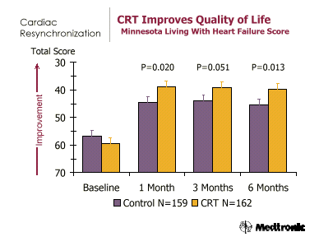
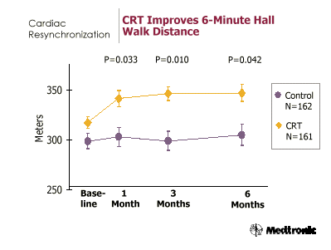
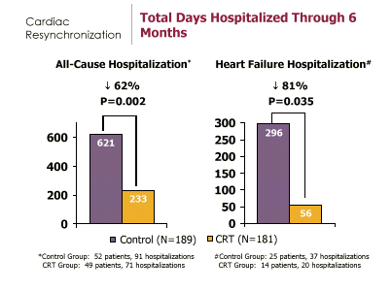
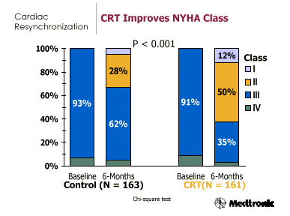
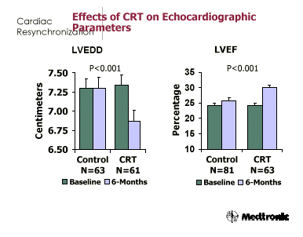
What We Expect From CRT (MIRACLE)
W.T. Abraham N Engl J Med, Vol. 346, No. 24,2003

Slide 63
CRT Improves Quality of Life and NYHA Functional Class
NYHA: Proportion Improving
1 or More Class
80%
*
*
*
60%
40%
20%
0%
MIRACLE
CONTAK
MIRACLE
CD
ICD
* P < 0.05
Control
CRT
NEJM 2002;346:1845-53 (MIRACLE)
NEJM 2001;344:873-80 (MUSTIC SR)
http://www.fda.gov/cdrh/pdf/P010012b.pdf. Accessed August 2, 2002 (CONTAK CD)
JAMA 2003; 289:2685-94 (MIRACLE ICD)

Slide 64
CRT Improves Exercise Capacity
* P < 0.05
NEJM 2002;346:1845-53 (MIRACLE)
NEJM 2001;344:873-80 (MUSTIC SR)
http://www.fda.gov/cdrh/pdf/P010012b.pdf. Accessed August 2, 2002 (CONTAK CD)
JAMA 2003; 289:2685-94 (MIRACLE ICD)
Notes:
Main purpose: Show concordance of proof from randomized controlled trials that CRT improves exercise capacity.
Key messages:
From the graph at left, 3 of the 4 randomized trials showed that CRT improves this measure of sub-maximal exercise capacity.
All studies showed that CRT improves peak VO₂, regarded as a more objective measure of exercise and functional capacity, compared to control.
Additional information:
The authors of the MIRACLE ICD paper make the following comment on the discrepancy in the 6 minute walk test:
“However, the absence of a positive treatment effect on the 6-MW contrasts with these earlier trials, and with the improvements observed in this study with the more objective measurements of peak oxygen consumption and treadmill exercise duration. Whether these discrepancies are due to differences between patient populations, or to the different timing of the 6-MW test (performed before instead of after CRT system implantation) remains uncertain.”

Slide 65
CRT Effect on LV Size and Function
LVEDV
LVESV
LVEF
LVFT
IVMD
MR Jet Area
Paired, Median Changes from Baseline
 Control (n=151)  CRT (n=172)
St. John Sutton M, et al. Circulation 2003;107:1985-1990

Slide 66
Improved Cardiac Function Without Oxidative Stress
n=7
Nelson et al. Circulation 2000;102:3053-3059
Ukkonen et al. Circulation 2003;107:28-31

Slide 67
Rimodellamento neurormonale post CRT

Slide 68
…Quali gli effetti
sulla mortalita’…?
C D’Ascia, G Riccio
Università degli Studi di Napoli Federico II

Slide 69
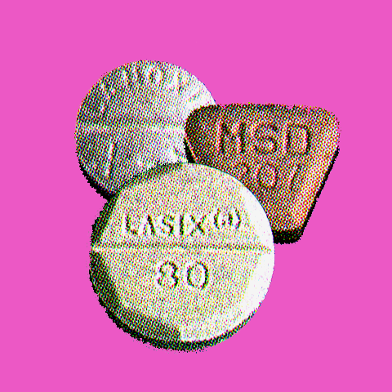
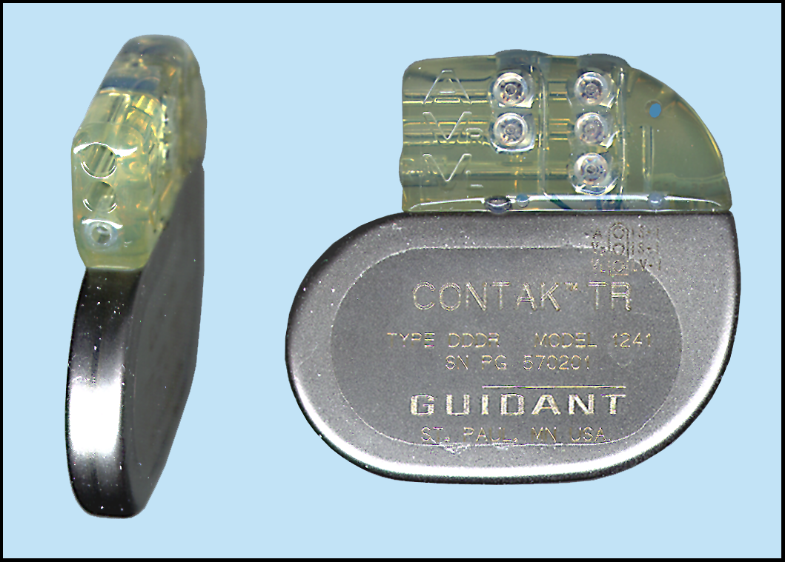
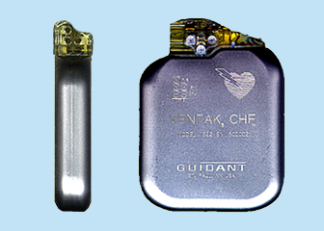
COMPANION: Comparison of medical therapy, pacing and def ibrillation in heart failure
NYHA III or IV
QRS ≥ 120 ms
PR > 150 ms
LVEF ≤ 35%
LVEDD ≥ 6 cm
2 200 patients
Optimal Pharmacologic Therapy (OPT)
OPT
BV pacing
Randomize
1:2:2
+
OPT
BV pacing
Defibrillation
+

Slide 70
Mortality/Morbidity Comparison
Risk reduction with CRT or CRT + ICD
Study
(n random.)
Follow-up
Treat-ment
Mor-tality & Hosp.
Mortal. & HF Hosp.
Mor-tality
HF Mort.
HF Hosp.
COMPANION¹
(n=1520)
12 M
CRT + ICD
19.3%
39.5%
43.4%
CRT
18.6%
35.8%
23.9%
MIRACLE²
(n=453)
6 M
CRT
39.0%
27.0%
50%
JAMA meta-analysis³ (n=1634)*
3-6M
CRT
23%
51%
29%
1. Bristow MR, et al. ACC 2003 Presentation accessed
at www.uchsc.edu/cvi on April 18, 2003
2. Abraham WT, et al. N Engl J Med 2002;346:1845-53
3. Bradley DJ, et al. JAMA 2003;289:730-740
* Includes MIRACLE
P < 0.05

Slide 71
Resincronizzazione ventricolare
Rimodellamento
elettrico
Miglioramento meccanico
Miglioramento emodinamico
Rimodellamento
anatomico
neuro-ormonale
Bio-molecolare
QOL
6 mn WT
Classi NYHA
Sopravvivenza

Slide 72
Ma allora il problema dello terapia dello scompenso e’ risolto?

Slide 73
Non-Responders
About 30% of patients treated with CRT do not demonstrate improvement in NYHA Class

Slide 74
Come ottimizzare l’efficacia della CRT
1. Ottimizzando la selezione dei candidati (responders)
Individuazione preventiva standard dei possibili responders, in base ai parametri di ritardi/asincronie cardiache (echocardiography)
2. La regolazione del PM (PM tuning):
« Ottimizzare » AV delay e la resiincronizzazione inter,intra-ventricolare (VV) (echocardiography)
3..Migliorando la tecnologia
Ottimizzare il posizionamento e la stabilita’ dell’elettrodo sn :
v. cardiaca laterale,necessaria…e non occasionale!

Slide 75
MATERIALI
E
TECNICA DI IMPIANTO
C D’Ascia, G Riccio
Università degli Studi di Napoli Federico II

Slide 76
Come si può stimolare il ventricolo sinistro ?
Accesso epicardico chirurgico:
toracotomia minima
rischio operatorio
vantaggio elettrico,sede e stabilita’ ?
Accesso endocardico transarterioso/transettale:
rischio embolico
procedura complessa
limitate esperienze
Accesso endocardico transvenoso/seno coronarico:
attuale approccio interventistico
sicuro e minimamente invasivo
maggiori esperienze e alta % successi
C D’Ascia, G Riccio
Università degli Studi di Napoli Federico II

Slide 77
Transvenous implant success rate (published data)
89%
88%
92%
92%
100%
88%
88%
83%
82%
80%
60%
40%
Miracle (N=434)
Easytrack pre-CE
(N=150)
SW Study (N=158)
MARK (N=44)
InSync It Reg (N=201)
SD Study (N=227)
Miracle ICD (N=227)
MUSTIC SR (N=67)
Easytrack Registry

Slide 78
Importance of LV pacing site
Pulse Pressure (% ↑)
LV +dP/dt (% ↑)
ANT
LAT
POST
ANT
LAT
POST
BASE
BASE
9
18*
10
17
30*
24
MED
MED
15
23
APEX
APEX
* = p < 0.05 MED-LAT > every other site
Auricchio et al., Cardiostim ’98

Slide 79
Optimal Pacing Site
80%
79%
78%
70%
Posterior
8%
66%
64%
60%
Postero-
Posterior
50%
lateral
14%
Lateral
or
Postero-
lateral
Lateral
or
Postero-
lateral
40%
40%
30%
Lateral
20%
Lateral
50%
31%
10%
0%
Insync
Easytrak
Insync
Study
Miracle
Italian
European
(first 120 pts)
Registry
Registry
LV lead positioning in published studies
64-79 %: post-lateral vein

Slide 80
Transvenous approach
Middle cardiac vein
Posterior cardiac vein
3. Postero-lateral cardiac vein
4. Lateral (marginal) cardiac vein
5. Great cardiac vein
4
5
3
2
1
R V
C D’Ascia, G Riccio
Università degli Studi di Napoli Federico II

Slide 81
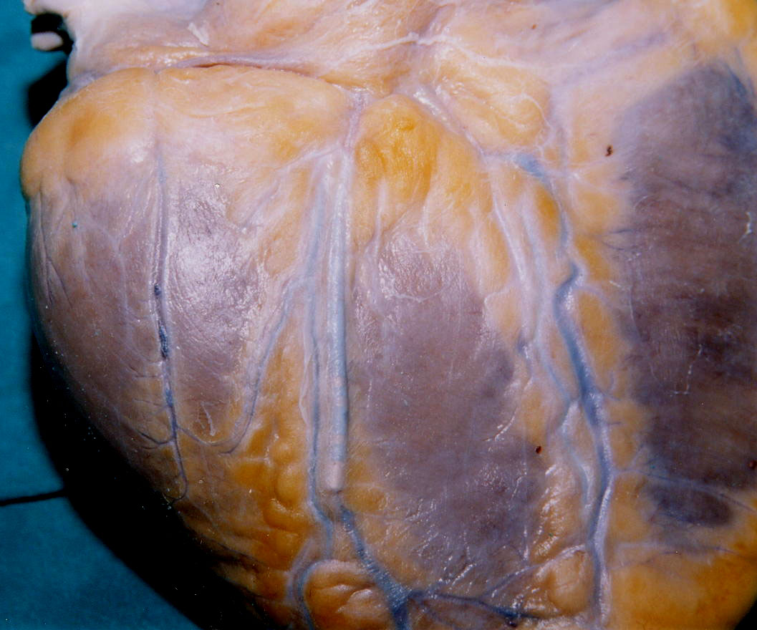
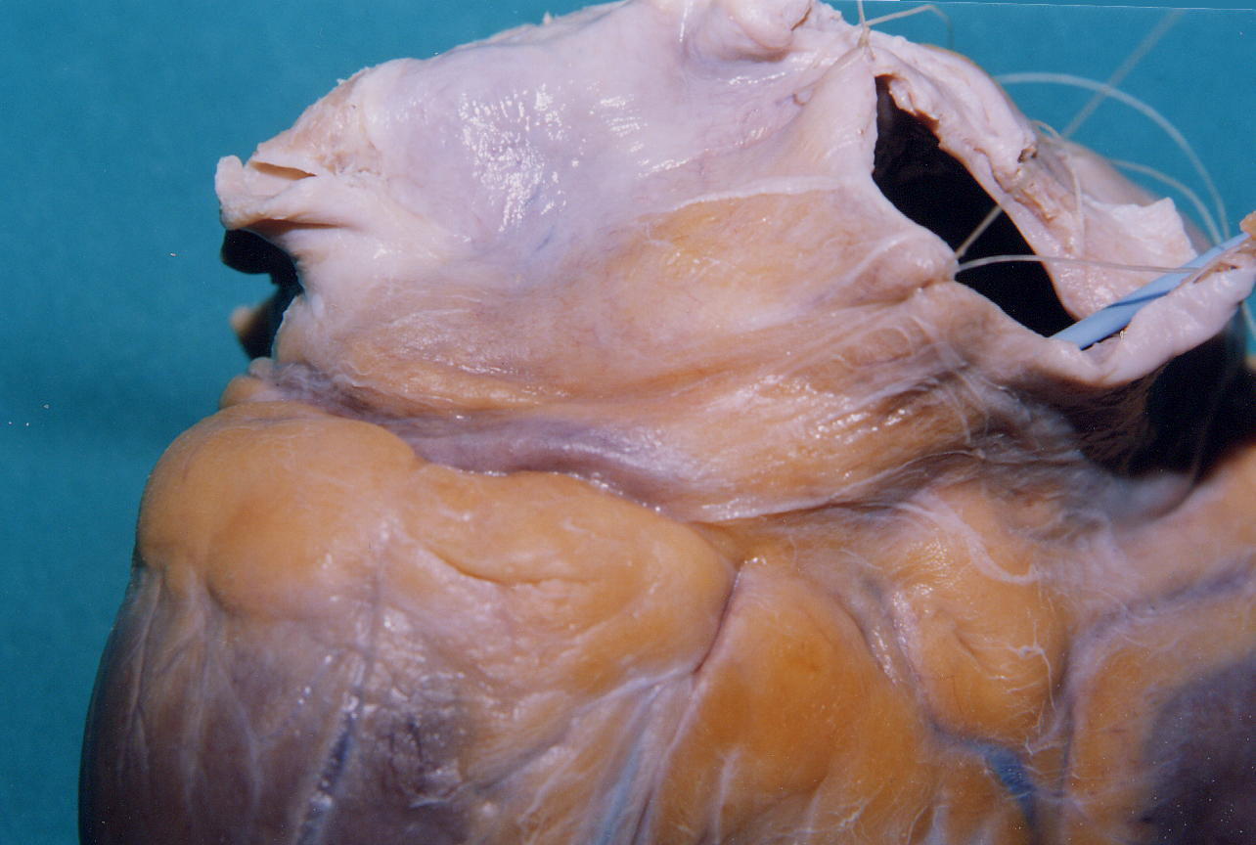
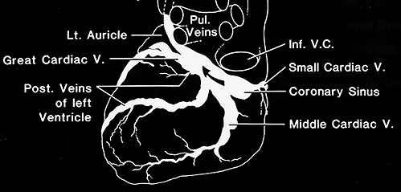
Postero-lateral vall

Slide 82
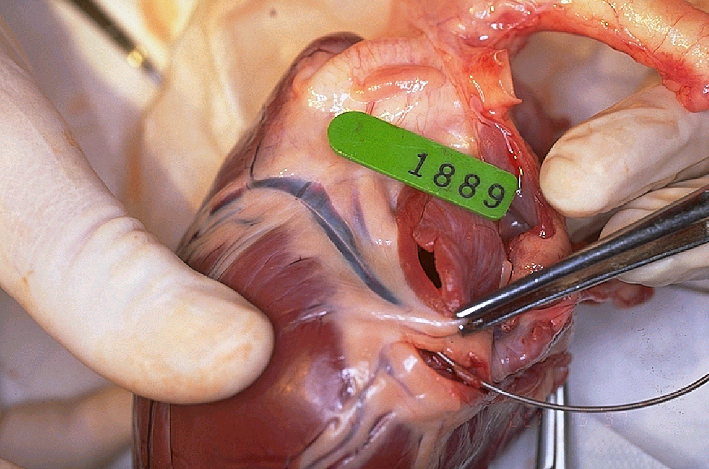
Parete postero-laterale: s.c. e v.c. magna
Notes:
This is a picture of the lead higher up in the great cardiac vein. The vein is quite large in relation to the lead and appears to be entirely patent.

Slide 94
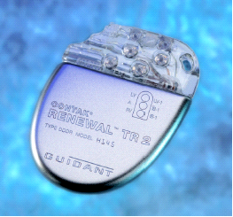
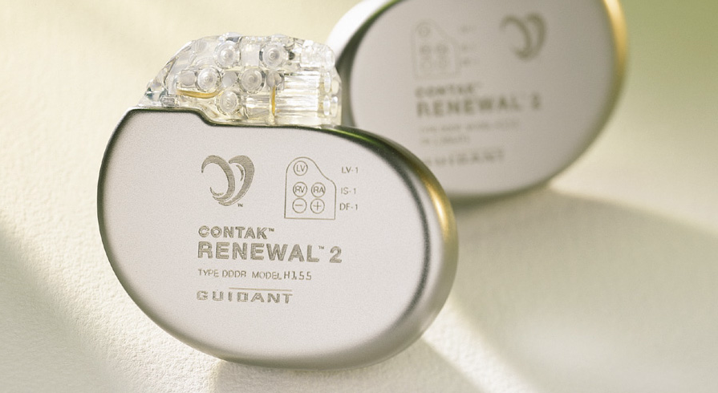
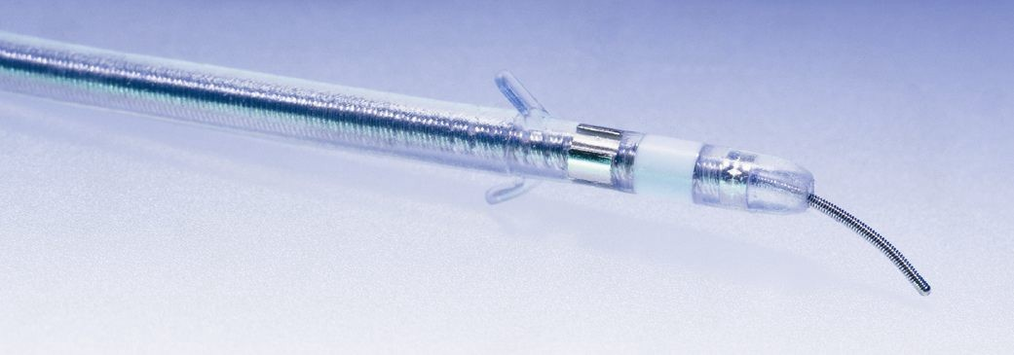
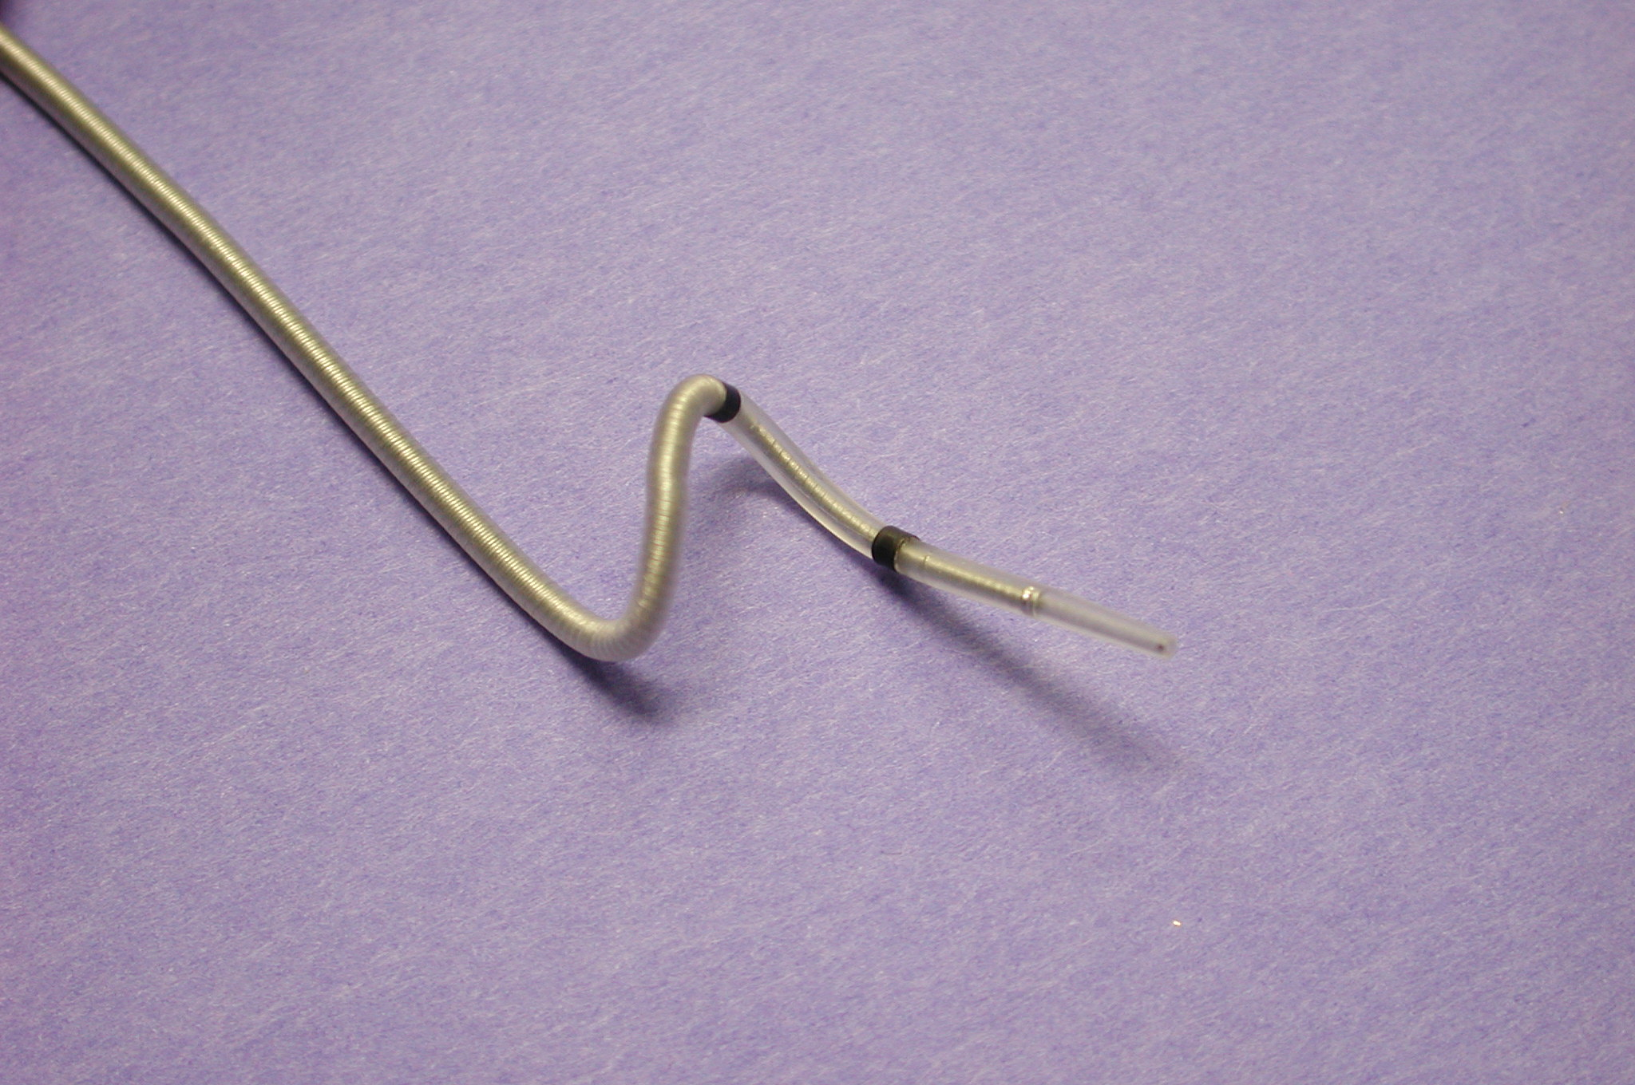
SISTEMA DI STIMOLAZIONE MULTISITO
CONTAK
C D’Ascia, G Riccio
Università degli Studi di Napoli Federico II

Slide 95
System parts
Guiding catheter
Finishing wire
Balloon catheter
Lead
Guide wire
EASYTRAK

Slide 96
Epicardial approach: Rationale
Sternotomy/Thoratocomy
Concomitant cardiac surgery procedure:
CABG
Valve repair/replacement
Ventricular reduction
Mini-thoracotomy
Transvenous implant failure
Non satisfactory LV pacing site
Transvenous LV lead dislodgment

Slide 97
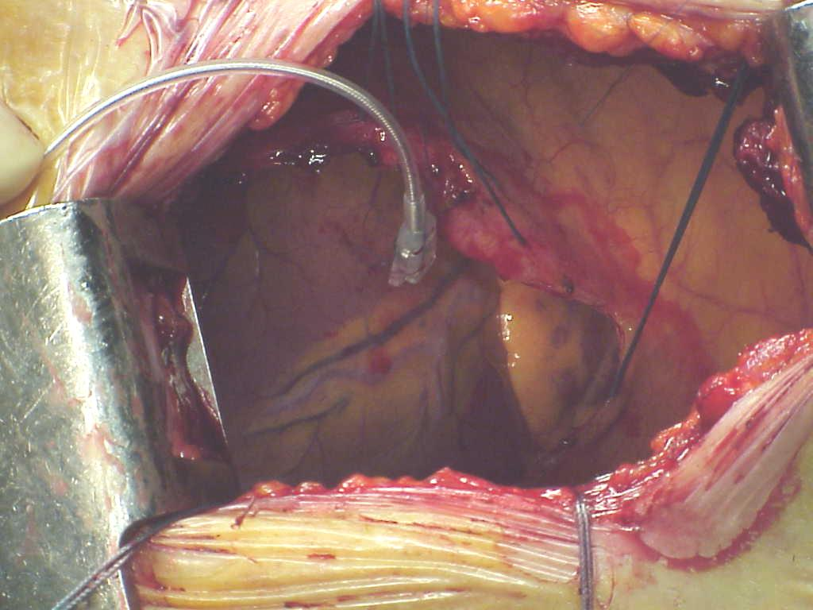
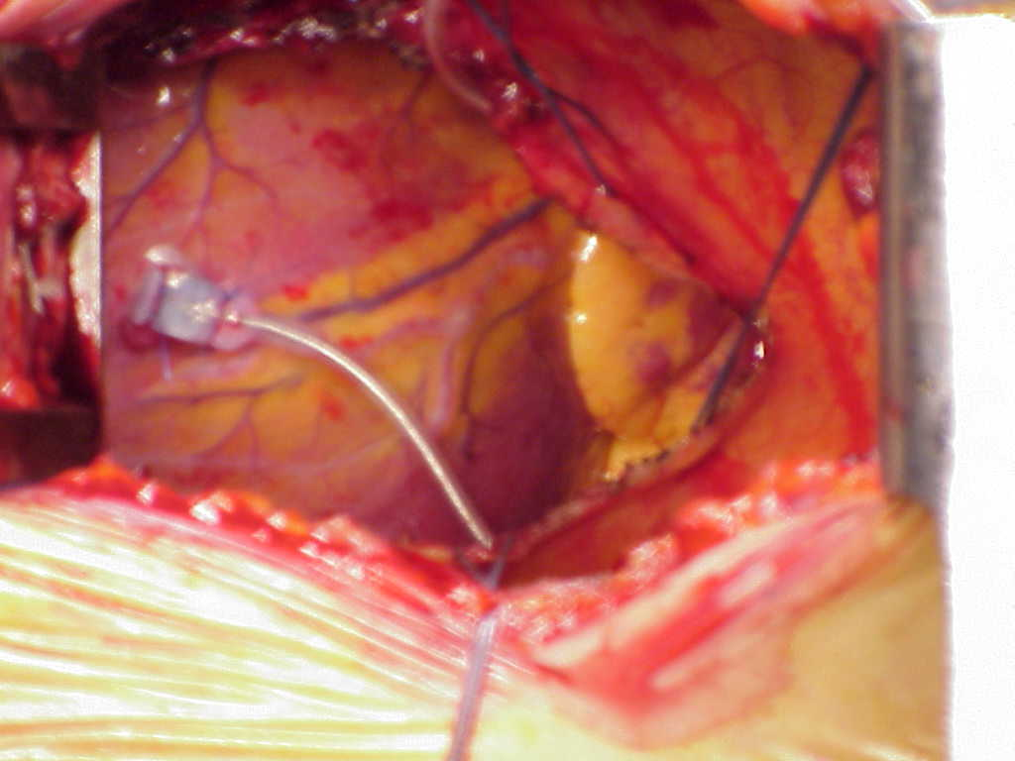
Toracotomia laterale
Istituto di Cardio chirurgia e Settore funzionale di Aritmologia
Dipartimento clinico di Cardiologia ,cardiochirurg e Med Interna Univ Fedrico II,Napoli

Slide 98
Difficoltà di approccio al ventricolo sin: cause di insuccesso in fase di impianto
Localizzazione spaziale dell’ostio del seno coronarico
Ostruzione dell’ostio
Avanzamento nel seno coronarico
Variabilità del sistema venoso con vasi troppo piccoli
Instabilita’ dell’elettrodo per vasi troppo grandi
Difficolta’ di posizionamento in una sede ottimale(vena poster o laterale)
Inadeguatezza dei parametri bio-elettrici
Stimolazione esofagea/diaframmatica

Slide 99
Difficoltà di approccio al ventricolo sin:
Complicanze precoci o in fase di impianto
Puntura arteriosa succlavia
Pneumotorace
Bradicardia o arresto cardiaco
Perforazione/dissecazione di un vaso coronarico
Stimolazione esofagea/diaframmatica
Complicanze tardive
Dislocamento dell’elettrodo
Aumento critico della soglia
Perdita di cattura
Stimolazione esofagea/diaframmatica
Peggioramento dei parametri di funzione

Slide 100
Early and Late Complications
Procedure Related Complications in 571 Patients Attempted; Proportion (n)
MIRACLE
Unsuccessful
implant
7.5% (43)
CS Dissection or Perforation
6%
(35; all re-covered w/o sequela)
Bradycardia
⏐0.3% (2)
Death
⏐0.3% (2)
Abraham WT, et al. NEJM 2002;346:1845-53 (MIRACLE)
%
18
12
16
months
14
3
12
12
months
Published Studies
10
months
11
8
months
6
6
6
months
months
4
3
2
months
0
LV lead
Dislodgement
Phrenic
Nerve Stim.
InSync
Study
Results)
Study (Final
InSync
Results)
InSync Ital.
Registry
Mustic Trial
Miracle
Study
EasyTrak
Pre-CE-Mark
EasyTrak
European
(Prelim.
Registry
Other Reasons

Slide 101
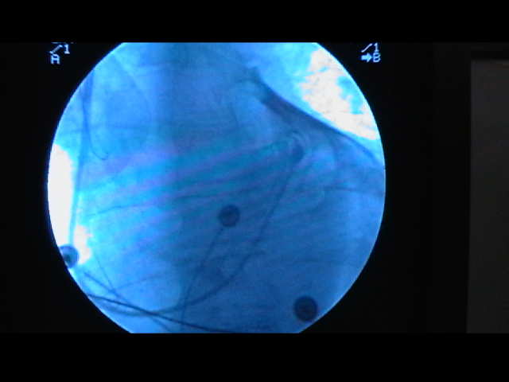
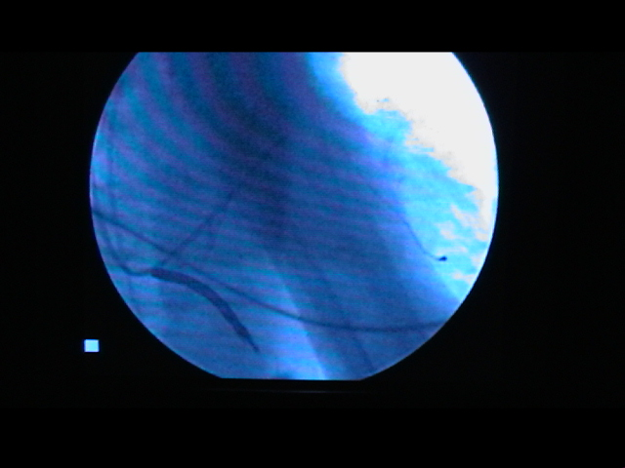
Venografia retrograda del seno coronarico
Perforazione di piccola vena e impianto in v. poster-laterale
OAS
C D’Ascia, G Riccio
Università degli Studi di Napoli Federico II

Slide 102
CONSIDERAZIONI CONCLUSIVE I
-Le CMD scompensate, si associano frequentemente ad anomalie elettriche , desincronizzazione ventricolare e morte improvvisa
-Esistono 3 meccanismi di resincronizzazione cardiaca,quello AV e quelli Inter o Intra-Ventricolare, e di essi il II e III sembrano i più efficaci
-La sede di stimolazione con migliori benefici emodinamici, in presenza di BBS, sembra essere la regione laterale, basale o media, del V sn, ma con notevole variabilità soggettiva
-La stimolazione del Ventricolo sn, attraverso il seno coronarico, è sicura e praticabile

Slide 103
Clinical Indications
HF & ICD co-morbidity
HF population
ICD population
Primary HF prevention in ICD patients
Prevention of Sudden Cardiac Death in HF patients

Slide 104
Conclusioni/3
- l ’approccio endocardico appare metodica consolidata,sicura ,
con rischio chirurgico imitato,non richiede anestesia totale,
ed e’ ampiamente accessibile al cardiologo interventista
-I tempi d’intevento e l’esposizione fluoroscopica si riducono con
l’aumentare dell’esperienza dell’equipe
-Le percentuali di successo sono molto alte
-I casi di failure sono in genere legati ad alterazioni del sistema venoso coronarico
-Vanno comunque tenuti in conto alcuni rischi non prevedibili come: dislocamenti ,incremento di soglia in cronico , scarsa possibilita’di ottimizzazione del sito di stimolazione

Slide 105
Conclusioni/4
- L’approccio epicardico è fattibile, senza aumentare
la mortalità e la morbidità, ma va riservato ai casi di failure
dell’endocardico,o in corso di concomitante chirurgia cardiaca,
-L’utilizzo al fine di ottimizzare il sito ha un suo rationale
ma richiede ancora verifica
Ridotto e’Il rischio di dislocamenti e ridotta e’ l’esposizione
fluoroscopica
- Basse soglie in acuto ed in cronico

Slide 106
Posizionamento Elettrocatetere
Easytrak e Rimozione
Giuda BMW
Posizionamento Elettrocateteri
Atriale e Ventricolare Dx
Introduzione Elettrocatetere
Easytrak su Guida BMW
Rimozione Catetere Guida
e Guida Finishing Wire
Introduzione Guida
Finishing Wire
Venografia Retrograda OSC
Introduzione Catetere Guida
C D’Ascia, G Riccio
Università degli Studi di Napoli Federico II

Slide 110
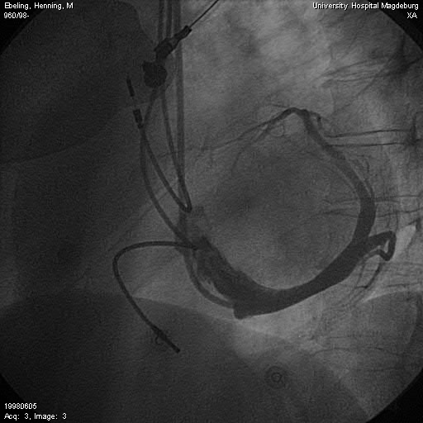
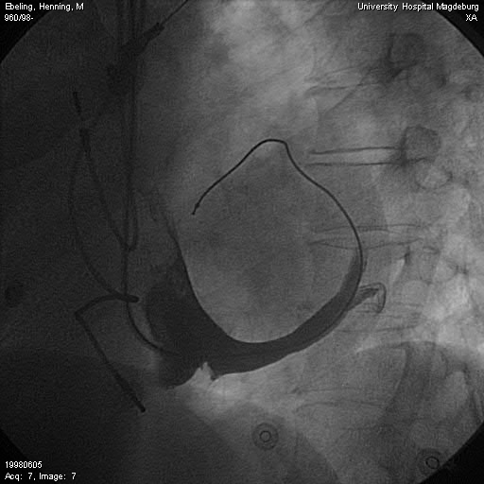
Venografia retrograda del seno coronarico
v.ant
Elettrodo in v.ant
v.cm
v.lat
OAS
Posizionamento in Vena Interventricolare Anteriore
C D’Ascia, G Riccio
Università degli Studi di Napoli Federico II

Slide 111
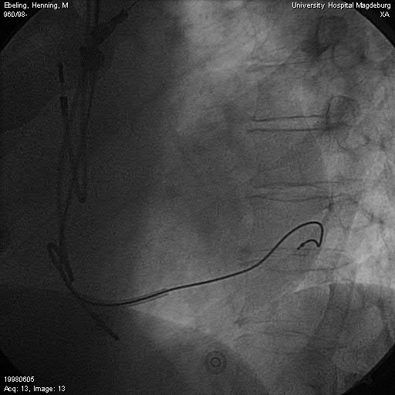
Vengrafia retrograda del seno coronarico
Elettrodo in v.lat
OAS
Posizionamento in Vena Laterale
C D’Ascia, G Riccio
Università degli Studi di Napoli Federico II

Slide 112
FINE

