Slide 1
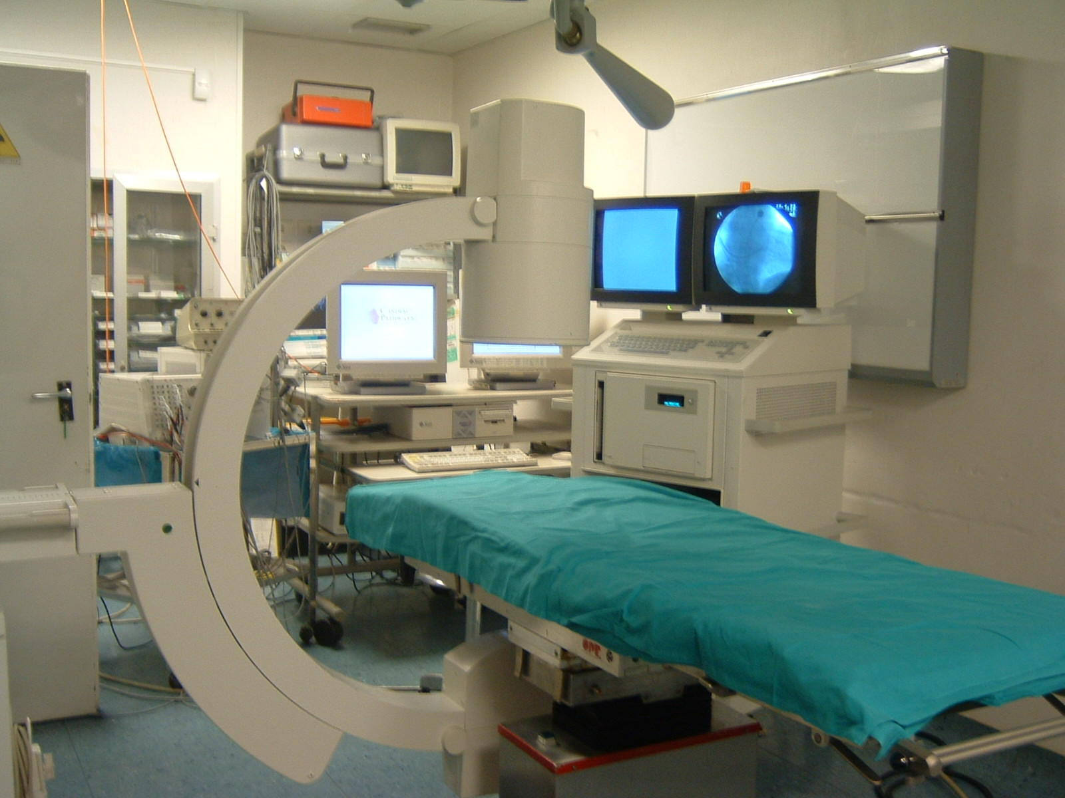
XXIV INTERNATIONAL SYMPOSIUM ON PROGRESS IN CLINICAL PACING
HOW TO:
SAFELY PERFORM RIGHT AND LEFT VENTRICULAR BIOPSY
S. L d’Ascia, MD, PhD
Isituto Clinico Città Studi Milano
Ep Unit, Head

Slide 2
ENDOMYOCARDIAL BIOPSY
GUIDELINES, INDICATIONS AND STATE OF ART
TECHNIQUE AND RISK
OUR SINGLE CENTER EXPERIENCE
Notes:
THIS IS MY SCHEMA IN THIS PRESENTATION, THE TOPIC IS BIG SO WE JUST UNDERLINE SOMETHING ABOUT INDICATION AND STAT OF ART AND, LIKE ASKED, WE WILL FOCUS ON TECNIQUES AND OUR SINGLE CENTER EXPERIENCE

Slide 3
EMB SURGEON INDICATIONS
Cardiac allograft rejection monitoring
(to survey the sufficiency of immunosuppressive therapy after cardiac transplantation)
Acute cellular rejection increase 6.7% of mortality during the first month and 12% during the first year after transplantation
Registry Of The International Society For Heart And Lung Transplantation: twenty second official adult heart transplantation report-2005
J.Heart Lung Transplant 2005

Slide 4
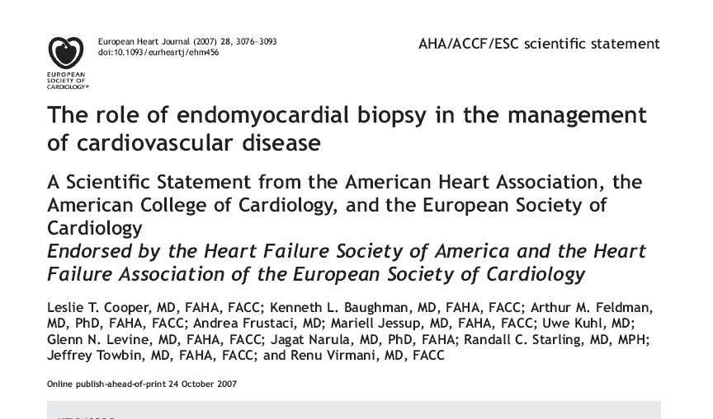
EMB INDICATIONS
Notes:
IN THE 2007 THE BEST IMPORTANT INTERNATIONAL SOCIETY READ IS PROCEDURE

Slide 5
Notes:
UNLUCKY THIS IS THE FIRST ADVICE OF THE DOCUMENT: THE ROLE OF EMB AR CONTROVERSIAL.

Slide 6
ARE RECCOMENDATION CLASS OR ADVICES?
Notes:
UNLUCKY THIS IS THE FIRST ADVICE OF THE DOCUMENT: THE ROLE OF EMB AR CONTROVERSIAL.

Slide 7
EXPERIENCE BEFORE 2007
Notes:
BEFORE 2007 THERE WAS NO GUIDELINES AND THE INVESTIGATION PERFORMED BY EMB WAS PRINCIPALLY ON PRYMARY DISEASE LIKE RESTRICTIVE CARDIOPATY AND ARRHITMIAS. AT THE PRESENT THE INDICATION ARE DIFFERENT AND BIGGER AND INCLUDING PRINCIPALLY NEW ONSET HEART FAILURE.

Slide 8
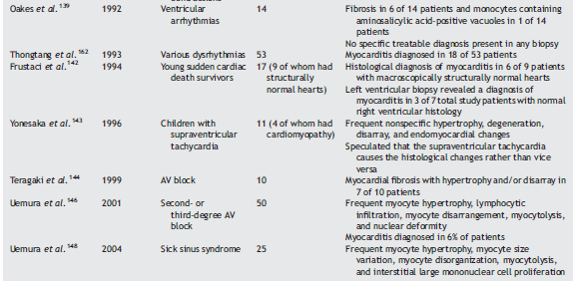
EXPERIENCE BEFORE 2007
Notes:
BEFORE 2007 THERE WAS NO GUIDELINES AND THE INVESTIGATION PERFORMED BY EMB WAS PRINCIPALLY ON PRYMARY DISEASE LIKE RESTRICTIVE CARDIOPATY AND ARRHITMIAS. AT THE PRESENT THE INDICATION ARE DIFFERENT AND BIGGER AND INCLUDING PRINCIPALLY NEW ONSET HEART FAILURE.

Slide 9
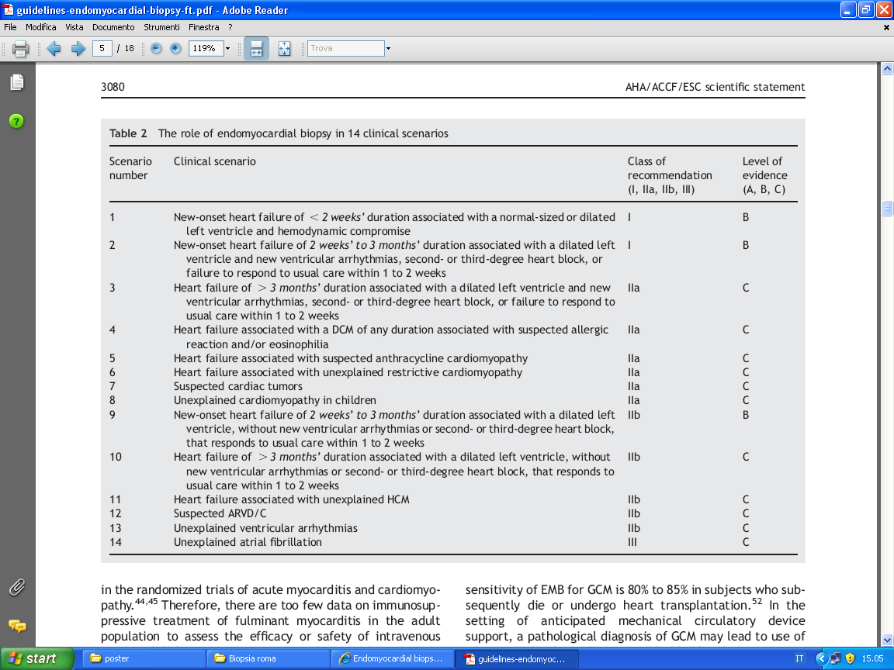
EMB INDICATIONS
Notes:
The society underlin 14 scenarios. Disease what can investigated by rmi or hoter tecniques like arvd or atrial fibrillation are are in second b or 3 class if reccomandation. And the new onset heart failure won the forst class of reccomandation

Slide 10
EMB INDICATIONS
Notes:
The society underlin 14 scenarios. Disease what can investigated by rmi or hoter tecniques like arvd or atrial fibrillation are are in second b or 3 class if reccomandation. And the new onset heart failure won the forst class of reccomandation

Slide 11
CLASS 1B: NEW ONSET HF
TIME TO ONSET OF UNEXPECTED DISEASE
HEMODINAMIC COMPROMISSION
DILATATION OF LV
ARRHYTHMIAS
FAILURE TO RESPOND TO USUAL CARE
Notes:
IN THE UNEXPAINED HEART FAILURE IN CILDREN LIKE ADULT WE WHEITH PRINCIPALLY THIS PARAMETERS:
THE TIME OF THE ONSET
THE LIFE COMPROMISSION
THE LEFT VENTRICULAR SIZE ABND DILATATION
THE ARRHITMIAS
AND, SURE, THE FAILURE OF USUAL CARE

Slide 12
CLASS IB: NEW ONSET HF
Perform EMB if the new onset of unexpected HF are < 2 weeks duration with hemodynamic compromission
Or
If the time of HF are from 2 weeks to 3 months but associated to LV dilatation and new arrhythmias
Always weigh the usual care failure

Slide 13
Percutaneus access technique
Right internal jugular vein (U.S.A.)
Femoral vein (Italy *)
Subclavian vein(*)
Femoral artery (*)
Atrial Transeptal technique (*)
(*) our experience
Notes:
To the rigth ventricol italian oerator prefer the femoral access, to the left ventricol usually aree used the femoral artery. Transeptal acces is not indicated in the giudelines but personally i use tbhis tecnique because i have a big experience in this apporoach

Slide 14
Right versus Left EMB
No comparative studies exist on which to base a reccomandation for LV vs RV ventricular EMB
However, Left EMB has been used to investigate LV specific processes
Notes:
To the rigth ventricol italian oerator prefer the femoral access, to the left ventricol usually aree used the femoral artery. Transeptal acces is not indicated in the giudelines but personally i use tbhis tecnique because i have a big experience in this apporoach

Slide 15
Percutaneus access technique: the standard
Standard EP Monitoring (ecg, Ox saturation, invasive BP)
Fluoroscopy
In stand by: echo, pericardiocentesis tools, surgery
Heparin/ACT time (arterial access)
Notes:
To the rigth ventricol italian oerator prefer the femoral access, to the left ventricol usually aree used the femoral artery. Transeptal acces is not indicated in the giudelines but personally i use tbhis tecnique because i have a big experience in this apporoach

Slide 16
Percutaneus access technique: extra protection
Right ventricular pacing backup
A long sheath reduces the risk of valves damage
Sonography/echo of the neck to evaluate the diameter of the vein in the jugular approach
A “Pig Tail” Cath in Aorta/medium contrast (LV access)
ASA use in addition to heparin
(Transeptal access is only for expert center)

Slide 17
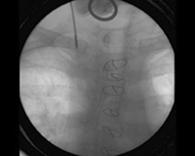
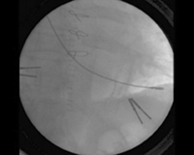
Percutaneus access technique
FLUOROSCOPY IS BETTER THAN ECHO
(some operators use both)
EMB VIA INTERNAL JUGULAR VEIN

Slide 18
EMB RISK
DECKERS JW, HARE JM, BAUGHMAN KL
COMPLICATIONS OF TRANSVENOUS RIGHT VENTRICULAR ENDOMYOCARDIAL BIOPSY IN ADULT PATIENTS WITH CARDIOMIOPATHY: A SEVEN-YEAR SURVEY OF 546 CONSECUTIVE DIAGNOSTIC PROCEDURES IN A TERTIARY REFERRAL CENTER
J. AM. COLL CARDIOL 1992

Slide 19
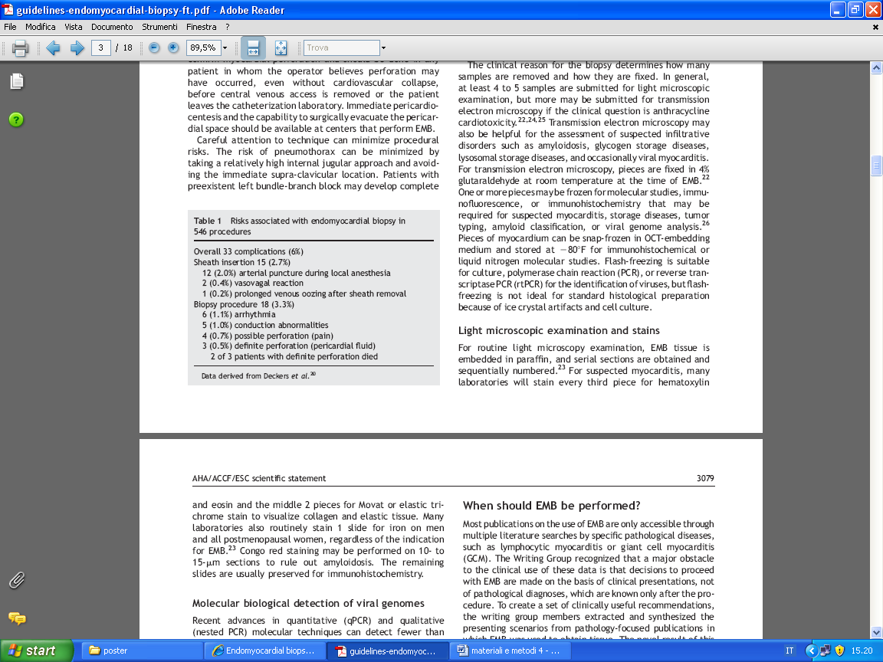
EMB RISK

Slide 20
ANALYSIS OF EMB TISSUE
TAKE 4-10 SAMPLES (FROM THE SEPTUM)
FIXING
INCLUSION
COLORATION
PROBHE USING
FROZEN AT -80°
LIGHT MICROSCOPIC
TRASMISSION ELECTRON MICROSCOPY
IMMUNOFLUORESCENCE
CULTURE
PCR
Rt PCR

Slide 21
IF YOU WANT TO DO HISTOLOGICAL INVESTIGATION YOU CAN NOT FROZEN THE SAMPLES
YOU ARE FINDING ICE CRYSTAL ARTIFACT

Slide 22
IF YOU WANT TO DO GENOMA INVESTIGATIONS YOU CAN NOT FIX THE SAMPLES
IN PAST WE TRIED TO DO PCR USING SAMPLES FIXED IN FORMALIN AND INCLUDED

Slide 23
WE FAILED!
(AND LOSE BIOPSY!)

Slide 24
EMB AS RESEARCH TOOL
UNDERSTANDING OF THE PATHOPHYSIOLOGY
UNDERSTANDING THE RELATIONSHIP BETWEEN BIOCHEMICAL CHANGES AND PHENOTYPE
ASSESSING THE PROGRESSION OF THE DISEASE
ASSES THE RESPONSIVENESS OF CARE

Slide 25
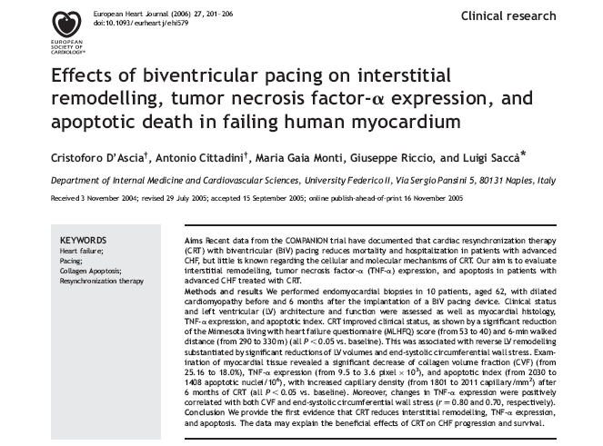

Slide 26
OUR EXPERIENCE
We studied by EMB the effects of CRT in patients with advanced heart failure
We performed EMB at time zero and 6 months after CRT (pubblished data)
We used histological processing and many different investigation
This year we are evaluating results from EMB at 5 years after CRT, investigated by histological methods and PCR too! (sorry, you have to wait…)

Slide 27
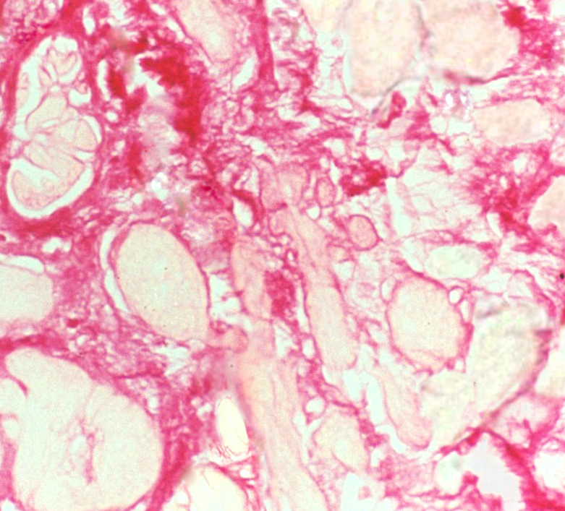
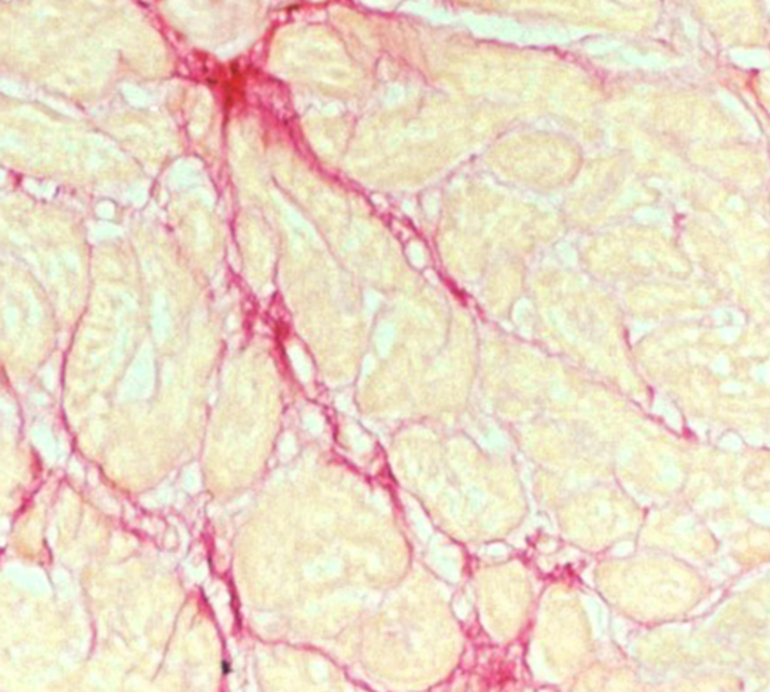
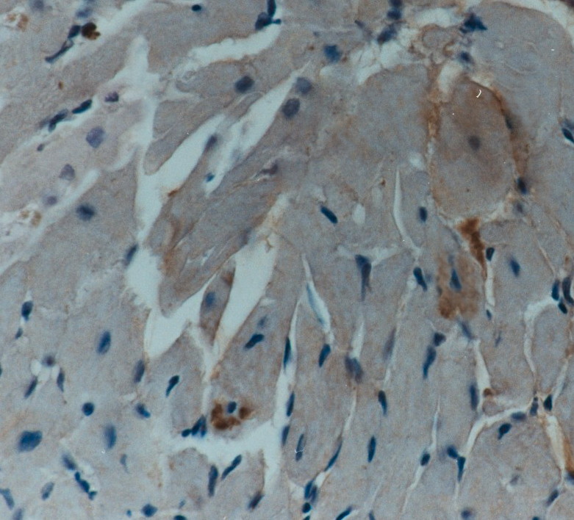
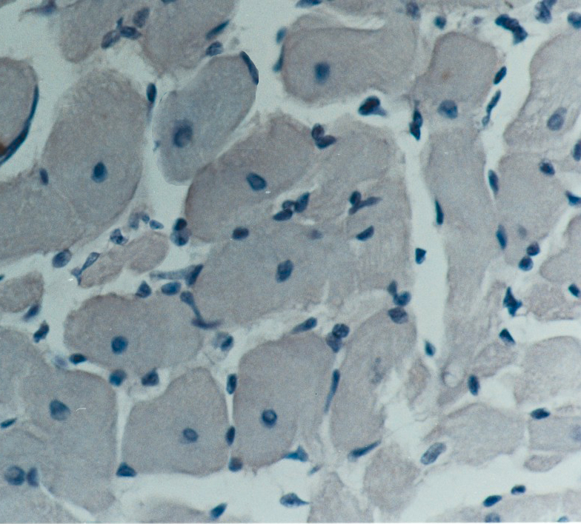
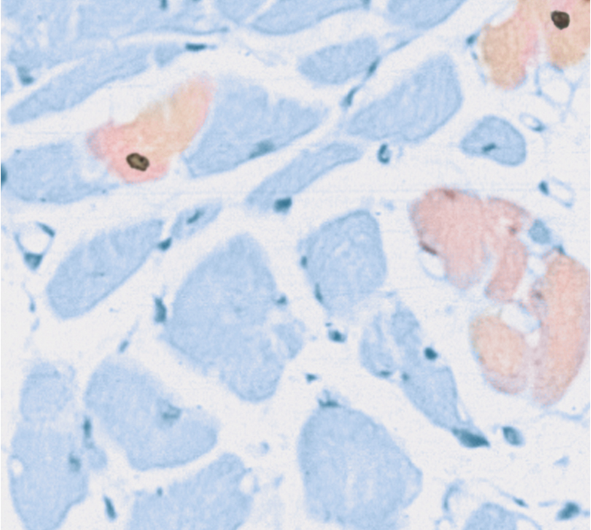
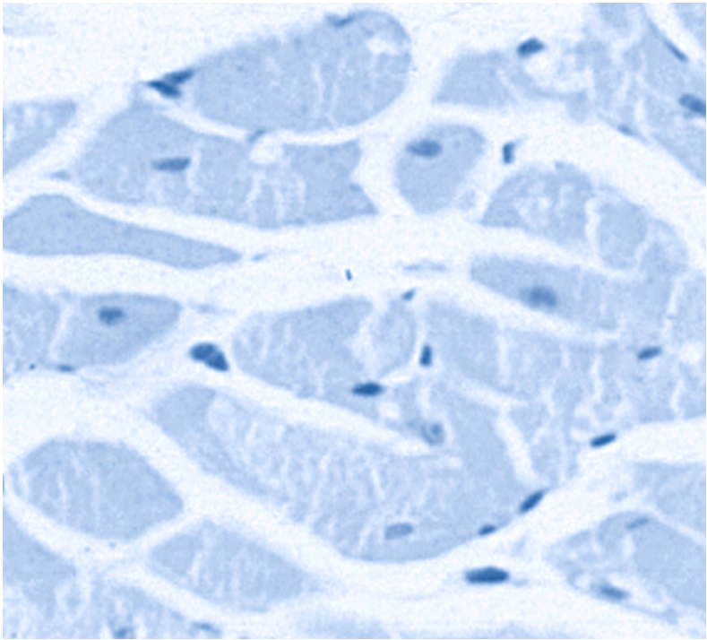
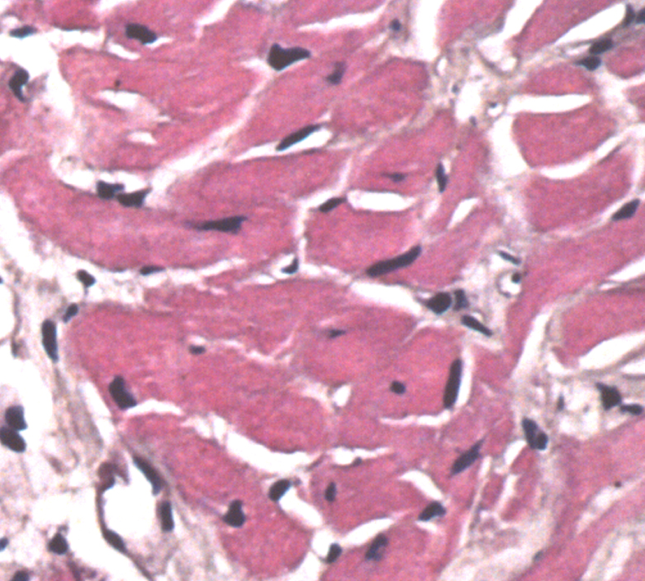
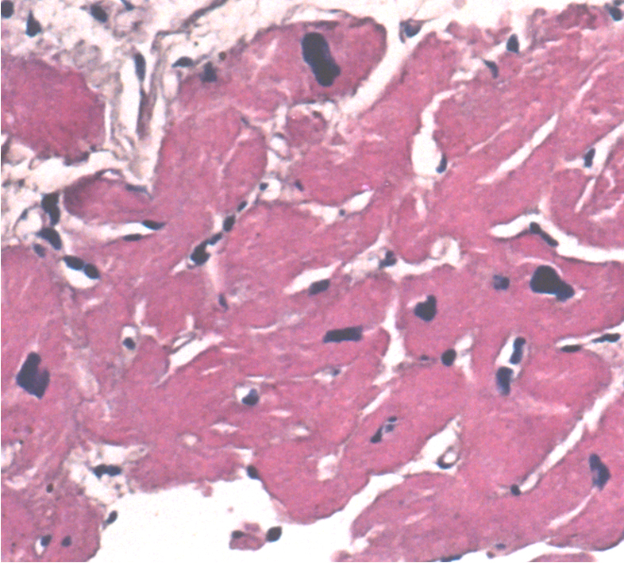
Fibrosis Index by histological colaration
(picrosiruis red)
Pre-CRT
6M Post-CRT
TNF-α
by immunoreaction
Apoptosis index
by hairpin probe
Cellular Diameter
Notes:
27

Slide 28
OUR EXPERIENCE: 2003-2010
65 pt
195 samples (3/pt media)
65 pt
RV
12 pt
RV + LV

Slide 29
EMB RISK

Slide 30
OUR EXPERIENCE: complications
Total: 6,5% of pt
PNX: 2/65pt
Venous bloody: 1/65pt
Reversible conduction abnormalities: 2/65pt (usually pre-existent LBB!)
Vagal reaction: 2/65pt
Artery injury: 1/65pt
Tachi arrhitmias: 1/65pt
Pain: 1/65ptù
Tamponation: 0/65pt

Slide 31
CONCLUSION
The guidelines have limitations
The paradox is: more serius is the pt more indicated is EMB
Must weigh each case
Must identify the study target (appropriate method)
Must take more samples for different study’s method
EMB analisys are expansive and need expert laboratory
EMB is not technically hard to do (hard is the samples study!)
Complications are uncommon and related to the patient compromission rather than operator
WE RECCOMMEND USING EMB AS A RESEARCH TOOL

Slide 32
Thank you

