Slide 1
Success rate of SP ablation
95 - 98 %
Risk of inadvertent AV block from 0.5 to 2 %

Slide 2
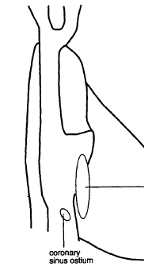

Slide 3
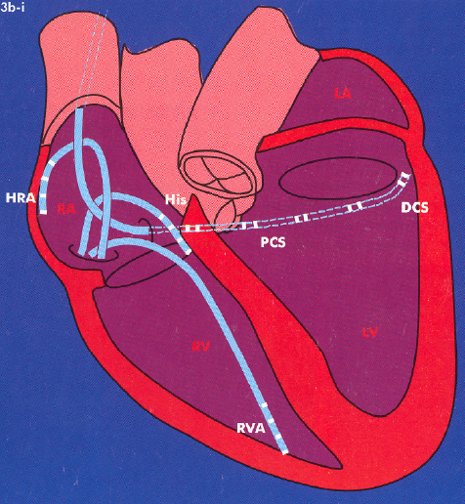

Slide 4
Koch’s triangle
1. Superior border =
tendon of Todaro
2. inferior border =
septal leaflet of
the tricuspide valve
3. Base (posterior
border ) =
ostium of the
coronary sinus
4. Apex =
compact AVN
1
2
3
Tendon of Todaro: a continuation of the commissure between the eustachian (IVC)
and thebesian (CS) valves into the musculature of the atrial septum

Slide 5
Typical AVNRT slow-fast whit anterior exit
The earliest atrial activation is in the anterior septum, recorded by the His catheter, buried in the ventricular electrogram

Slide 6
Typical AVNRT slow-fast whit anterior exit
The retrograde fast P has little or no ability of decremental conduction and its atrial exit is usually registered from the H catheter at the apex of Koch’s triangle

Slide 7
Retrograde conduction
over the FP
The site of the earliest A
activation is recorded at
anterior septum, superior
to the Tendon of Todaro,
about 5-8 mm posterior
and superior to the site of
prox H bundle

Slide 8
Retrograde conduction
over the SP
The earliest A activation
is recorded at posterior
septum, between the os
CS and the TA
Target of the ablation
of the slow pathway:
a small area in the
isthmus between the
os CS & the TA at the
base of the triangle
of Koch
base

Slide 9
The fast retrograde limb of the
tachycardia has a posterior exit
in some pts
“ atypical AVNRT slow-fast with
posterior exit ”
AV block can occasionally
result from ablation in a posterior
location

Slide 10
RAO
LAO
The ablation catheter is positioned along the TA
slightly anteriorly to the CS ostium, where the SP
potential is recorded
Notes:
Santini – 2003

Slide 11
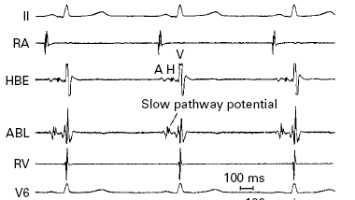
The ablation catheter
is positioned anterior
to the CS ostium
The V electrogram is
substantially larger
than the A eletrogram
A:V ratio < 0.5
with a distinct
deflection consistent
with a slow
pathway potential
immediately after the A

Slide 12
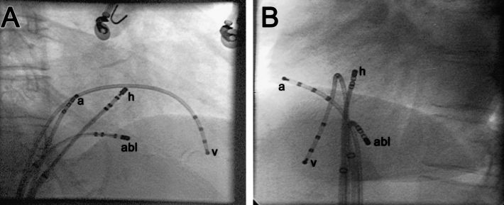
RAO
LAO
In the LAO view, when the ablation catheter is at level of the
superior aspect of the CS ostium, it appears more leftward
than the His catheter
Notes:
To avoid the risk of AV block – Calkins -2004

Slide 13
Observation
Elderly obese pts had shorter distances between the prox-HB area and the base of the CS os in the RAO view (the shape of the TA changes from a circle to an ellipse, compressed by the ascending aorta and diaphragma), but in the LAO view this distance is not so narrow check the position of the abl catheter in the LAO view (it’s safer)
Notes:
Koch’s triangle – Naito 2000

Slide 14
Slow Potentials of Haissaguerre
Low amplitude signals with a slow
slope recorded along the mid – or
posterior septum, anterior to the
CS
Uniphasic and rounded, biphasic,
or occasionally a doube hump

Slide 15
Slow Potentials of Haissaguerre
1. These potentials are not recorded
within or posterior to the CS ostium
2. Slow potentials are present also
in control subjects without AVNRT
and the post-ablation persistence
is not correlate with the inducibility
of AVN reentrant echo beats

Slide 16
Optimal electrograms
A / V = 0.1– 0.5 during SR e.g. A = 1/10 - ½ of V

Slide 17
Integrated approach
Using the RAO 30° view,
1. Put the cath in the HB region to recorder either the most distal HB or RB potential
2. Fully deflect the tip and slowly withdraw along the septal TA down to the most postero-inferior aspect of the interatrial septum, adjacent to the CS ostium

Slide 18
Integrated approach
If 2 pulses of RF at 30-35 W for
20-60 sec at the posterior septum, anterior to the CS, where low amplitude and hump-shaped potentials are recorded, fail move the tip anteriorly with slight advancement of the catheter itself, if necessary, to reach the mid-septum

Slide 19
By a combined anatomic-electrogram mapping approach, RF is applied at postero-septal sites where there is a small AV ratio and a fragmented or multicomponent A electrograms. Because electrograms with these characteristic can be recorded near the TA at sites that are distant from the SP, the region that is explored should be limited to the posterior septum, near the CS os
Notes:
Morady 2004

Slide 20
Anatomical approach
Put the catheter at the lowest 1/3 ot the area between the HB and the CS os at the RAO view, just in front of and above the CS os also posterior to the His catheter at the LAO view where the His catheter is seen tangentially
Recording of the slow potential is not always necessary for SP abl
Notes:
Enjoji - 1999

Slide 21
Anatomical approach
1. It is true that SP ablation can be achieved at sites where slow potentials are nor recorded.
2. These potentials can also be found at sites where SP ablation fails
3. They may be recorded at sites distant from the region of the SP and in pts without AVNRT
Notes:
Enjoji - 1999

Slide 22
Endpoint
Non inducibility of AVNRT
Persistence of single AVN echo beats or dual physiology are not indicator of failure

Slide 23
Endpoint
The risk of causing complete
AV block may increase substantially by continuing attemps to eliminate the residual slow pathway conduction

Slide 24
Ablation, which successfully eliminates inducible and spontaneous AVNRT in the presence of persistent SP conduction, is associated with significantly altered SP conduction characteristic, indicating the presence of a damaged or different (nonclinical) SP after ablation, incapable of sustaining tachycardia
Notes:
Characteristic of SP conduction after successful AVNRT ablation – Klein 2006

Slide 25
Elimination of SP conduction is not necessary for a good outcome
SP conduction after ablation can be observed in 30-70% of cases, (and 60% of these pts can have single AVN echoes), in spite of the fact that ablation results in suppression of AVNRT
Notes:
Characteristic of SP conduction after successful AVNRT ablation – Klein 2006

Slide 26
Hypotesis
1. The SP may be injured and rendered unable to sustain tachycardia
2. It may be eliminated, revealing the presence of another SP incapable of participating in tachycardia
3. The SP may remain unchanged, but interaction with the FP may be disrupted in a manner that prevents further tachycardia
Notes:
Characteristic of SP conduction after successful AVNRT ablation – Klein 2006

Slide 27
Electrophysiologic changes following effective SP ablation
1. AH interval =
2. shortest 1:1 VA conduction CL =
3. ↑ of the 1:1 AV conduction CL
4. ↑ of anterograde AVN ERP
5. loss of previously demonstrable critical delay during A stimulation that resulted in initiation of AVNRT

Slide 28
Electrophysiologic changes following effective SP ablation
When SP conduction persists after elimination of AVNRT
1. AV block CL (PW)
2. AVN ERP may not prolong after ablation

Slide 29
Electrophysiologic changes following effective SP ablation
Successful ablation of the SP in pts without discontinuous AVN conduction curves results in significant prolongation of
1. AV block CL (PW)
2. AVN ERP

Slide 30
Multiple fast and slow
AVN pathways in 33 % of patients
1. naturally
2. effect of a partial damage during selective AVN ablation

Slide 31
AVNRT ablation
How to do it
7-French 4 mm tip defectable catheter under temperature control (the sheath 1F size bigger) max temperature: 55°C max power: 45 Watts max time: 60 sec
Notes:
“VA” linking upon cessation of atrial enytrainment of the same tachycardia with 1:1 AV conduction

Slide 32
50 – 60 °C
20 – 30 W
60 sec
OK: electrode-tissue interface
T 48 °C (42 56 °C)
50 – 60 °C: higher temperature
is associated with a higher
success rate but a higher risk of
AV block

Slide 33
Combined approach
1. electrogram-guided
2. stepwise anatomic approach

Slide 34
Put the catheter to record the HB and then deflect infero-posteriorly, withdraw slowly with gentle clockwise torque so that the tip lies along the TA near the ostium of the CS but not in or posterior to os CS
Check for A/V < 0.5 and search for the SP potential (of Haissaguerre)
Move the catheter into the midseptal region, if necessary

Slide 35
If the characteristic A electrogram is not identified in the postero-medial region, the area posterior to or within the CS ostium should be mapped
RF accelerated irregular JR that subsides after 10-20 sec
Pullback the tip for 3-4 mm until burst of JR occurs again and then subsides

Slide 36
Posterior RAO anterior
1 =
A/V < 0.5
Probable SP
potential
In the posterior
septum,anterior
to the os CS
1-2-3 =
Pullback of the
tip
P

Slide 37
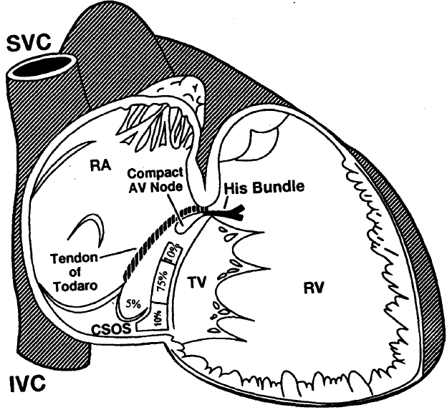
Most successful sites
of SP ablation are
located near the TA
at the roof of or
superior to the CS os
The remaining 5-10%
of sites are located
posterior to or
within the CS os
Most successful sites
are within 5 mm
above and below the
level of the upper
margin of the CS os
RAO

Slide 38
Observation
The site of successfull SP ablation
is consistently about 13 mm from
the site recording the prox HB,
despite marked variability in the
dimensions of triangle’s Koch
pts with large triangles
require ablation in the medial region
rather than the posterior region
Notes:
Koch’s triangle – Ueng - 1996

Slide 39
Immediatly STOP RF
1. Appearance of VA block during
accelerated junctional rhythm
2. Nonconducted P wave
3. Impedance rise
4. Displacement of the catheter tip

Slide 40
Junctional Ectopy/Rhythm
1. Its occurrence is a highly sensitive, but not a specific predictor of success
2. Its absence usually predicts inefficay of the lesion

Slide 41
4 distinct forms of AVNRT
1. typical S/F with/without jump, short HA interval (25-90 ms) and the first retrograde A recorded in the HB region
The low amplitude hump-like potentials are recorded at the mid or posterior septum, anterior to the osCS, never within or posterior to it
Notes:
Santini- Ital Heart J - 2003

Slide 42
2. left variant of S/F AVNRT with a very short HA interval and an unusually prolonged SP, a “double” response phenomenon (a single APC that conducts simultaneously over the FP and SP)
RF at the postero- or –mid-septal site of the MA or deep, 1-2 cm within the CS, in the roof
Notes:
Santini- Ital Heart J - 2003

Slide 43
3. atypical S/S with more than one jump, HA variable due to the different properties of the SP and to the supposed existence of a considerable longer CLP
The first retrograde A is in the postero-septal region
RF in the roof or in the inferior lip of the CS or just a few millimeters inside
Notes:
Santini- Ital Heart J - 2003

Slide 44
4. atypical F/S with a short AH (30-180 ms) and a long HA interval with the earliest retrograde A in the posteroseptal region
Notes:
Santini- Ital Heart J - 2003

Slide 45
The junctional rhythm occurs in ~ 90 % of cases
It is a sensitive but not specific marker of successful ablation and it can also be elicited during ~ 30-35 % of ineffective application
Notes:
Santini- Ital Heart J - 2003

Slide 46
Fast junctional tachycardia with CL 350 ms = 170 bpm suggest the proximity to the
AVN impending the development of AV block
Notes:
Santini- Ital Heart J – 2003 / Fitzpatrick 2001

Slide 47
Causes of inadvertent AV block
1. Catheter displacement
2. A position too anterior, close to the HB recording site
3. the FP exit is close to the postero-septal region
Notes:
Santini- Ital Heart J - 2003

Slide 48
ATTENTION
1. Any PR prolongation during SR
2. V-A block or delay if there is a junctional ectopy
Notes:
Santini- Ital Heart J - 2003

Slide 49
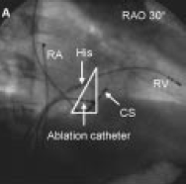
superior
inferior
base/posterior

Slide 50
Anterior to CS os
TT = tendon of Todaro
ER = Eustachian ridge

Slide 51
Junctional ectopy (JE) during ablation of the SP is a sensitive but nonspecific marker of successful ablation
100% effective applications
65% ineffective applications
The bursts of JE are significantly longer at effctive target sites than at ineffective sites
Notes:
JR- Morady

Slide 52
Althogh the occurence of VA block is not always followed by AV block, its consistent presence during applications that resulted in AV block indicate that VA block should be considered a harbinger of AV block and an indication to immediately discontinue the delivery of energy
Notes:
JR- Morady
HARBINGER = messaggero

Slide 53
The occurrence of VA block is a more accurate predictor of impending AV block than is the rate of the JE during wich the VA block occurs
Even in pts with poor VA conduction during VP in the baseline state, 1:1 conduction is expected during JE
Notes:
JR- Morady

Slide 54
Recommendations
1. Monitor the HRA to assess VA conduction during JE
2. Immediately stop RF delivery whenever VA block is observed
3. No delivery RF during isoproterenol infusion
4. Stop or ↑ power if JE are not seen within the first 10-20 sec
Notes:
JR- Morady

Slide 55
Recommendations
5. Try to induce AVNRT only after energy applications that are accompanied by JE
6. If RF applications are discontinued as soon as VA block occurs, the risk of AV block may be markedly reduced
Notes:
JR- Morady

Slide 56
Physiological VA block may be distinguishable from pathological VA block if the RR interval immediately preceding the VA block is relatively shor and/or if there is a return of 1:1 Va conduction during JE despite the continued delivery of RF energy
Notes:
JR- Morady

Slide 57
Slow-fast AVNRT
During RF of the SP the A activation sequence recorded during JR is
similar to that of retrograde FP; howewer HA-JR is < HA -SVT
Notes:
Electrophysiologic characteristics of JR – Chen 2005

Slide 58
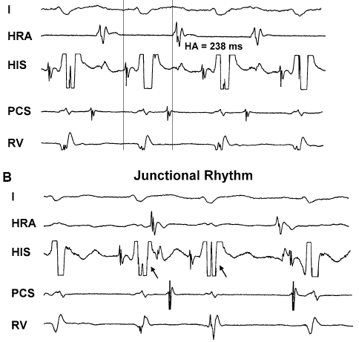
Fast-slow AVNRT
SR
JB
JB
During RF of the SP there is no retrograde conduction during JR
The A activation during is the same as that of SR
Notes:
Electrophysiologic characteristics of JR – Chen 2005

Slide 59
In pts with S-F AVNRT, the JR during RF of the SP conducts to the A through the FP; in pts with F-S AVNRT there is no retrograde conduction during JR
There are different characteristic of the JR during SP ablation of different types of AVNRT
Notes:
Electrophysiologic characteristics of JR – Chen 2005

Slide 60
1
Origin of JR during ablation of AVNRT
In yhe posterior region of the triangle
Of Koch
Stimulation of the compact AVN by
RF current by a discrete SP, resulting
in JR. The earliest A activation occurs
then at the apex of the triangle
2. JR originating from multiple
automatic foci in the posterio region.
This is a result of transitional AVN
fibers uncoupling and/or injury.
Anisotropic conduction from ≥ 1 of
these sites to the surrounding atrial
tissue by varying routes would explain
the variation in retrograde A activation
sequence
2
Notes:
Origin of JR – Josephson – 1997
UNCOUPLING = disinnestare

Slide 62
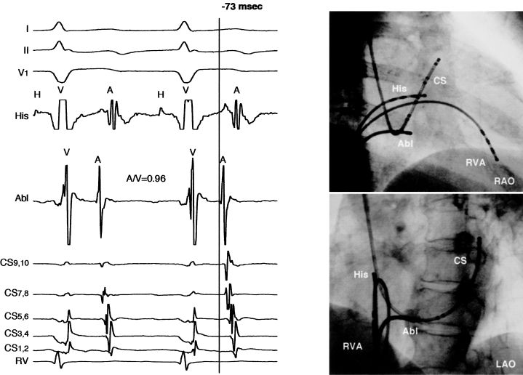
Fast-slow AVNRT
30°
The tip is in front of the os CS
(on the anterior side)
60°
Notes:
Uncommon AVNRT – Ooie - 2003

Slide 63
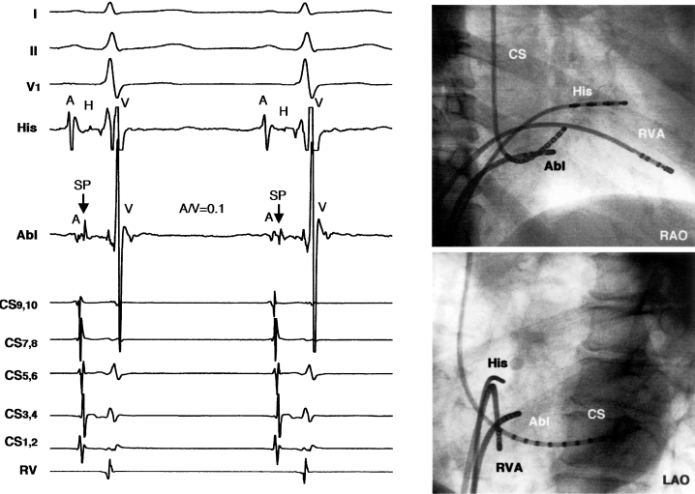
30°
The tip is at the 2/3 between the HB
region and os CS
60°
Notes:
Uncommon AVNRT – Ooie - 2003

Slide 64
The distance between HB potential recording site and successful ablation site varies according to the length of Koch’s triangle, but the distance between successful ablation site and upper margin of the CS ostium is relatively constant
Notes:
Rostock- 2005

Slide 65
Despite a higher incidence of preexisting prolonged PR intervals, SP ablation in elderly pts (> 75 years) is both effective and safe and should considered as the first line therapy also in this patient population
Notes:
Rostock- 2005

Slide 66
Risk of intraprocedural or delayed higher-degree AV block
Consider:
1. PR normal, > 200 or < 300 ms
2. age, SHD or His-Purkinje disease associated
3.evidence of dual pathway physiology
4. type of AVNRT; atypical AVNRT S-F with posterior exit
5. elimination or modification of anterograde slow pathaway
Notes:
Reithmann & Steinbeck + Editorial Comment of Markowitz 2006

Slide 67
1. the SP is said to have been ablated if there is no evidence of dual physiology at the end of the procedure
2. the SP is said to have been modified when AVNRT is no longer inducible but an A-H jump of at least 50 ms, usually accompanied by one A echo beat, is present at the end of the procedure
Notes:
Long term FU – Borggrefe - 2001

Slide 68
Total elimination of the functional SP is assumed if the anterograde ERP following SP modification is longer than the TCL
Notes:
Hohnloser – 2001

Slide 69
Regular short RP tachycardia
TCL
Notes:
RF again? – Field 2006

Slide 70
Differential diagnosis
1. typical AVNRT
2. orthodromic AVRT (see VA < 70 ms)
3. AT with long AH interval
4. junctional automatic tachycardia
Notes:
Hohnloser – 2001

Slide 71
A-V response after VP rules out AT
A
v
v
v
Notes:
RF again? – Field 2006

Slide 72
A PAC during SVT advances V without terminating tachy
HV is shorter
V
Notes:
RF again? – Field 2006

Slide 73
AH interval at basaline: 58 ms
AH interval during SVT: very long
Hp1. AT with long AH interval
Hp2. slow pathway during S/F SVT but AH interval of the APC is only 50 ms
Hp1. and Hp2. the AH interval should be longer than AH interval during SVT and not shorter
Notes:
Hohnloser – 2001

Slide 74
During sustained junctional tachycardia a PAC is able
1. to suppress the automatic junctional focus for a single beat
2. to conduct to the V over the fast pathway the AH interval is similar to the baseline AH interval
Notes:
Hohnloser – 2001

Slide 75
After delivery of RF for slow pathway ablation you can see:
1. sustained junctional tachycardia that spontaleously terminates after the isoproterenol is stopped
2. single or sustained junctional beats following A stimulation junctional beats or AVN echo beats ?
Notes:
Hohnloser – 2001

Slide 76
1. the first return beat after A pacing had a relatively constant escape CL regardless of the stimulus prematurity automatic junctional tachy
2. the AH interval of the first beat often varies with stimulus prematurity
AVNRT
3. if the return beat continues to be seen until the A ERP is reached automatic junctional tachy
Notes:
Hohnloser – 2001

Slide 77
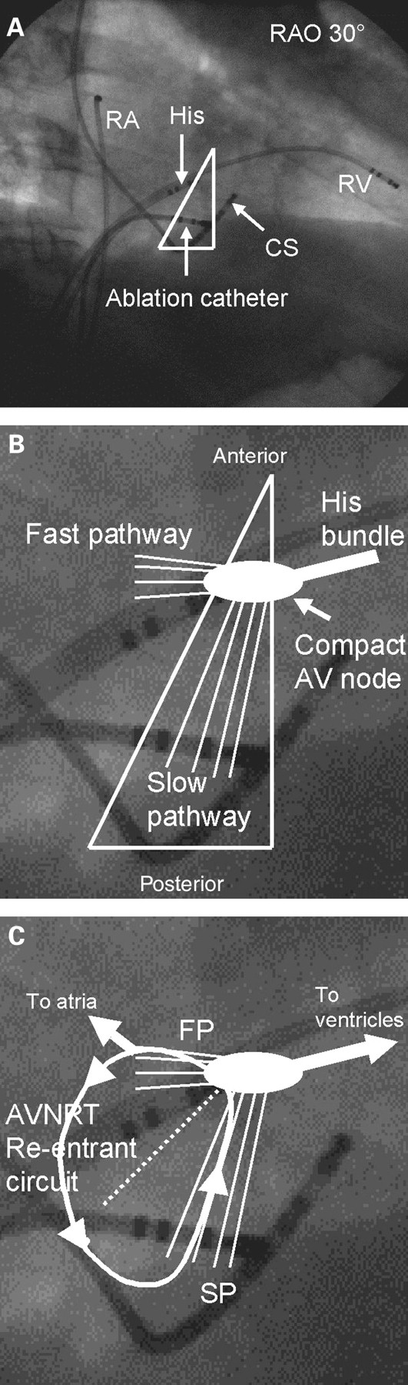
Notes:
Fitzpatrick - 2001

Slide 78
Koch’s triangle
1. Superior border =
tendon of Todaro
2. inferior border =
septal leaflet of
the tricuspide valve
3. Base (posterior
border ) =
ostium of the
coronary sinus
4. Apex =
compact AVN
1
2
3
Tendon of Todaro: a continuation of the commissure between the eustachian (IVC)
and thebesian (CS) valves into the musculature of the atrial septum

Slide 79
RAO 30°
LAO 60°
Slow pathway ablation for AVNRT
Note the catheter placed in CS through the PLSV
Notes:
Katsivas- 2006

