Slide 1
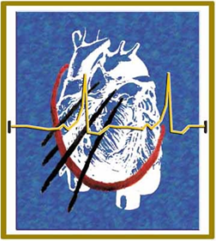

LAA Closure Before, During and After Atrial Fibrillation Ablation
Salvatore d’Ascia, MD, PhD
EP Lab, Head
Istituto Clinico Città Studi
Milano, Italy

Slide 2
This is a huge topic...
But the key could be to find a MARKER:
how can i decide to do AF ablation? How can i predict the succes of procedure?

Slide 3
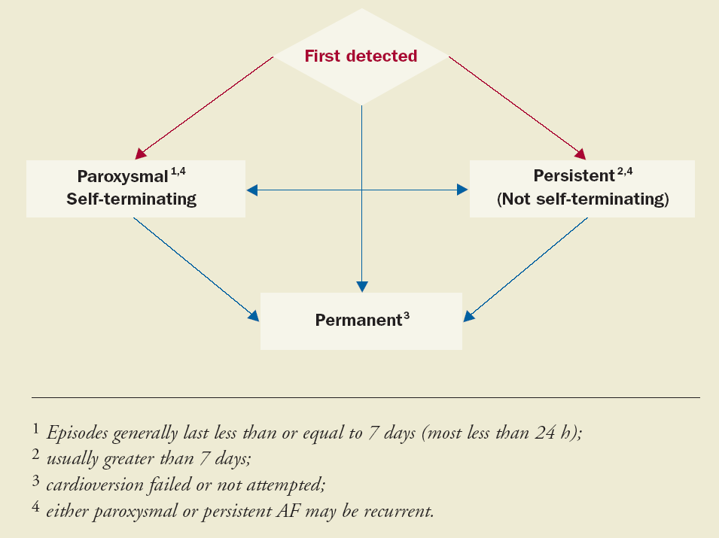

Slide 4
THE CURRENT CLASSIFICATION
Assumption 1: persistent and permanent AF constitute definite different disease subtypes.
Assumption 2: to separate these subtypes are important as concerns curative treatments

Slide 5
MISLEADING CONCEPTS
(limitations)
  Lack of correspondence between “clinical” AF subtypes and atrial substrate
  No consideration of comorbidities as predictors of ablation indications and long-term results

Slide 6
In the practice (during ablation) we face to with:
Electrical AF
Anatomical AF
Mixed AF

Slide 7
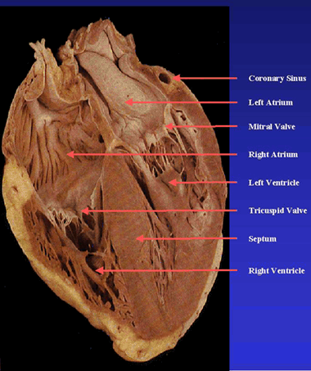
ELECTRICAL AF
  Usually (but not necessary) represented by lone paroxysmal AF
  Simple substrates: PV – posterior wall rotors, focal drivers (CS, LAA, Marshal ligament, etc)
  No fibrosis
  During AF, discernable electrical signals allover the LA

Slide 8
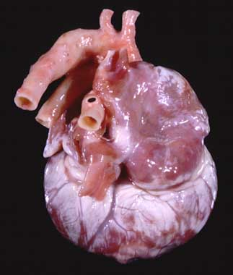
ANATOMICAL AF
  Often coincident with long-standing permanent AF (the most complex)
  Complex substrates: extensive cellular loss, patchy areas, LA dilation with or without MR, increased stress wall
  Extensive amount of FIBROSIS
  During AF, absence of clear electrical activity in the majority of the LA

Slide 9
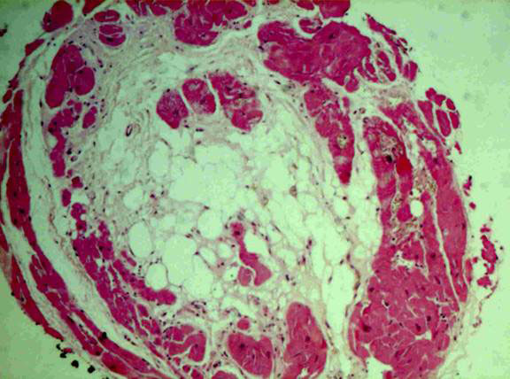
ELECTRO-ANATOMICAL AF
  The most frequent form of “chronic” AF
  Mixed substrate: patchy fibrotic areas, mild LA dilation with or without mild MR, focal driver (PA, CS, LAA, etc)
  Fibrosis limited (often just to the posterior wall)
  During AF, electrical activity can be observed allover the LA, with frequent areas of fractionation and complex electrogram

Slide 10
From electro to anatomical AF: FROM PV TO LA

Slide 11
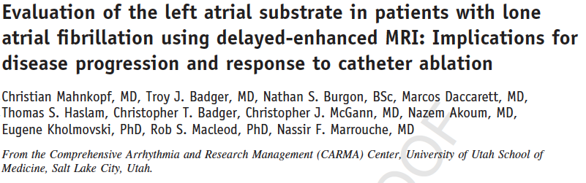
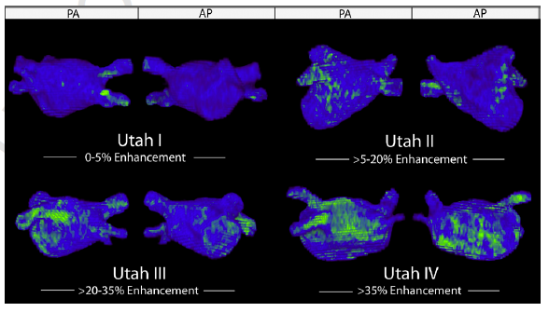
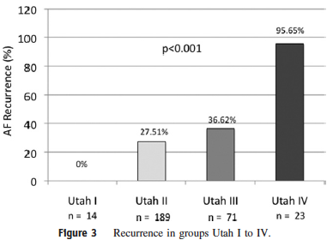
MRI TISSUE CHARACTERIZATION (before ablation!)

Slide 12
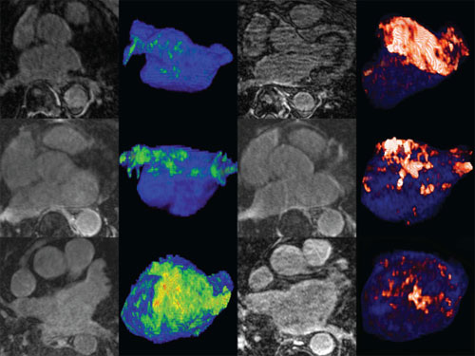
Electrical AF
Electro-anatomical AF
Anatomical AF
fibrosis
muscle
Mahnkopf et al. Heart Rhythm 2010

Slide 13
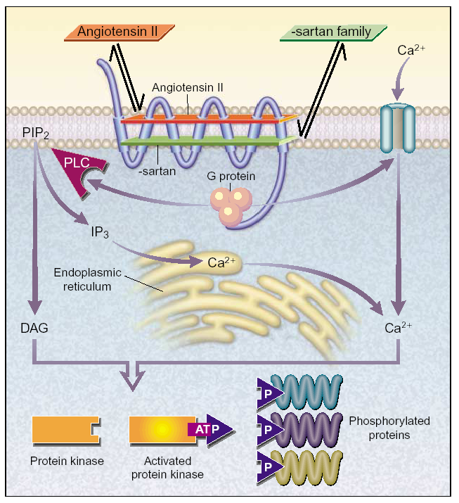
THE PATHWAY TO FIBROSIS
ATRec sustained activation
Activation of DAG and PKC
Activation of ERK and MAPKs
↑Collagen Syntetasis
↓Collagenasis
Genic expression modulation
Contractile protein isoform shifts
RAAS activation
↑Tissue ACE & AT II
↑ANP & BNP
↓atrial NO synthesis
“Systemic” Disease?
Tailored integrated hybrid approach
Notes:
13
Hemodynamic consequences of AF encompass loss of atrial kick and AF-induced tachycardia.
Ventricular and atrial volume and pressure increases, along with a reduction in the propelling heart function, may lead to an activation during chronic fibrillation.
Thus, if, on one hand, paroxysmal AF can be considered a regional atrial heart disease,
On the other hand, systemic and regional neuroormonal activation during chronic AF may be compared to a systemic disease. To suggest a comparison which may better clarify this idea, I like thinking of a cancer with metastasis at distance.

Slide 14
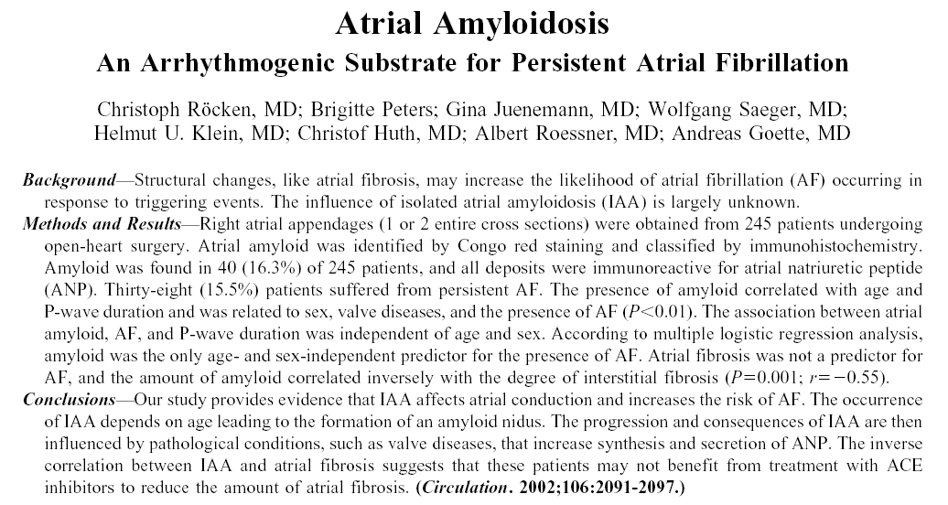
THE PATHWAY TO AMYLOIDOSIS
Atrial dilation and/or hypertrophy during chronic AF
↑synthesis and secretion of ANP
ANP fibrils deposition
Isolated atrial amyloidosis
Isolated scar-like areas with possibility for slow-conduction and reentry (strong af substrate hard to ablate)
Notes:
14
ANP plays an integral role in the regulation of hydromineral homeostasis under normal and pathological conditions. ANP secretion is stimulated by volume expansion, supine posture, hypoxia, myocardial ischemia, and other factors. There is a positive correlation between ANP level, cardiac filling pressure, and renin level.
Thus it is well understandable that several studies have found a significant raise in serum levels of ANP in AF. The increase of mRNA content of ANP parallels the one in synthesis and secretion of ANP, sometimes leading to the deposition of amyloid.
After CPVA for patients with long-standing AF, we observed a reduction in diuresis in the first weeks after procedure, as well as an increase in congestive symptoms, such as dyspnoea. This phenomenon seems not to be related to AF recurrences, and we are testing the hypothesis that CPVA might affect atrial ANP synthesis, causing a rebound effect in patients with previous high ANP levels.
In this case, temporary diuretic therapy might turn out to be beneficial in the post-procedure course, since it might reduce symptoms and prevent some recurrences acutely triggered by further atrial dilation.

Slide 15
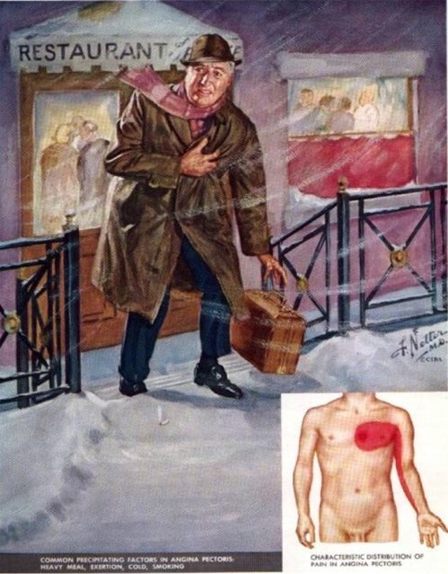



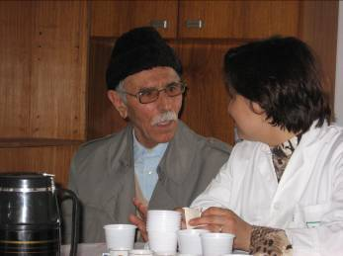

THE COMORBIDITIES
OBESE
PREVIOUS STROKE
DIABETES
CORONARY ARTERY DISEASE
ELDERLY
NEUROMUSCULAR DISEASE

Slide 16
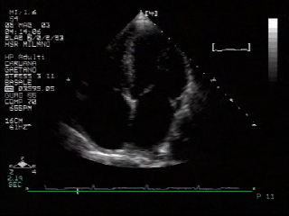
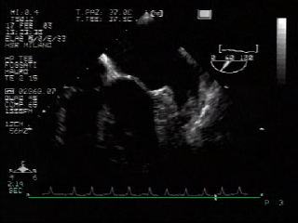
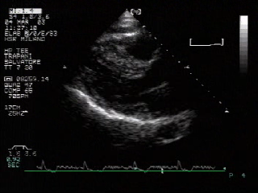
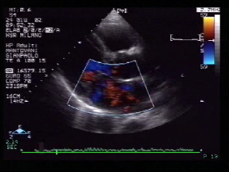
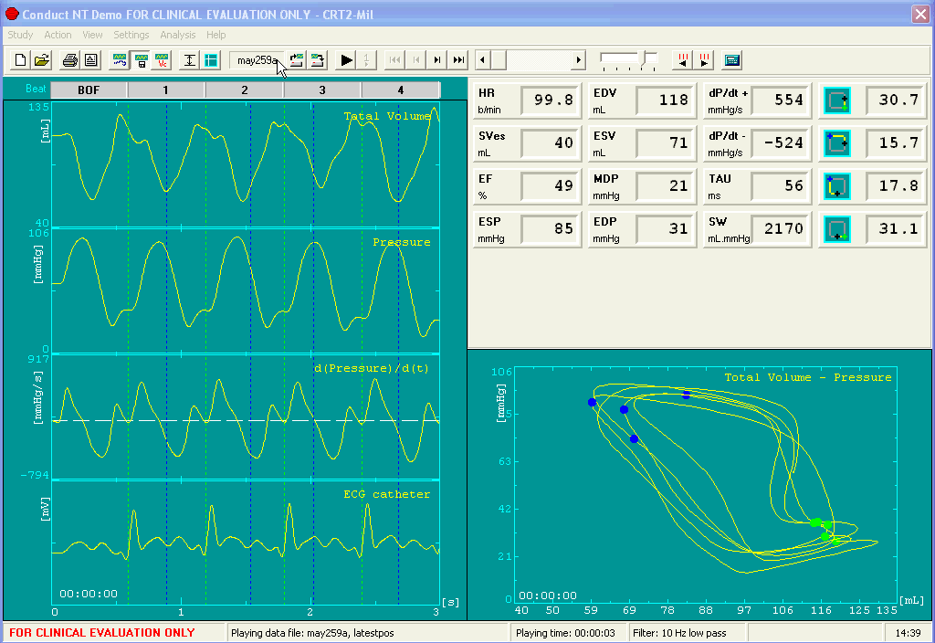
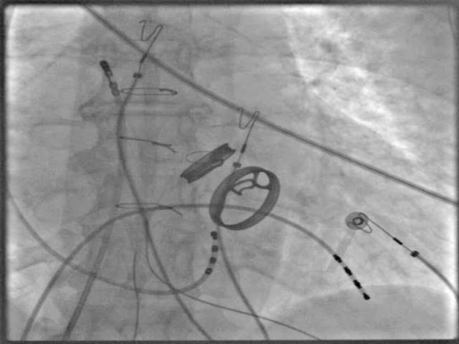
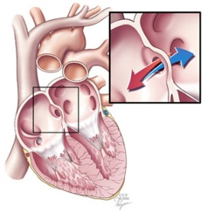
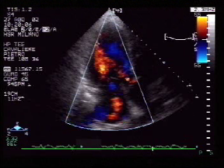
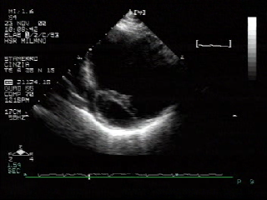
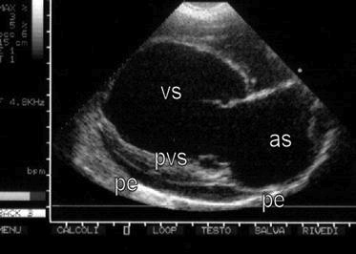
AF & THE HEART
LAA THROMBUS
AMILODOSYS
MITRAL REGURGITATION
HYPERTROPHIC CARDIOMYOPATHY
DIASTOLIC HF
VALVE PROTHESES
ATRIAL DEFECT
ISCHEMIC DISEASE
DILATED CARDIOMYOPATHY
CONGENITAL HEART DISEASE

Slide 17
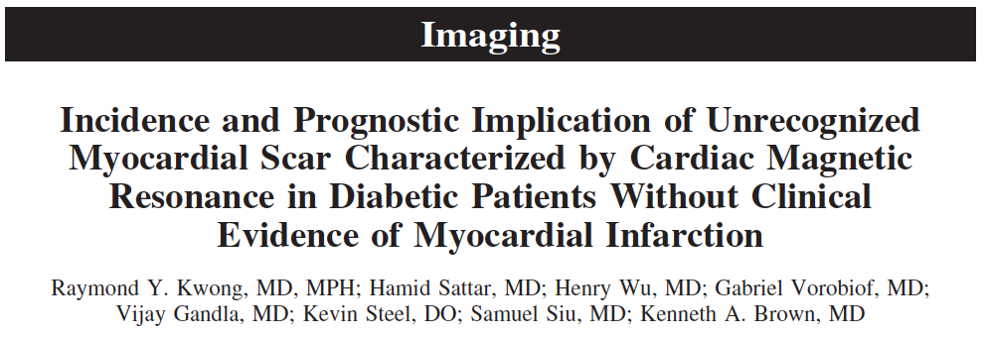
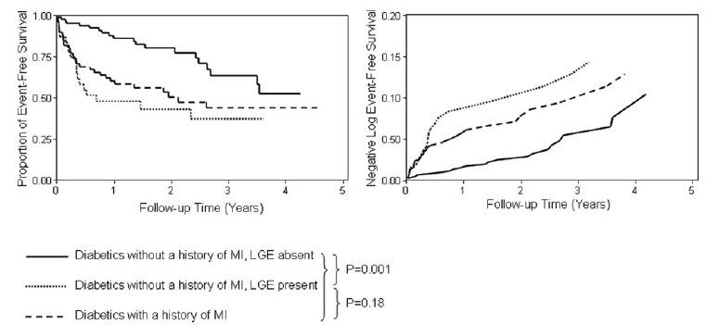
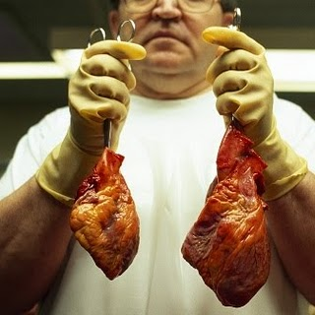
DIABETES MELLITUS
  Fibrosis promotion by CAD
  Fibrosis promotion by systolic and diastolic HF
  Direct LA fibrosis by microvascular dysfucntion
  Direct LA fibrosis by RAAS activation
Circulation 2007

Slide 18
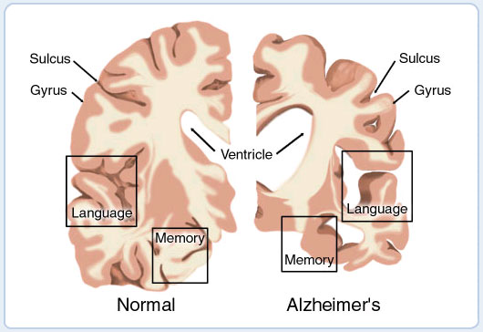
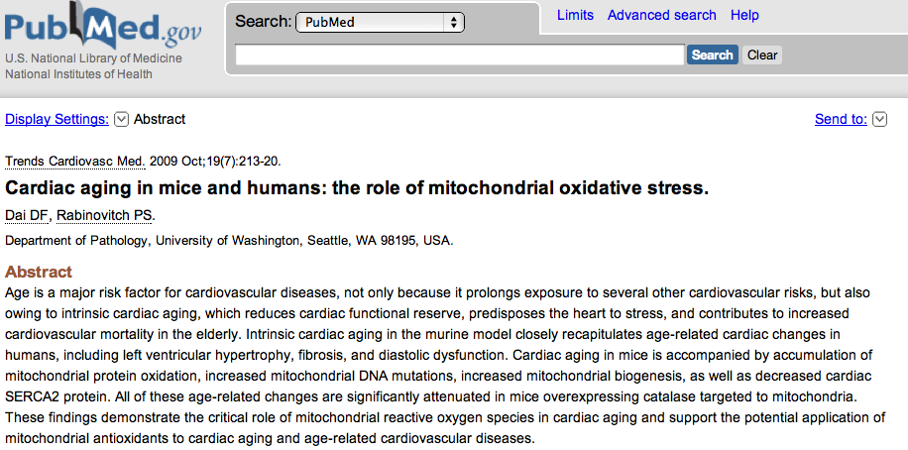
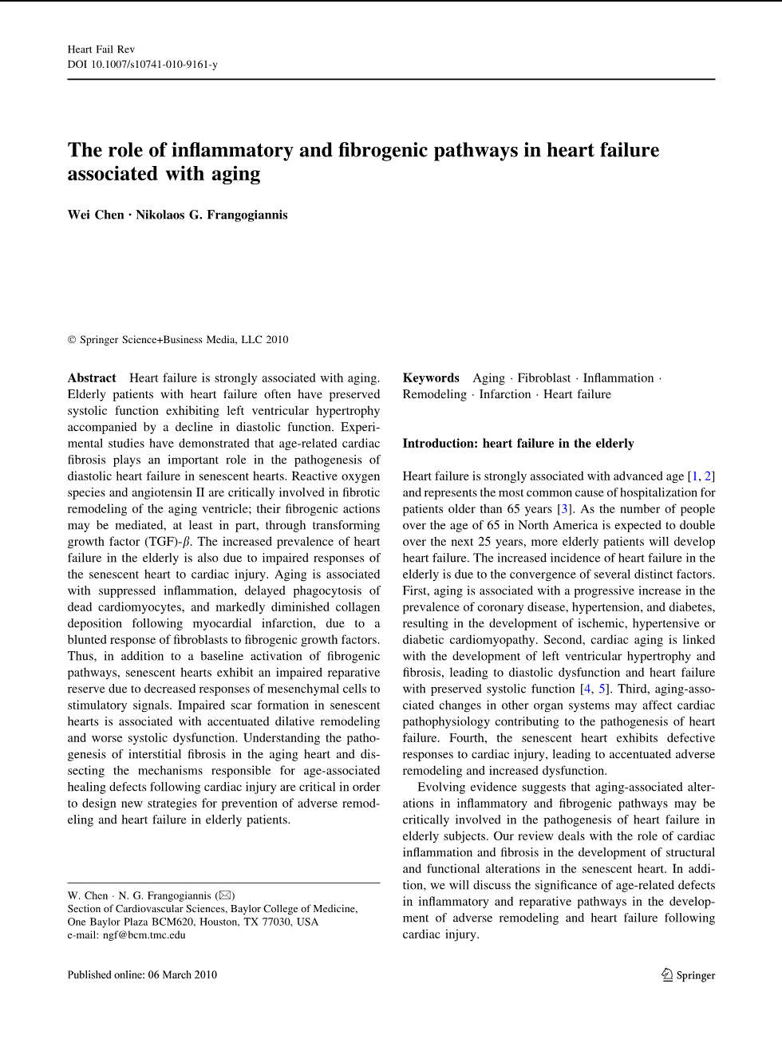
AGE
  Fibrosis promotion by programmed cellular apoptosis
  Fibrosis promotion by oxidative stress
  Direct LA fibrosis by RAAS activation
  Comorbidities

Slide 19
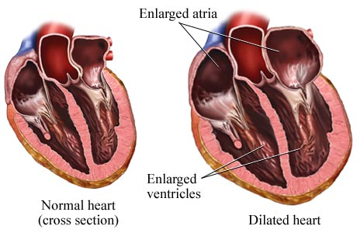
CAD/CMD/SYSTOLIC HF
  Fibrosis promotion by increased atrial wall stress
  Fibrosis promotion by inflammatory damage to the LA
  Direct LA fibrosis by RAAS activation
  Associated MR

Slide 20
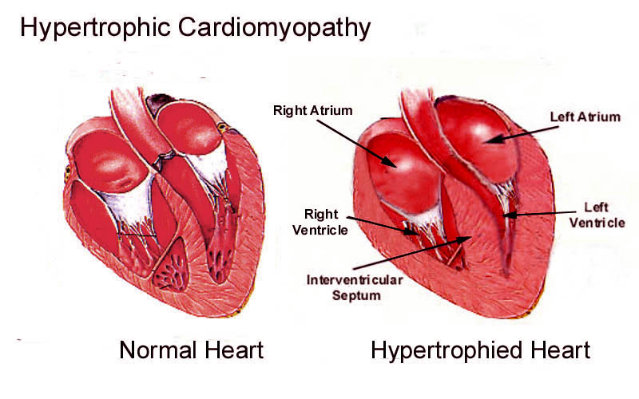
DIASTOLIC HEART FAILURE
  Fibrosis promotion by increased atrial wall stress
  Fibrosis promotion by ANP accumulation
  Direct LA fibrosis by RAAS activation
  Associated LA fiber dysfunction (HCM)

Slide 21
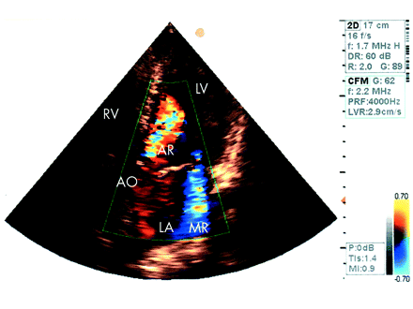
+++/++ MR (NOT FUNCTIONAL)
  Fibrosis promotion by increased atrial wall stress
  Fibrosis promotion by ANP accumulation
  Direct LA fibrosis by RAAS activation
  ++++ MR require surgery

Slide 22
WHY ARE THEY IMPORTANT?
  All these comorbidites may lead to DISEASE PROGRESSION
    Left atrial muscle streching
    Oversynthesis of ANP leading tissue deposit
    Extensive cellular loss
    Extensive fibrosis

Slide 23
Suggestion for Anatomical AF
(extensive fibrosis at the MRI)
A few patients
Endpoints:
  Reduction of tachycardiomyopathy
  Improved QoL
  No need for OAT
  No risk for stroke
  No risk for major emorrhagies

Slide 24
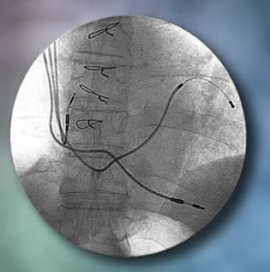
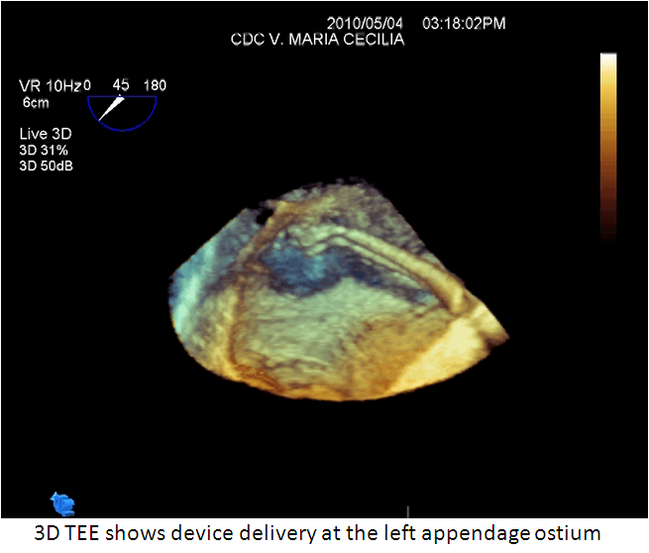
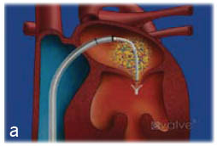
Suggestion for Anatomical AF
AV node ablation
CRT-ICD implant
LAA closure
Percutaneous mitral clip
CRT
LAA PLUG
MV CLIP

Slide 25
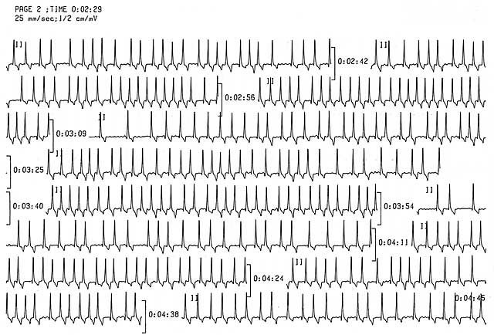
ANATOMICAL AF: tipical patient
(CRT, AV node ablation & LAA Plug)
Age > 75 with diabetes
Permanent AF with difficult rate control
Dilated LA with MR
CMD (EF < 30%) & Prior TIA

Slide 26
ANATOMICAL AF: ex of the best dangerous pt
Age > 75 with CAD
Already PKR
Previous TIA
Severe LA dilation
Long-lasting AF
LAA closure
AV node ablation

Slide 27
ANATOMICAL AF
A FURTHER EXAMPLE
Age < 65
Normal EF
Multiple LA ablation session
Previous or not TIA
Severe LA dilation
Long-lasting AF (MRI shows extensive fibrosis)
CRT implant (PM)
LAA closure
AV node ablation

Slide 28
ANATOMICAL AF
A FURTHER EXAMPLE
Age whichever
Normal EF
Successful ablation
AF recurrence 10 y after
Absence of electrical activity in the LA
LAA closure

Slide 29
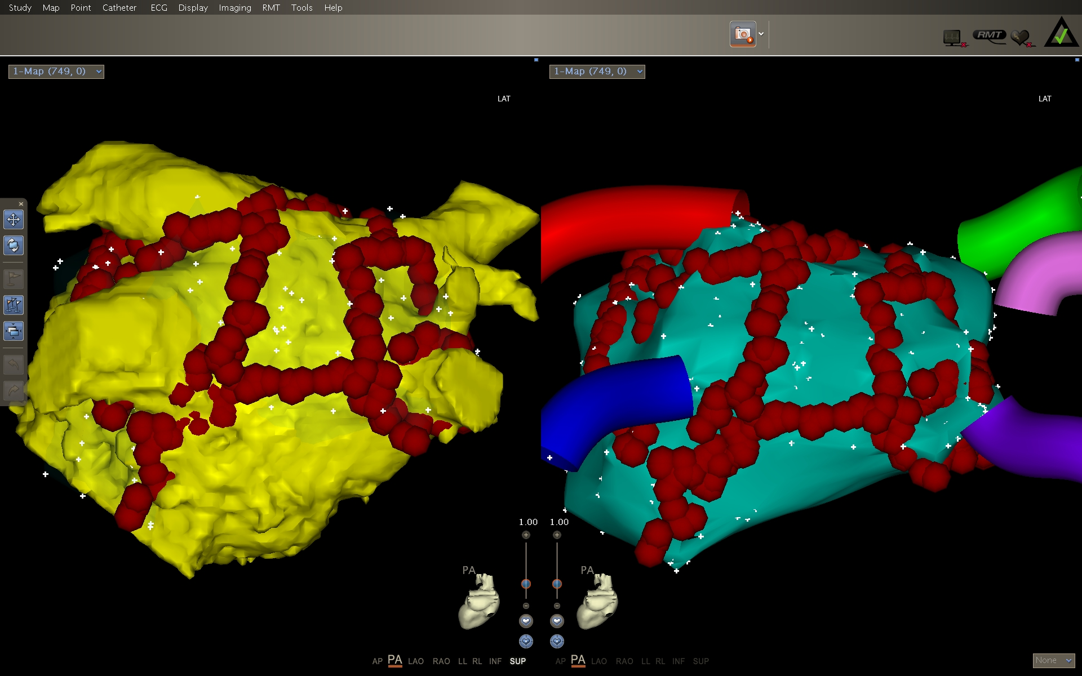
ELECTRICAL MIXED AF SUGGESTIONS
CPVA with or without AAD (amiodarone often)
Further endpoints:
  Restoration of atrial kick
  No dependence on battery/lead issues

Slide 30
ELETTRICAL AF: ex of the best pt
Age < 50
Normal EF
Never ablation
Previous or not TIA
Moderate LA dilation
Long-lasting AF (MRI shows surviving tissue)
AF ablation

Slide 31
ELECTRICAL AF
Age whichever
EF > 40%
Never ablation
Previous or not TIA
Mild/moderate LA dilation
Long-lasting AF (MRI shows surviving tissue)
CPVA

Slide 32
A FUTURE VIEW?
Chronic AF is a systemic disease
Progression to anatomical AF is mainly due to fibrosis
The comorbidities start/enhance the fibrogenesis/cellular apoptosis

Slide 33
A FUTURE VIEW?
Modern MRI identify LA fibrosis and muscular damage
Indication to ablation should be based not on the response to ECV, but on
CLINICAL ENVIRONMENT OF THE “AF DISEASE”

Slide 34
A FUTURE VIEW?
In the earliest phases, ablation of chronic AF can stop/delay progression
In patients with anatomical disease and comorbidities, treatment of underlying disease, BIV-pacing and LAA closure are the main endpoints: ↑QoL
↑ hemodynamic
↓mordibity (including stroke)

