Slide 1
PULMONARY VEINS’ OSTIAL DECONNECTION THROUGH ELECTROPHYSIOLOGIC APPROACH WITH LASSO CATHETER IN ATRIAL FIBRILLATION: two years’ experiences

Slide 2
ATRIAL FIBRILLATION
About 0,4 % of general adult population, incidence grows up exponentially with age ( 2.4% >60 , 5-10% > 70 )
Most frequent cause of stroke in aged pt.
in 15% of cases there is not any organic cardiopathy or metabolic desease related to
C. D’Ascia
Unita’ Operativa ‘ARITMOLOGIA’ Università di Napoli Federico II

Slide 3
BACKGROUND: Why so much retard on the therapy of AF?
Negative factors :
Slight knowledge about this arrhythmia and their electrogenic pathway
Method and operator technical difficulties
Studies concerning the same method of radio-frequency
ablation are discording about results and success
It is extremely difficult to represent so many different classes of patiens in medium studies
C. D’Ascia
Unita’ Operativa ‘ARITMOLOGIA’ Università di Napoli Federico II

Slide 4
ATRIAL FIBRILLATION
TRADITIONAL THERAPEUTIC AIMS
To convert in Sinusal rhythm patients with paroximal forms of recent onset
To preserve Sinusal rythm and prevent recurrents
To Control ventricular rate
To Prevent thrombotic events
CURRENT THERAPEUTIC AIMS
To obtein the Sinusal rhythm with an electrogenethyc approach of the AF
To find best techniques to ablate triggers and\or to modify both the substrate and\or the vagal-simpathetyc system
To prevent thrombotic events (of course !!!)

Slide 5
POURPOSES
To Verify therapeutic effectiveness and safety of pulmonary veins Ostium Segmental Deconnection (OSD) with Lasso mapping system and radio-frequency ablation with Thermo-cool catheter
To Verify how many veins’ ostia must be ablated to obtain the best clinical result (to deconnect only the ostia of pulmonary veins where are initiating AF foci (firings)
To verify if the partial ablation (OSD) of PV increase the number of recurrings and, conseguently,the n. of procedures

Slide 6
POPULATION
28 patients (13 F, 15 M) ; Medium age 52 (36-68)
6 pt with Persistent A F (1 to2 symptomatic episodes in the last 6 months)
22 pt with Paroximal A F (1 to3 simptomatic events in the lats 6 months)
Unresponsiveness to antiarrhytmic drugs alone or in association (70% class IC, 20% class III, 10% other,50% class1C+class II or IV)
15 pt with normal atrial diameters/13 pt with left atrium dilatation
Associated Pathologies
8 pt (28,6)% with light or mild mytral regurgitation
12 pt (42,8%) light or mild hypertension
5 pt (17,8%) ischemic-hypertensive pathologies
3 pt (10,71)% pt no associated organic pathologies
Electrophysiologic Study
28 pt (100%) pt with atrial fibrillation inducibility during EPS
8 pt (28,6)% no focal source of induced AF
Previous Procedures
6 pt (21,5%) were ablated with linear approach on right side

Slide 7
MATERIALS
Tetra-polar right ventricular catheter
Josephson Daig Tetra- or deca-polar catheter for Coronary Sinus (CS); (1 steerable octo-polar catheter in case of emergency)
Biosense Webster Celsius Thermo-cool ablator catheter 7 F (3,5 mm) D curve
( Power limit of 25 to 30 W,for 30-60 seconds ; irrigated with 17 ml/min saline flow )
Lasso mapping circumferential catheter, deca o duodeca-polar,7 F
Preface Multipourpose 8,5 F, trans-septal catheterization
adult BRK
0,32-260 Guide
Pigtail catheter 6 F
2 Terumo connected pumps
C. D’Ascia Università di Napoli Federico II

Slide 8
METHODS
Continuous vital parameters’ monitoring
Eparin 2500 U when catheters are in left atryum and 1000 U every hour ( ACT desireable values: 300-400)
Pump Infusion: 400 ml/h during ablation, 50 ml/h during mapping
Selective PV angiography was performed by hand(5-10 ml of contrast)
RF-Energy delivered :Power limit of 25 to 30 W,for 30-60 seconds
RF-Application in the ostial sector of the earliest activation ,with tip contact distance of about 15-20 mm of PV ostium)
Anti-aggregant therapy for three monts following the ablation procedure
C. D’Ascia Università di Napoli Federico II

Slide 9
The introductor for transeptal puncture must be parallel to the coronary sinus cat. in RAO
ANATOMIC REFERENCES FOR TRANSEPTAL PUNCTURE
RAO
PIGTAIL cat. Positioning on Aortic Root
HIS cat. Positioning on upper-frontside of Aortic Root (parallel to septum)
Coronary Sinus cat. Positioning on lower-backside perpendicular to the septum (marks the valvular plan)
L. De Vito, V. Liguori e C. D’Ascia Università di Napoli Federico II

Slide 10
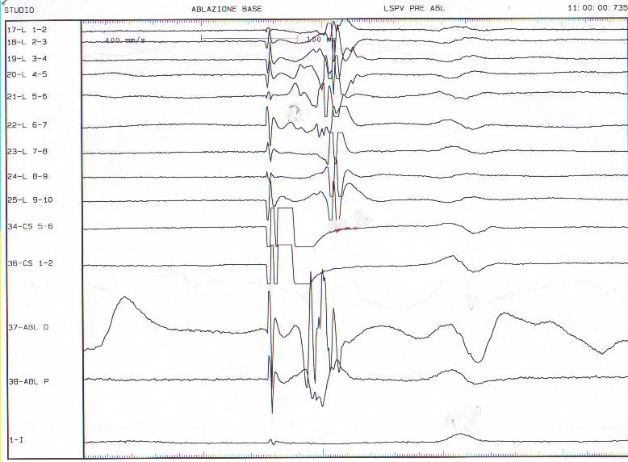
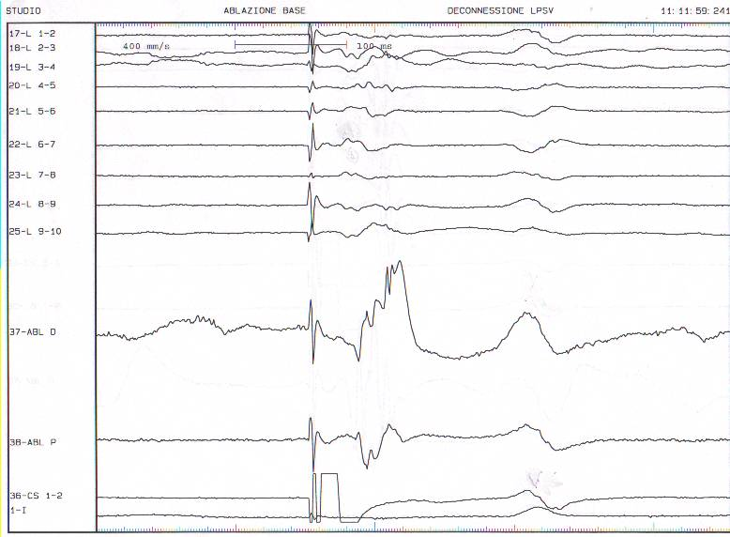
Clinical case n 1
LEFT SUPERIOR PULMONARY VEIN ABLATION
A
A
VE
V
V
Pacing CS 5-6
L. De Vito, V. Liguori e C. D’Ascia
Università di Napoli Federico II

Slide 11
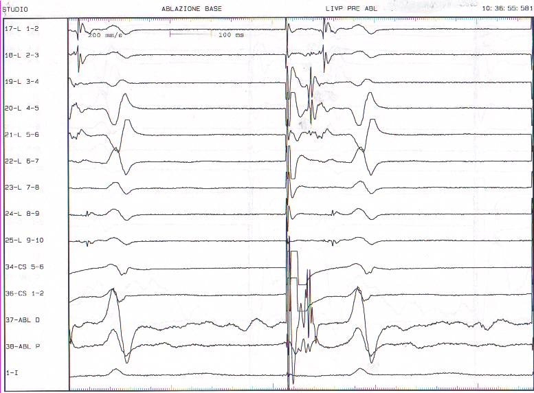
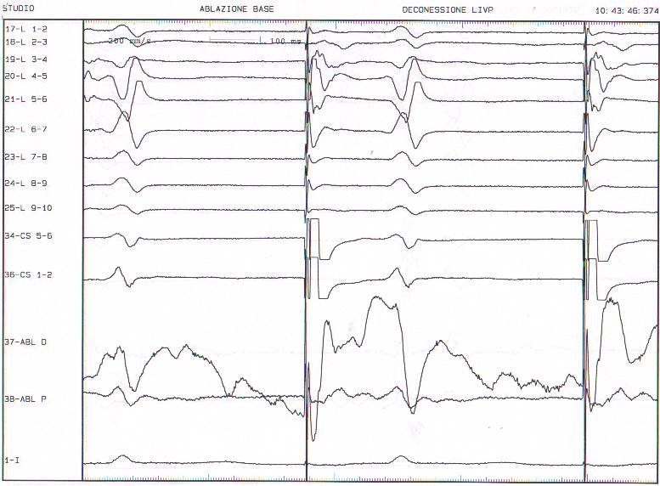
Clinical case n 1
LEFT INFERIOR PULMONARY VEIN ABLATION
A
VE
A
A
V
V
Pacing CS 5-6
L. De Vito, V. Liguori e C. D’Ascia
Università di Napoli Federico II

Slide 12
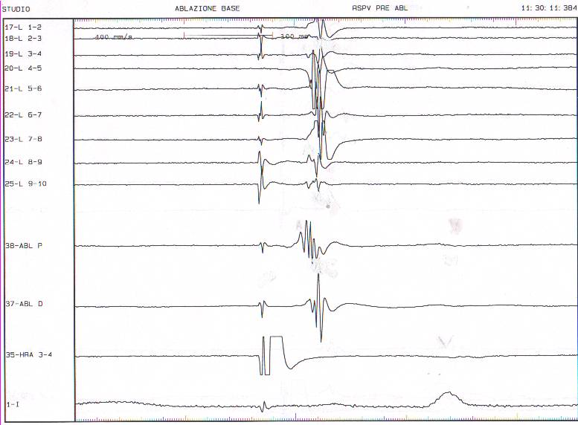
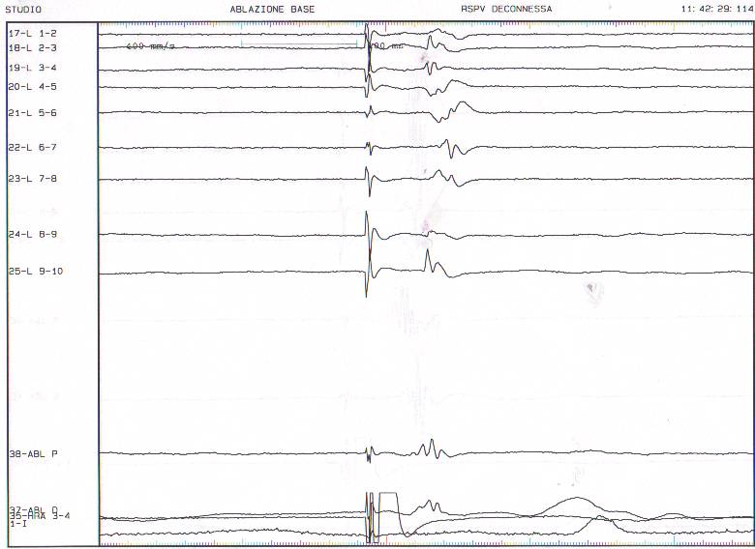
Clinical Case n 1
RIGHT SUPERIOR PULMONARY VEIN
A
VE
A
A
VE
A
V
V
Pacing HRA 3-4
L. De Vito, V. Liguori e C. D’Ascia Università di Napoli Federico II

Slide 13
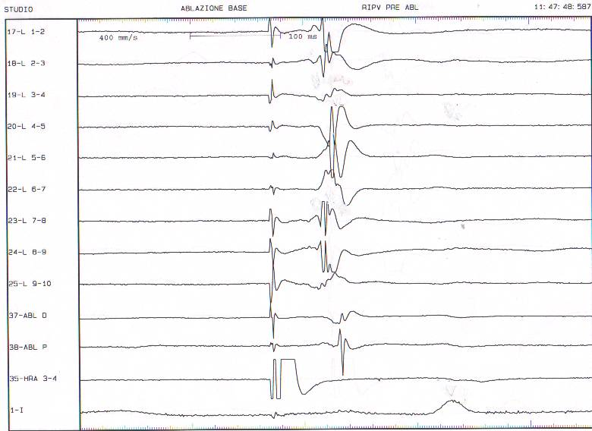
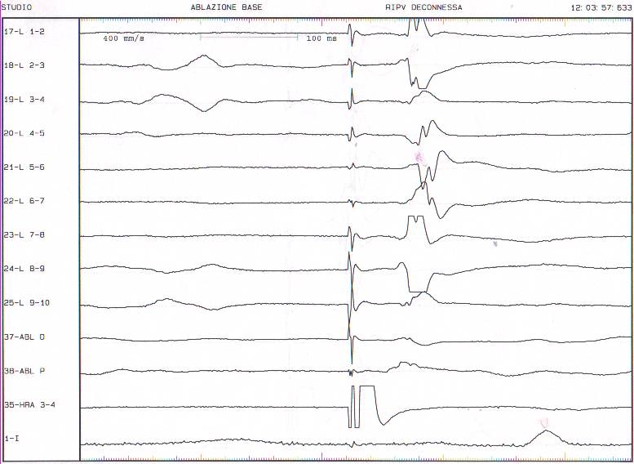
Caso clinico I
A
A
VE
VE
A
A
VE
A
A
V
V
Pacing HRA 3-4
L. De Vito, V. Liguori e C. D’Ascia Università di Napoli Federico II

Slide 14
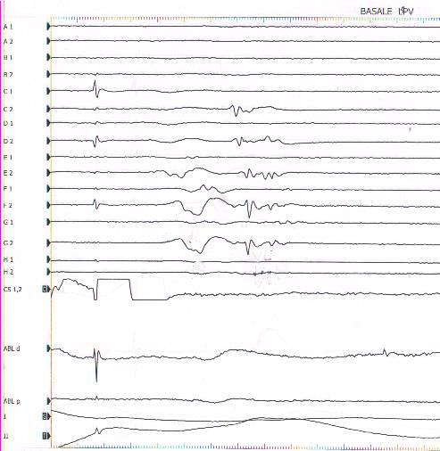
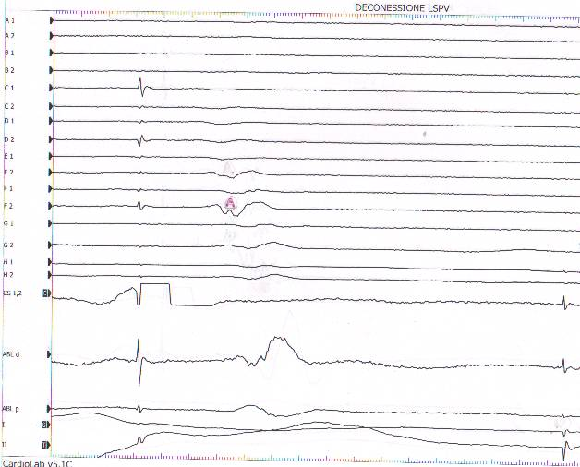
Clinical case n 3
LEFT SUPERIOR PULMONARY VEIN ABLATION
A
A
VE
V
Pacing CS 5-6

Slide 15
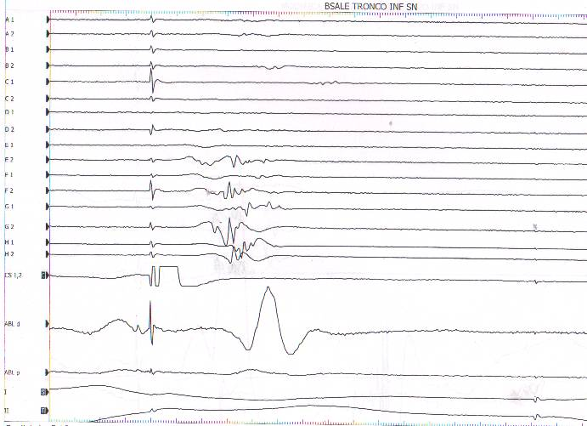
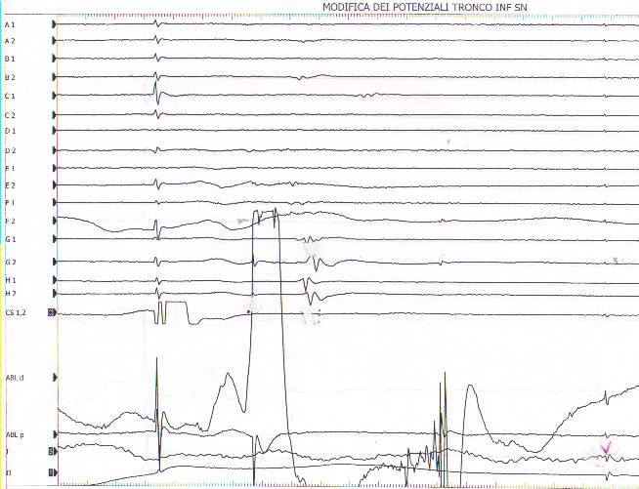
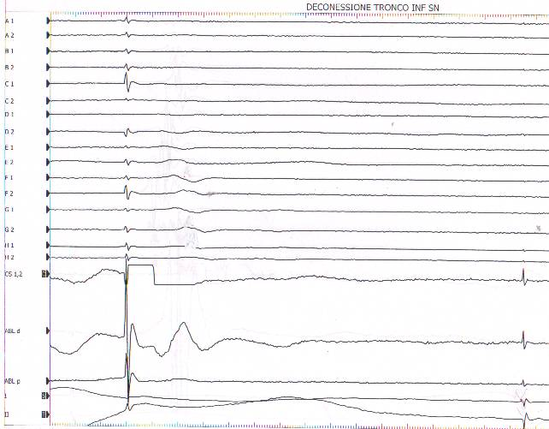
Caso clinico III
Modulazione
A
A
A
VE
VE
V
V
V
V
V
L. De Vito, V. Liguori e C. D’Ascia Università di Napoli Federico II
Pacing SC 5-6

Slide 16
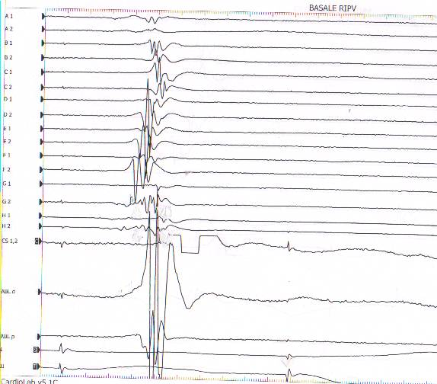
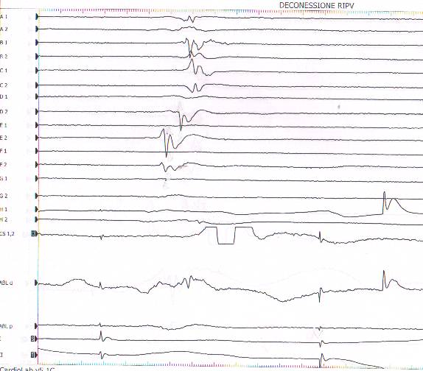
Caso clinico III
VE
A
A
V
V
Pacing HRA 3-4
L. De Vito, V. Liguori e C. D’Ascia Università di Napoli Federico II

Slide 17
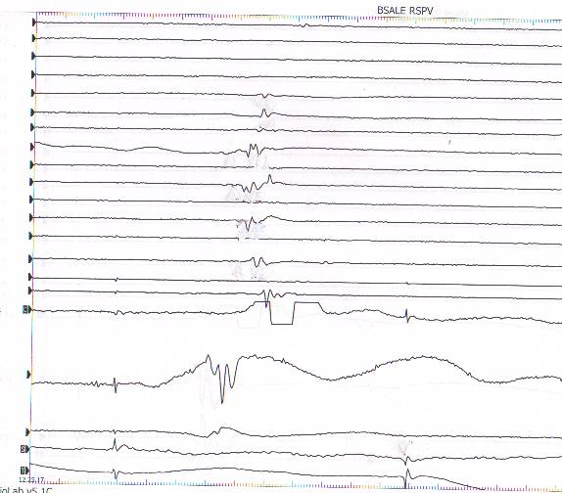
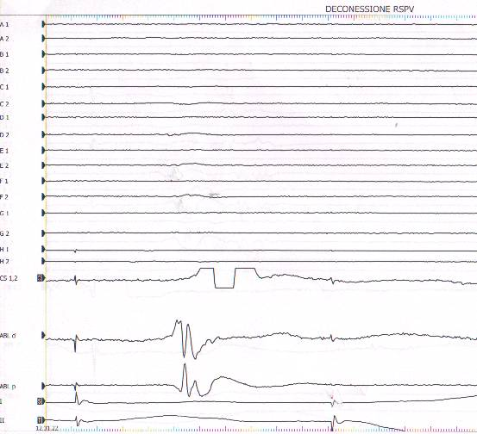
Caso clinico III
A
VE
A
V
V
V
Pacing HRA 3-4
L. De Vito, V. Liguori e C. D’Ascia Università di Napoli Federico II

Slide 18
The choise of the number of pulmonary ostia to be treated was due to the presence/absence of PV foci . (in 2 of the red cases we were forced to work only on two veins by technical difficulties in ostium ablation).
RESULTS at 18 months: Sintesys
72,8%
77,8% 62,5%
37,4% 50%
22,3%
27,3% 37,5%
22,3%
28=100%
10=35,8%
20=71,4%
8=2,9%

Slide 19
RESULTS
No immediate complications except 1 case of ischemic ecg
with CPK-MB elevation
In middle-term follow-up (18 months) 10 pt.(35%) had a recurring and a 2th ablation
8 Pt(28%) were un-successfully re-ablated
2 Pt(7%) were successfully re-ablated
8 Pt(28%) presented AF permanently
1 Pt(3.5%) presented persistent AF during the first week, then controlled with AAD only
LIMITS
Small number of patients with non-omogeneus pathologyes
Small FU period
L. De Vito, V. Liguori ,SLD’Ascia e C. D’Ascia
Università di Napoli ,’Federico II’

Slide 20
CONCLUSIONS
Our study confirms the success of the OSD (71.5 %)
Not observed heavy complications as embolism, stroke, perforations and effusions
BUT
about 1/3 of pt (35,7%) needs to remake the procedure
FINALLY
28.5% of the pt present AF, at FU of 18 months, and needs to continue AAD therapy for rate control or to remake another ablation procedure
LIMITS
The only partial success of adjunctive procedure of alone OSD indicate, in our pt, the need to employ others RF-approach like atrium linear ablation or vagal modulation

Slide 21
CONCLUSIONS
Pulmonary veins’ ostium segmental ablation with RF can treat AF, yet some patients need the new procedure too. Moreover, about 1/3 of those pt still keep AF after the OSD, and have to be treated with AAD.
The only partial success of adjunctive procedure of OSD indicate in those pt the need to do others RF-approach like atrium linear ablation or vagal modulation

