Slide 1
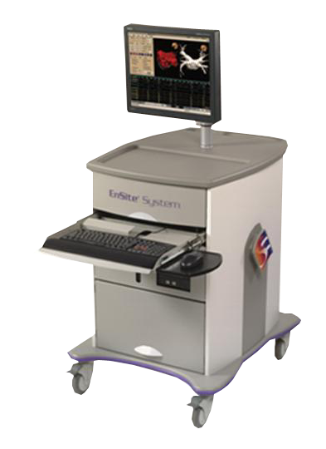
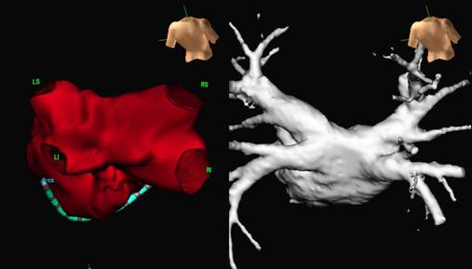
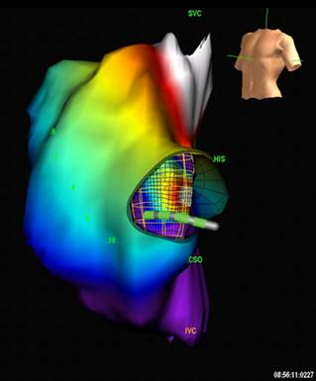
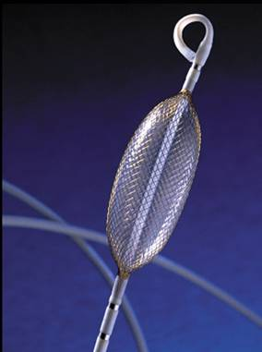
Il Sistema EnSite™
Basato sull’Anatomia EnSite NavX™
Basato sull’Attivazione
EnSite Array™
Notes:
Our product, the EnSite System, consists of hardware, including the Next Generation Display Workstation, the breakout book, a patient interface unit along with disposable products, including the EnSite NavX surface electrode kit and the EnSite Array multielectrode catheter. I’ll tell you a bit more about each of these in a moment.

Slide 2
Proprieta’ del Sistema NavX™
Navigazione 3D e mappaggio
Visualizzazione di qualsiasi catetere, di qualsiasi forma, in qualsiasi camera
Visualizzazione simultanea di:
64 elettrodi di 12 cateteri
20 elettrodi di 1 singolo catetere
Notes:
In addition to EnSite NavX for AF, the EnSite Array catheter helps diagnose and guide therapy in those patients where the anatomic approach is not appropriate. With both EnSite Array and EnSite NavX, the Ensite System facilitates any approach to AF.

Slide 3
EnSite NavX™ - Metodologia
Basato sulla Superficie
Un segnale elettrico di 5.6 kHz viene emesso dalle 3 coppie degli elettrodi di superficie (Patch)
Ogni elettrodo del catetere viene localizzato 93 volte al secondo
Notes:
Electrical fields between patch pairs on X, Y, and Z axis locate EP catheter electrodes.
An electrical signal is transmitted between the patches; catheters sense the signals to compute their location within the heart. The physician then sweeps a catheter across the heart chamber to outline the structures and generate a 3-D computer model of the heart.
Surface-based
Posizionare 6 elettrodi superficiali
Permette la creazione dell’anatomia e la navigazione di qualsiasi tipi di catetere
Un segnale elettrico di 5.6 kHz viene mandato attraverso 3 coppie di patches
La posizione degli elettrodi sono mostrati in uno spazio 3D

Slide 4
Creazione della Geometria
Rapida ricostruzione dell’anatomia del paziente
Collezione di punti 3D utilizzando fino a 20 elettrodi contemporaneamente (modo continuo)
Possibilta’ di raccolta punto punto

Slide 5
Creazione della Geometria modo continuo – high detail
Notes:
AVI movie
Here’s a quick illustration to show you how the chamber maps are built. At the start of an EnSite procedure, the catheter is inserted in the chamber and validated by the system.
(click on map image)
As a catheter is moved within the chamber, the system records three-dimensional points. The operator can also give certain points special emphasis (indicated by white squares)—these are called locked points, to help define key areas of the anatomy, such as the isthmus or crista. As seen in the published literature, chamber maps or geometries can be built in as little as five minutes. Thereafter, there is no need for fluoroscopy, since the system provides superior orientation to fluoroscopy through the 3D model and superior catheter orientation through the 3D catheter display.
When the geometry is finished, event data can then be recorded.

Slide 6
Creazione della Geometria modo continuo – high detail
Mangrum, et al; UVA; Charlottesville, VA USA
Notes:
AVI movie
Here’s a quick illustration to show you how the chamber maps are built. At the start of an EnSite procedure, the catheter is inserted in the chamber and validated by the system.
(click on map image)
As a catheter is moved within the chamber, the system records three-dimensional points. The operator can also give certain points special emphasis (indicated by white squares)—these are called locked points, to help define key areas of the anatomy, such as the isthmus or crista. As seen in the published literature, chamber maps or geometries can be built in as little as five minutes. Thereafter, there is no need for fluoroscopy, since the system provides superior orientation to fluoroscopy through the 3D model and superior catheter orientation through the 3D catheter display.
When the geometry is finished, event data can then be recorded.

Slide 7
Creazione della Geometria Punto a Punto
Point-by-Point
Medium-Low
Pappone; HSR Milano
Notes:
AVI movie
Here’s a quick illustration to show you how the chamber maps are built. At the start of an EnSite procedure, the catheter is inserted in the chamber and validated by the system.
(click on map image)
As a catheter is moved within the chamber, the system records three-dimensional points. The operator can also give certain points special emphasis (indicated by white squares)—these are called locked points, to help define key areas of the anatomy, such as the isthmus or crista. As seen in the published literature, chamber maps or geometries can be built in as little as five minutes. Thereafter, there is no need for fluoroscopy, since the system provides superior orientation to fluoroscopy through the 3D model and superior catheter orientation through the 3D catheter display.
When the geometry is finished, event data can then be recorded.

Slide 9
Erogazione di RF (Terapia)
Navigazione durante l’ablazione
Compatibile con crioablazione
Indicatore di prossimita'
Marker delle lesioni
Il calibro del voltaggio mostra gli effetti dell’ablazione di RF
Notes:
EnSite NavX has many useful tools that provide important information during therapy delivery.

Slide 10
EnSite System per l’AF

Slide 11
Navigazione in tempo reale

Slide 12
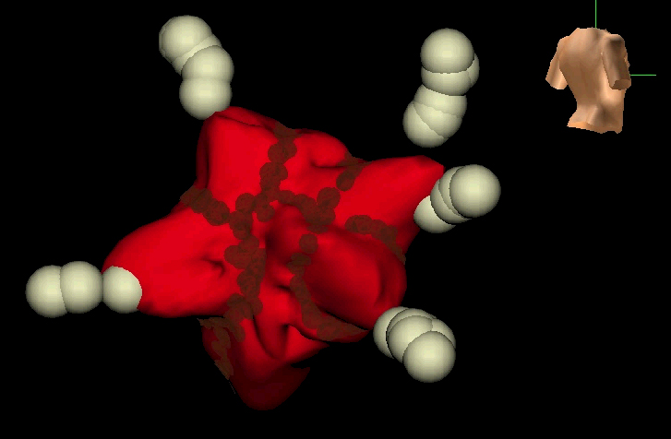
Supporti per diversi approcci nell’ablazione della FA (Atrio Sinistro)
Ablazione Lineare (approccio “anatomico”)
Ablazione Segmentale (approccio “elettrofisiologico”)
Notes:
The EnSite System will support you in accurately performing ablation procedures—no matter which therapy approach you take.

Slide 13
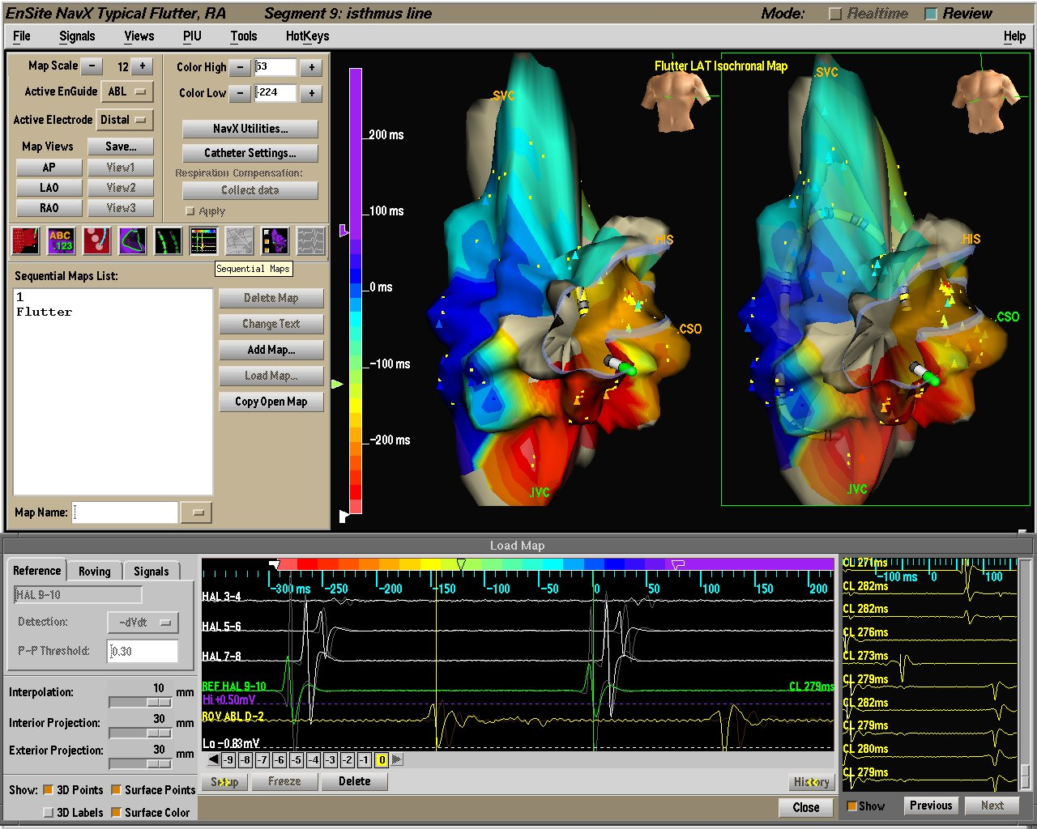
Mappaggio Sequenziale Principi di Funzionamento
Registrazione e visualizzazione sulla geometria dei tempi di attivazione e dei voltaggi utilizzando i cateteri standard
Notes:
Create a geometry (usually, but not required).
Set detection parameters.
Mark activation times or voltages on the nearest geometry surface.
Use any EP signal. Signals are used to confirm morphology in a stable rhythm.
Interior projection—projects the information collected to the nearest surface.
Defaults—15 mm interior/5mm exterior.

Slide 14
Mappa di Attivazione – Ritmo Sinusale
Notes:
Our Sequential Contact Activation and Voltage Mapping feature will provide more information about electrical activity, including areas of low conduction and low voltage. It will assist you in validating the success of ablation procedures and more quickly and accurately diagnose and treat arrhythmias.
Map types:
Isochronal
P-P voltage
P-Negative voltage

Slide 15
Mappa Voltaggio Pre-Ablazione
Pre Ablation Map PP
Courtesy of Dr C.Pappone

Slide 16
Mappa Voltaggio Post-Ablazione
Courtesy of Dr C.Pappone

Slide 17
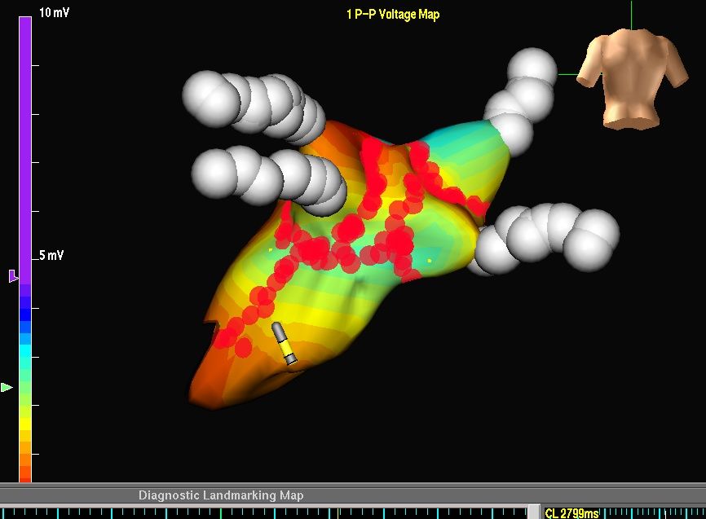
Mappa Voltaggio Pre e Post-Ablazione
Courtesy of Dr C.Pappone

Slide 18
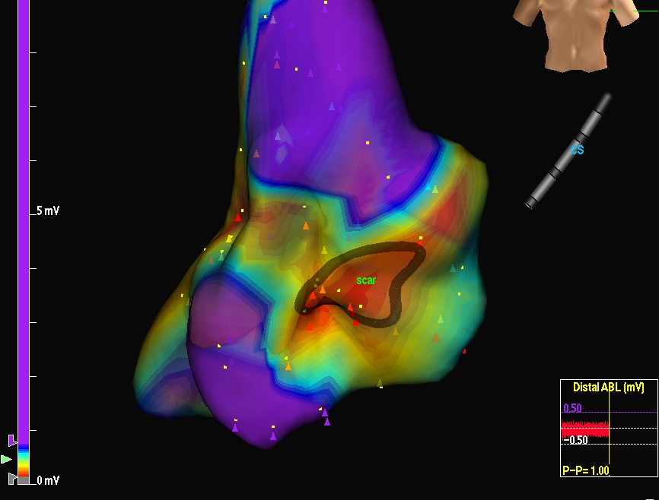
Mappa Voltaggio Pre-Ablazione (SCAR)

Slide 19
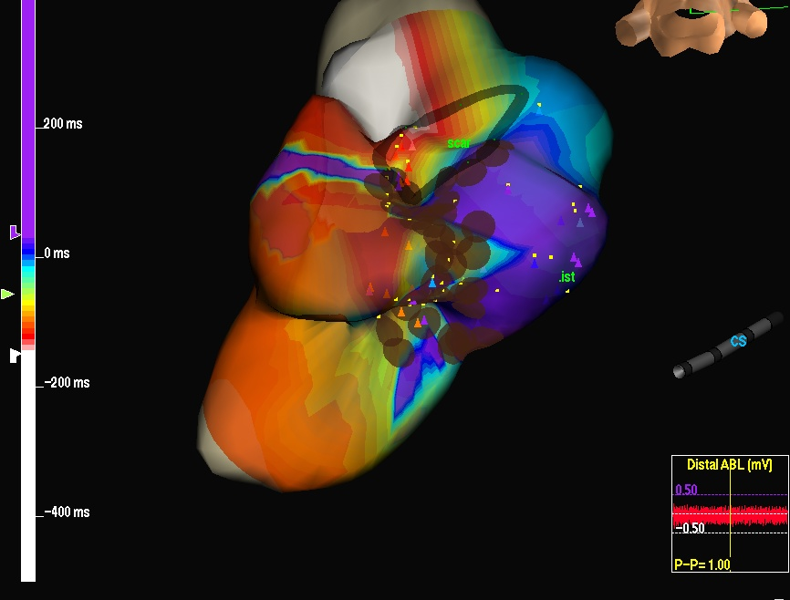
Mappa Attivazione Post-Ablazione
Identificazione GAP

Slide 20
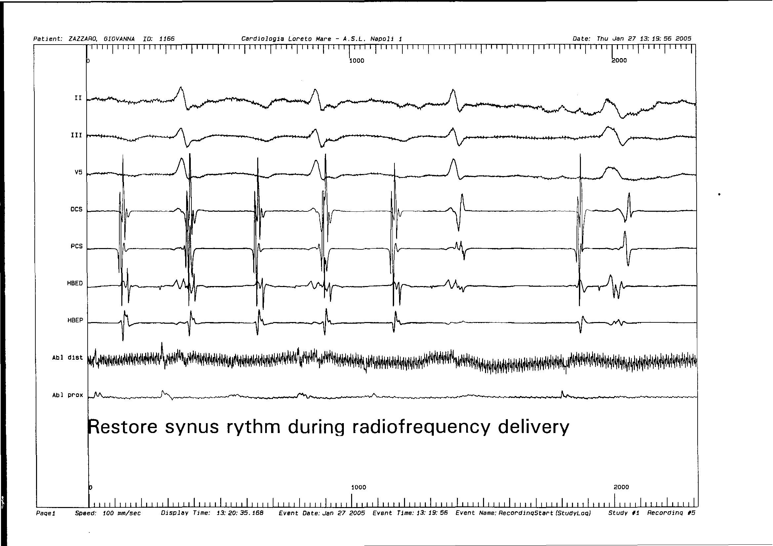
Interruzione della Tachicardia
Erogazione nella zona di GAP

Slide 21
Il Sistema EnSite™
Basato sull’Anatomia EnSite NavX™
Basato sull’Attivazione
EnSite Array™
Notes:
Our product, the EnSite System, consists of hardware, including the Next Generation Display Workstation, the breakout book, a patient interface unit along with disposable products, including the EnSite NavX surface electrode kit and the EnSite Array multielectrode catheter. I’ll tell you a bit more about each of these in a moment.

Slide 22
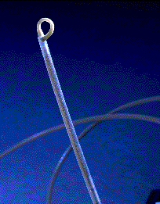
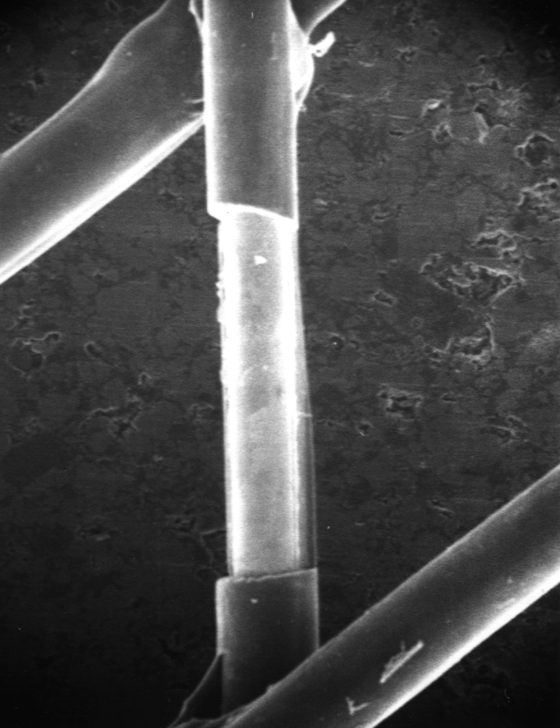
EnSite ArrayTM
64 microelettrodi su un array di 1.8 x 4.5 cm, 7,5 ml
9 French, lunghezza 110 cm
Notes:
The EnSite Array catheter is precisely manufactured and is unlike any other on the market.

Slide 23
EnGuide™ Algoritmo di posizionamento
E1 & E2 alternati
@ 100 volte al sec
(Distance)
1. Il sistema manda un segnale alla frequenza di 5kHz tramite il catetere mappante 200 volte al secondo
2. Gli elettrodi (E1 & E2) sul Catetere EnSite® alternativamente ricevono e rimandano il segnale di 5kHz al sistema
3. I 64 elettrodi sull’array ricevono il segnale di 5 kHz e tramite un processo simile alla triangolazione sono capaci di localizzare con precisione il catetere mappante 100 volte al secondo.
4. L’ output di questo processo e’ il display 3-Dimensionale degli elettrodi del catetere mappante.

Slide 24
Proprieta’ del catetere Array™
Creazione di mappe isopotenziali dinamiche per aritmie sul singolo battito
Localizzazione automatica del focus di aritmie focali
Conferma di linee di blocco o localizzazione gap
Identificazione dei circuiti delle aritmie complesse
Navigazione fino a quattro elettrodi dei cateteri EP

Slide 25
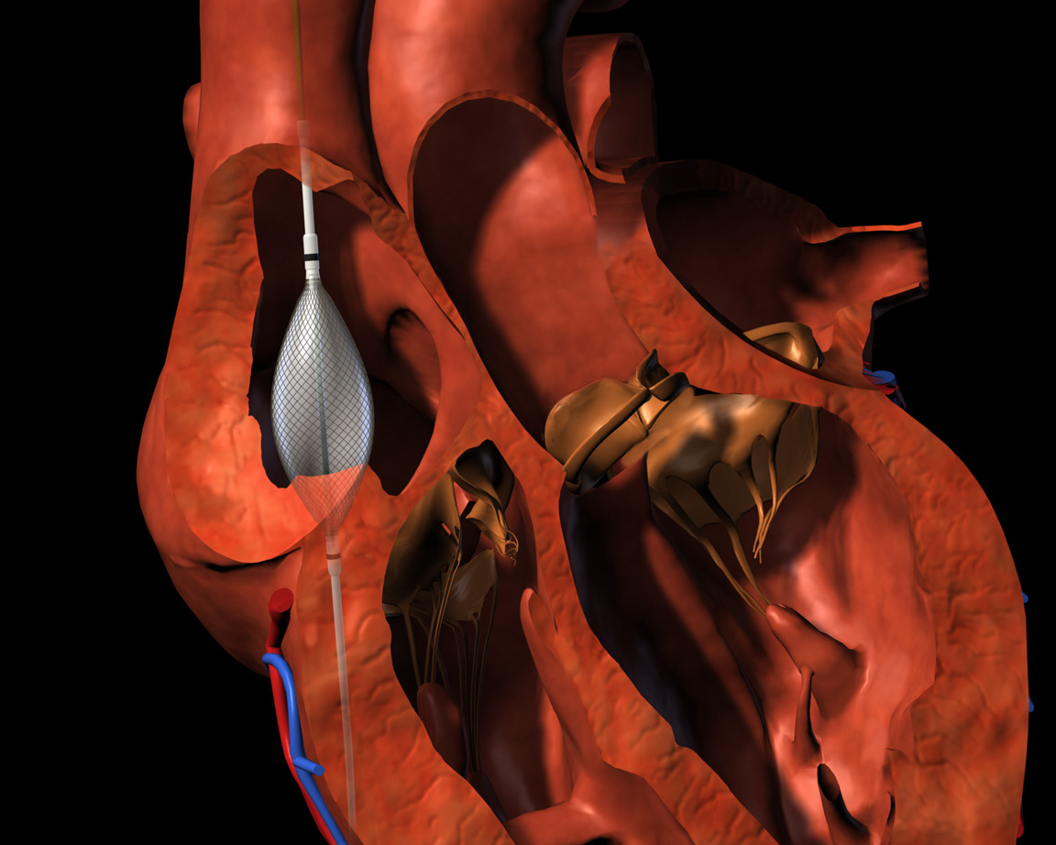
EnSite Array Creazione della Geometria
Notes:
At the start of an EnSite procedure, the EnSite Array catheter is inserted in the chamber and validated by the system. As the catheter is moved within the chamber, the system records three-dimensional points. The operator can also give certain points special emphasis (indicated by the white squares)—these are called locked points, to help define key areas of the anatomy, such as the isthmus or crista.
Chamber geometries can be built in as little as five minutes. Thereafter, there is no need for fluoroscopy, since the system provides superior catheter orientation through the 3D display.

Slide 26
Diagnosi
Guida
Conferma
Il sistema calcola più 3000 elettrogrammi unipolari ogni msec
I segnali unipolari sono utilizzati per definire l’origine dell’aritmia o per valutare le caratteristiche del tessuto (scar/rientro)
Notes:
The EnSite System supports the basic requirements behind any successful ablation. Noncontact mapping simplifies and enables all three components of the ablation procedure.
In the first movie, you can see how noncontact mapping accurately replicates details of the patient’s anatomy, such as the CS, isthmus, IVC, and tricuspid valve. In this atrial flutter example, you can see the full circuit, with activation tracking through the isthmus.
In the second movie, you can see you the EnSite System’s 3D cathether display will allow you to accurately navigate one or two catheters in three dimensions.
Finally, to confirm any ablation strategy, the system’s combined isopotential maps and virtual electrograms allow easy identification of block, conduction gaps or normal activation.

Slide 27
Flutter tipico

Slide 28
Gap dopo l’ablazione dell’Istmo

Slide 29
Conferma del blocco

Slide 30
Applicazioni : FA con focus non PV’s
19% FA origine non PV’s
Mappaggio singolo battito identifica il focus
Shih-Ann Chen, MD; Taipei VGH, Taiwan
Notes:
In addition to EnSite NavX for AF, the EnSite Array catheter helps diagnose and guide therapy in those patients where the anatomic approach is not appropriate. With both EnSite Array and EnSite NavX, the Ensite System facilitates any approach to AF.

Slide 31
Caso Clinico: FA identificazione PAC
Notes:
(AVI movie with flash movie linked to icon in lower right. In the Flash movie)
An example from a patient with an extremely large RSPV (also verified by venogram). The APC originates in the pulmonary vein and travels along a pathway in the roof to activate the rest of the atrium. Later, pacing from the CS showed similar entrance activation into the vein. This became the target for ablation.
This case illustrates the value of the detailed geometry for helping to understand anatomic challenges, as well as the advantages of the system for capturing rare ectopy, and guiding treatment. In this case, a lasso was used early in the procedure, but the size of the vessel presented challenges for acquiring good contact signals. Note how the virtuals pick up the low-amplitude activation in the pulmonary vein. (refer to Lemery NASPE 2002 abstract on the value of virtual egms in the PVs, particularly when placed in a virtual Lasso configuration.)

Slide 32
Stimolazione da CS (identificazione del target)
Notes:
(AVI movie with flash movie linked to icon in lower right. In the Flash movie,
This is CS pacing in the same patient. Activation proceeds along the roof and enters the pulmonary vein. An anatomic marker was laid on the roof, to serve as a guide for ablation.

Slide 33
Conferma del blocco (pacing da CS)
Notes:
(AVI movie with flash movie linked to icon in lower right. In the Flash movie,
In this post-ablation example, the virtual egms show double potentials on the chamber-side of the line of block. The isopotential map demonstrates complete entrance block on the roof pathway.
Value: in this patient with an enlarged, possibly-fused pulmonary vein, the system was able to accurately identify focal activation, help the physician determine a target site, guide ablation along an unusual structure, and confirm functional block through post-ablation pacing and analysis. The System enables ablation for AF based on the individual characteristics of the arrhythmia, whether focal or chronic, PV-based, or non-PV. Ablation is possible by means of anatomy only, but it is ideal for tailoring ablation strategy to target the specific foci of the patient—a strategy which may result in higher success (see Hindricks’ AF paper for validation.)

Slide 34
Futuri sviluppi

Slide 35
Futuri Sviluppi

